Slide 1
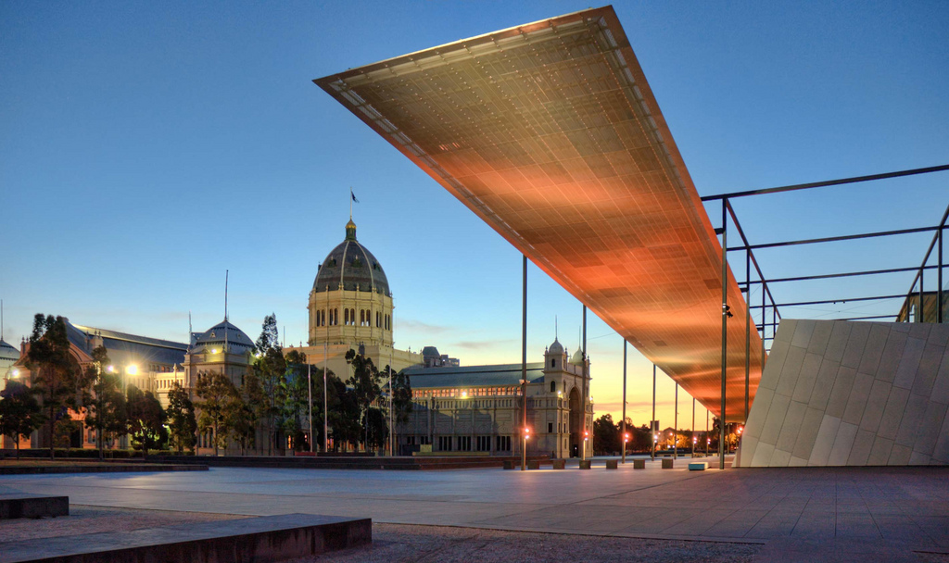
Personalisation
Seminar on
Unlocking the Secrets of the Past:
Text Mining for Historical Documents
Sven Steudter

Slide 2
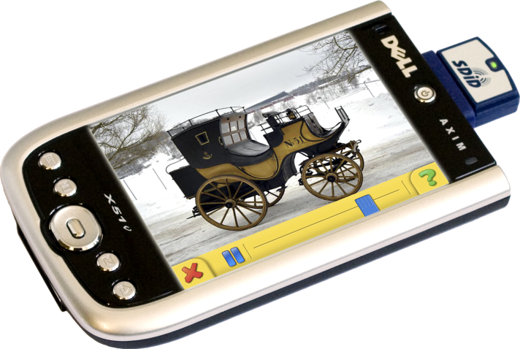
Domain
Museums offering vast amount of information
But: Visitors receptivity and time limited
Challenge: seclecting (subjectively) interesting exhibits
Idea of mobile, electronice handheld, like PDA assisting visitor by :
Delivering content based on observations of visit
Recommend exhibits
Non-intrusive ,adaptive user modelling technologies used

Slide 3
Prediction stimuli
Different stimuli:
Physical proximity of exhibits
Conceptual simularity (based on textual describtion of exhibit)
Relative sequence other visitors visited exhibits (popularity)
Evaluate relative impact of the different factors => seperate stimuli
Language based models simulate visitors thought process

Slide 4
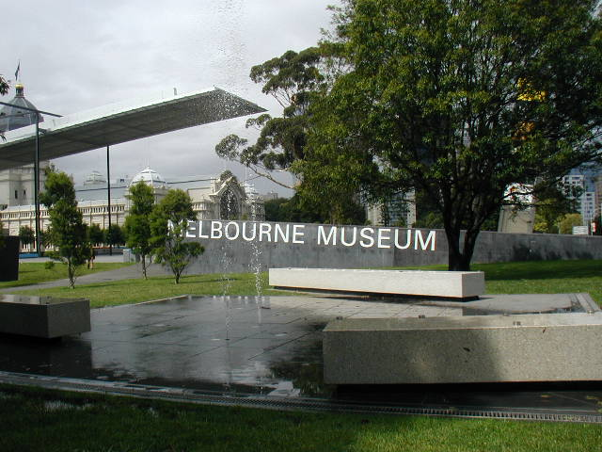
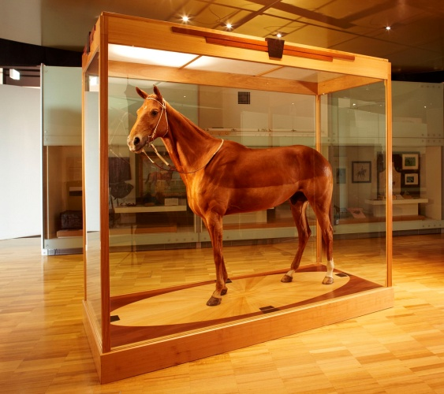
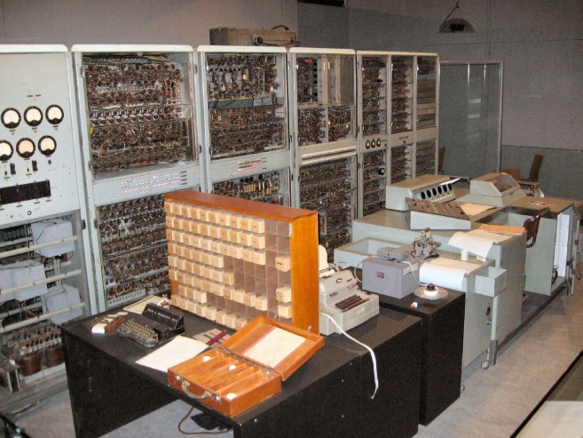
Experimental Setup
Melbourne Museum, Australia
Largest museum in Southern Hemisphere
Restricted to Australia Gallery collection, presents history of city of Melbourne:
Phar Lap
CSIRAC
Variation of exhibits : can not classified in a single category

Slide 5
Experimental Setup
Wide range of modality:
Information plaque
Audio-visual enhancement
Multiple displays interacting with visitor
Here: NOT differentiate between exhibit types or modalities
Australia Gallery Collection exists of 53 exhibits
Topology of floor: open plan design => no predetermined sequence by architecture

Slide 6
Resources
Floorplan of exhibition located in 2. floor
Physical distance of the exhibits
Melbourne Museum web-site provides corresponding web-page for every exhibit
Dataset of 60 visitor paths through the gallery, used for:
Training (machine learning)
Evaluation

Slide 7
Predictions based on Proximity and Popularity
Proximity-based predictions:
Exhibits ranked in order of physical distance
Prediction: closest not-yet-visited exhibit to visitors current location
In evaluation: baseline
Popularity-based predictions:
Visitor paths provided by Melbourne Museum
Convert paths into matrix of transitional probabilities
Zero probabilities removed with Laplacian smoothing
Markov Model

Slide 8
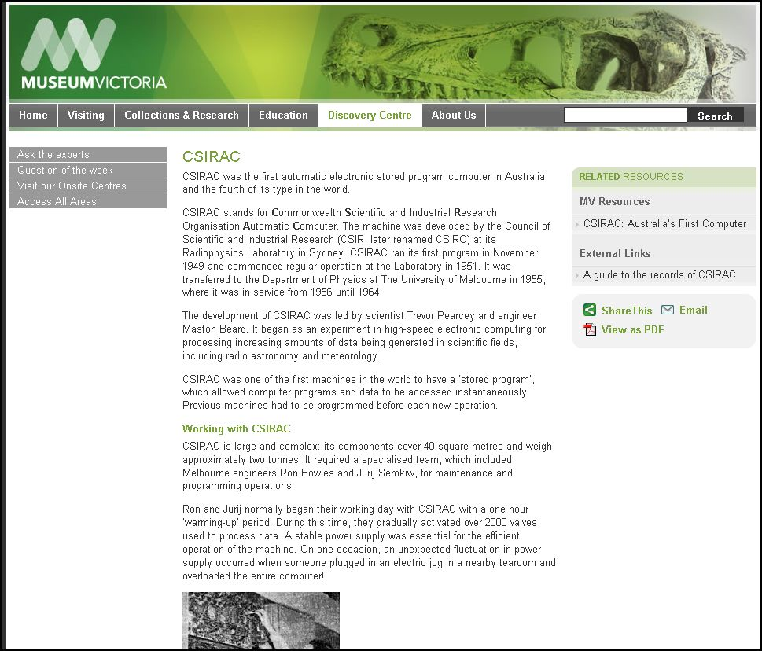
Text-based Prediction
Exhibits related to each other by information content
Every exhibits web-page consits of:
Body of text describing exhibit
Set of attribute keywords
Prediction of most similar exhibit:
Keywords as queries
Web-pages as document space
Simple term frequency-inverse document frequency, tf-idf
Score of each query over each document normalised

Slide 9
WSD
Why make visitors connections between exhibits ?
Multiple simularities between exhibits possible
Use of Word Sense Disambiguation:
Path of visitor as sentence of exhibits
Each exhibit in sentence has associated meaning
Detemine meaning of next exhibit
For each word in keyword set of each exhibit:
WordNet similarity is calculated against each other word in other exhibits

Slide 10
WordNet Similarity
Similarity methods used:
Lin (measures difference of information content of two terms as function of probability of occurence in a corpus)
Leacock-Chodorow (edge-counting: function of length of path linking the terms and position of the terms in the taxonomy)
Banerjee-Pedersen (Lesk algorithm)
Similarity as sum of WordNet similarities between each keyword
Visitors history may be important for prediction
Latest visited exhibits higher impact on visitor than first visited exhibits

Slide 11
Evaluation: Method
For each method two tests:
Predict next exhibit in visitors path
Restrict predictions, only if pred. over threshold
Evaluation data, aforementiened 60 visitor paths
60-fold cross-validation used, for Popularity:
59 visitor paths as training data
1 remaining path for evaluation used
Repeat this for all 60 paths
Combine the results in single estimation (e.g average)

Slide 12
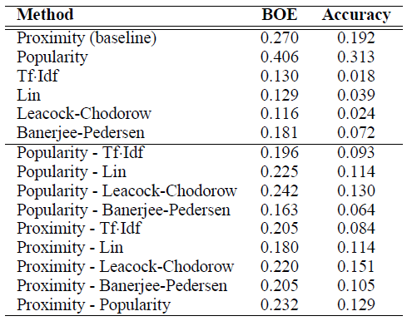
Evaluation
Accuracy: Percentage of times, occured event was predicted with highest Probability
BOE: Bag of Exhibits: Percentage of exhibits visited by visitor, not necessary in order of recommendation
BOE is, in this case, identical to precision
Single exhibit history

Slide 13
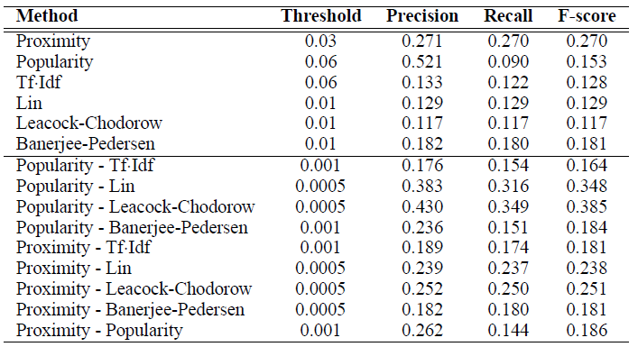
Evaluation
Single exhibit history
without threshold with threshold

Slide 14
Evaluation
Visitors history enhanced
Single exhibit history

Slide 15
Conclusion
Best performing method: Popularity-based prediction
History enhanced models low performer, possible reason:
Visitors had no preconceived task in mind
Moving from one impressive exhibit to next
History here not relevant, current location more important
Keep in mind:
Small data set
Melbourne Gallery (history of the city) perhabs no good choice

Slide 16
BACKUP

Slide 17
tf-idf
Term frequency – inverse document frequency
Term count=number of times a given term appears in document
Number n of term t_i in doument d_j
In larger documents term occurs more likely, therefor normalise
Inverse document frequency, idf, measures general importance of term
Total number of documents,
Divided by nr of docs containing term

Slide 18
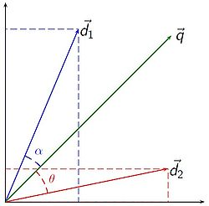
tf-idf: Similarity
Vector space model used
Documents and queries represented as vectors
Each dimension corresponds to a term
Tf-idf used for weighting
Compare angle between query an doc

Slide 19
WordNet similarities
Lin:
method to compute the semantic relatedness of word senses using the information content of the concepts in WordNet and the 'Similarity Theorem'
Leacock-Chodorow:
counts up the number of edges between the senses in the 'is-a' hierarchy of WordNet
value is then scaled by the maximum depth of the WordNet 'is-a' hierarchy
Banerjee-Pedersen, Lesk:
choosing pairs of ambiguous words within a neighbourhood
checks their definitions in a dictionary
choose the senses as to maximise the number of common terms in the definitions of the chosen words.

Slide 20
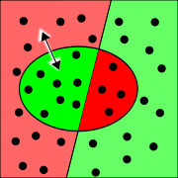
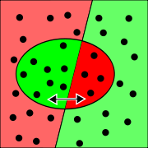
Precision, Recall
Recall: Percentage of relevant documents with respect to the relative number of documents retrieved.
Precision: Percentage of relevant documents retrieved with respect to total number of relevant documents in dataspace.

Slide 21
F-Score
F-Score combines Precision and Recall
Harmonic mean of precision and recall

