Slide 1


Speech Science
WiSe 2024
Spoken Language
Oct 24, 2024
Bernd Möbius & Valentin Kany
Language Science and Technology
Saarland University

Slide 2
Vowels and consonants: written
__e _ea__e_ _o_e_a__ _o_ _o_o__o_:
_a__e_ __ou_y i_ __e _o__i__ _i__
a _e_ _u__y __e___ i_ __e a__e__oo_.

Slide 3
Vowels and consonants: written
Th_ w__th_r f_r_c_st f_r t_m_rr_w: r_th_r cl__d_ _n th_ m_rn_ng w_th _ f_w s_nn_ sp_lls _n th_ _ft_rn__n.

Slide 4
Vowels and consonants: written/spoken
The weather forecast for tomorrow: rather cloudy in the morning with a few sunny spells in the afternoon.
Consonants apparently are more informative than vowels for comprehending a written utterance (in languages such as DE, EN, or similar).
Does this pertain to spoken language, too?

Slide 5

Vowels and consonants: spoken
cf. spoken language:
  consonants only
  vowels only
  original

Slide 6
Vowels and consonants: spoken
Vowels are apparently more informative than consonants, but we also need to have access to the temporal structure (and rhythm) of utterances.
Speech rhythm: a combination of syllable structure and the weight (duration, prominence) of vowels.
Demo:
  vowels only, without silence
  vowels only, with silence
  vowels only, monotonous
  original

Slide 7
Continuous speech
We perceive continuous speech by chunks
Syllables are prominent vowels, surrounded by (less prominent) consonants.
Sentences/utterances consist of phrases that consist of words that consist of syllables that consist of vowels and the consonants surrounding them.
Prosody (intonation, duration, intensity) contributes to making important chunks more prominent than others.

Slide 8

Continuous utterances
"The president will be elected for a period of four years."
Spoken language:
  natural, continuous
  chain of isolated words
  natural, pauses between words
  chain of isolated words, no pauses
  isolated vs. continuous function words
Production effort ↔ Informativity of words (longer+louder+unreduced = more effort and precision)

Slide 9
Continuous speech
Normal, everyday communication: spoken language is not comprised of speech sounds produced in isolation but of continuous utterances.
We do not identify the speech sounds that reach our ears as individual speech sounds.
  But we can demonstrate individual speech sounds.
The syllable (C*VC*) is arguably the minimal unit of speech perception...
  and the planning unit in speech production
  and the reference frame in speech acquisition.

Slide 10
Phonetics
Scientific study of spoken language
Basic conditions and constraints of human speech production and perception
How is spoken language produced and perceived?
  anatomy and physiology
  speech production, phonation, articulation
  speech acoustics, speech signals
  speech perception
Articulatory phonetics, Acoustic phonetics, Auditory-perceptual phonetics, Neurophonetics

Slide 11
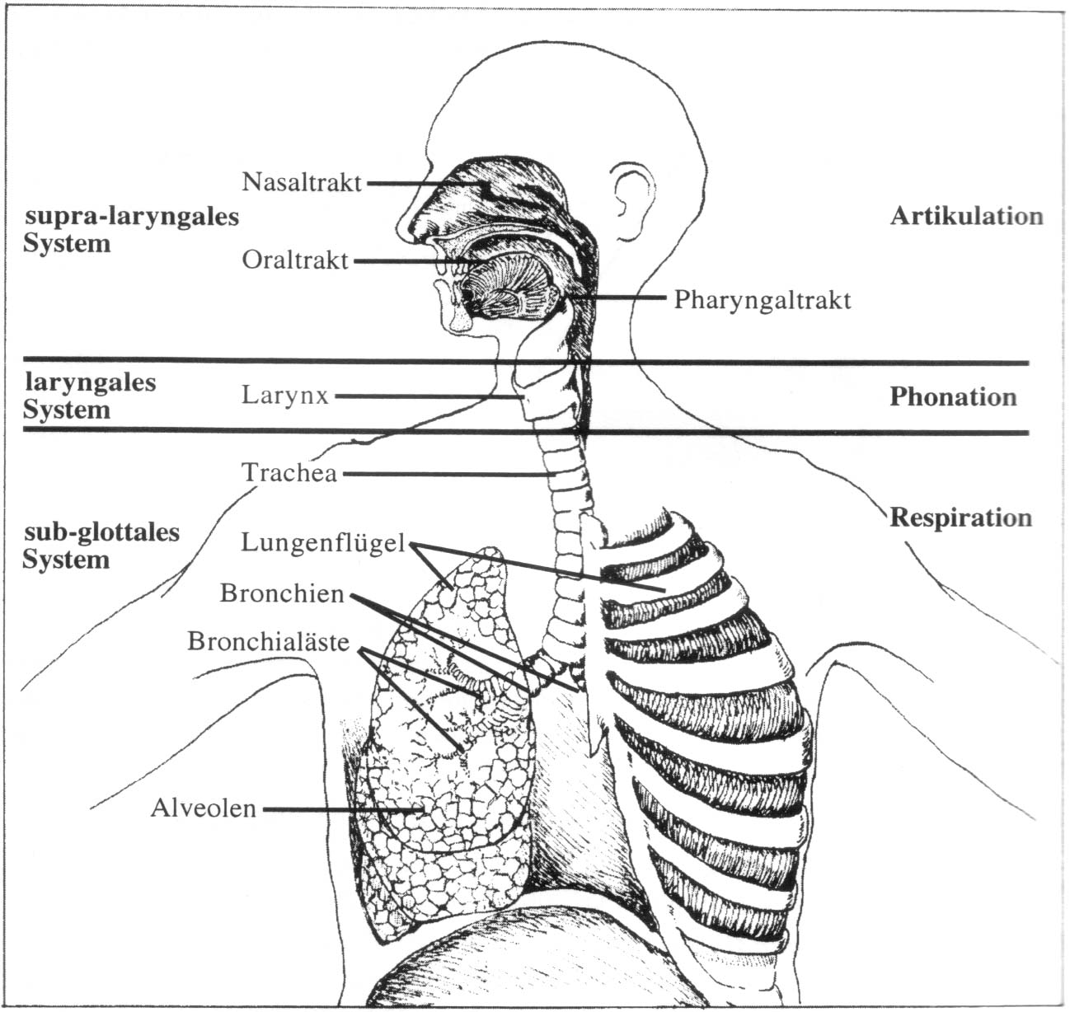
Speech production organs
[Reetz,1999]

Slide 12
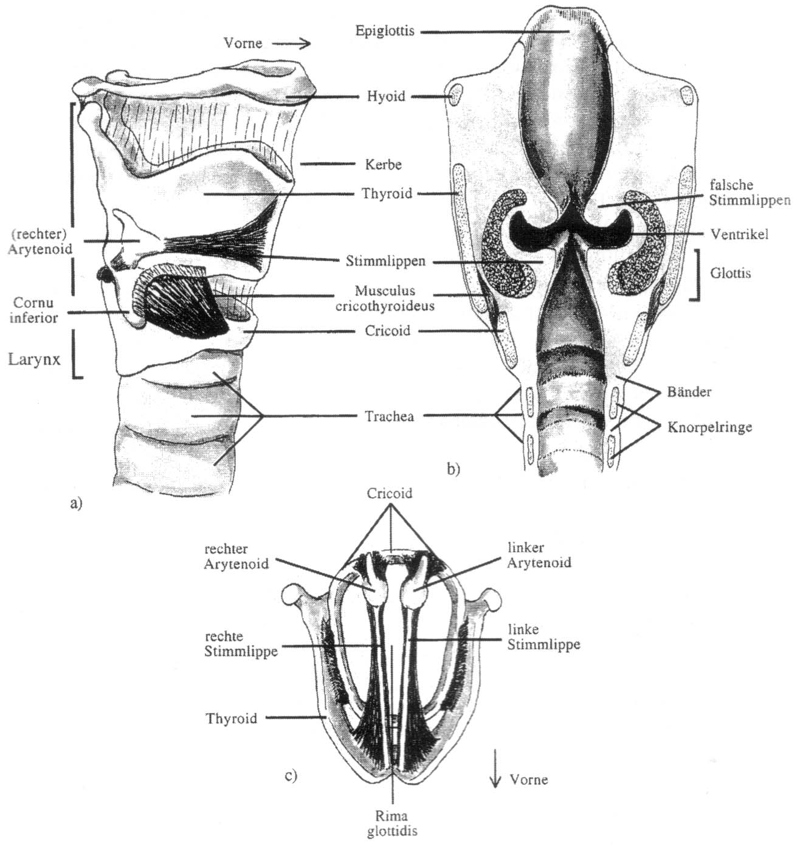
Speech production organs
[Reetz,1999]

Slide 13
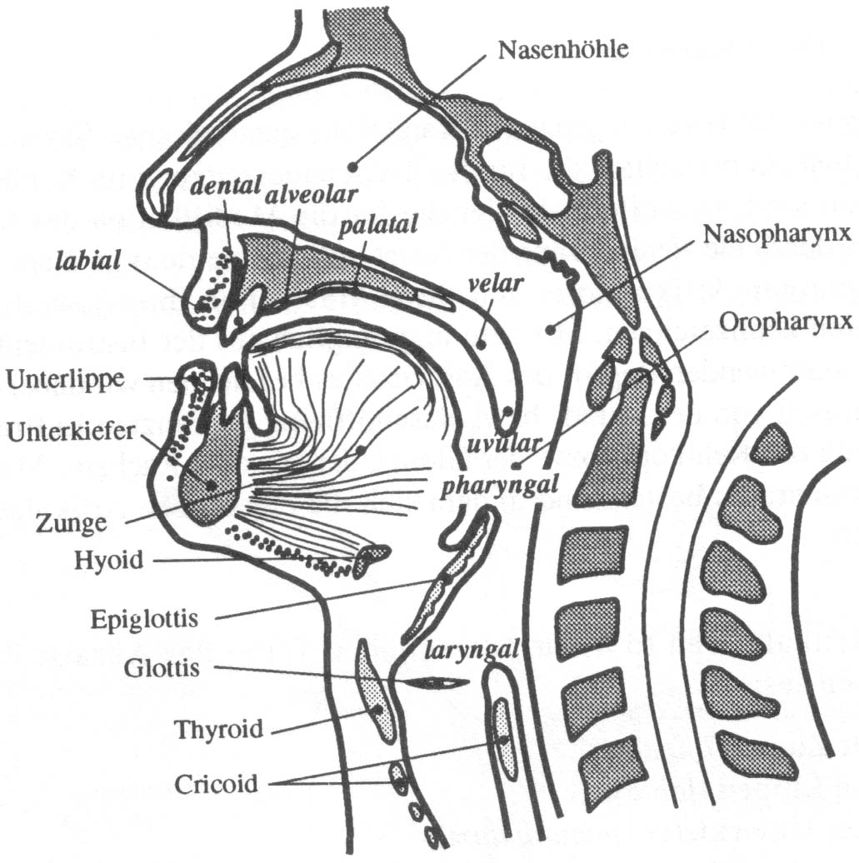
Speech production organs
[Reetz,1999]

Slide 14
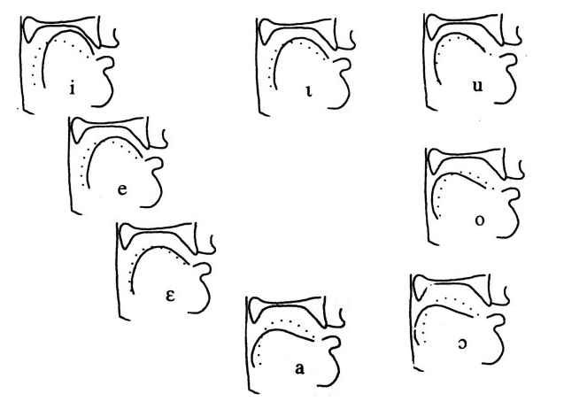
Acoustic Phonetics
Vocal tract geometry (tongue position)
of some English vowels
Sound pressure waves
of the first three formants

Slide 15
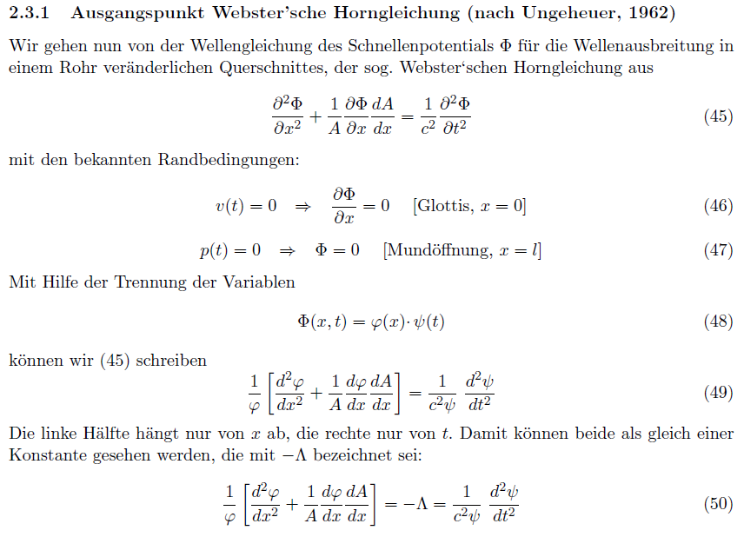
Acoustic Phonetics
NOT REQUIRED

Slide 16
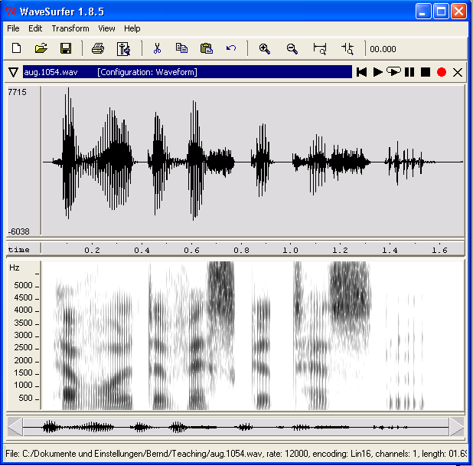
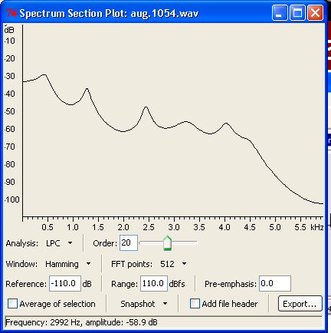
Acoustic speech signal

Slide 17
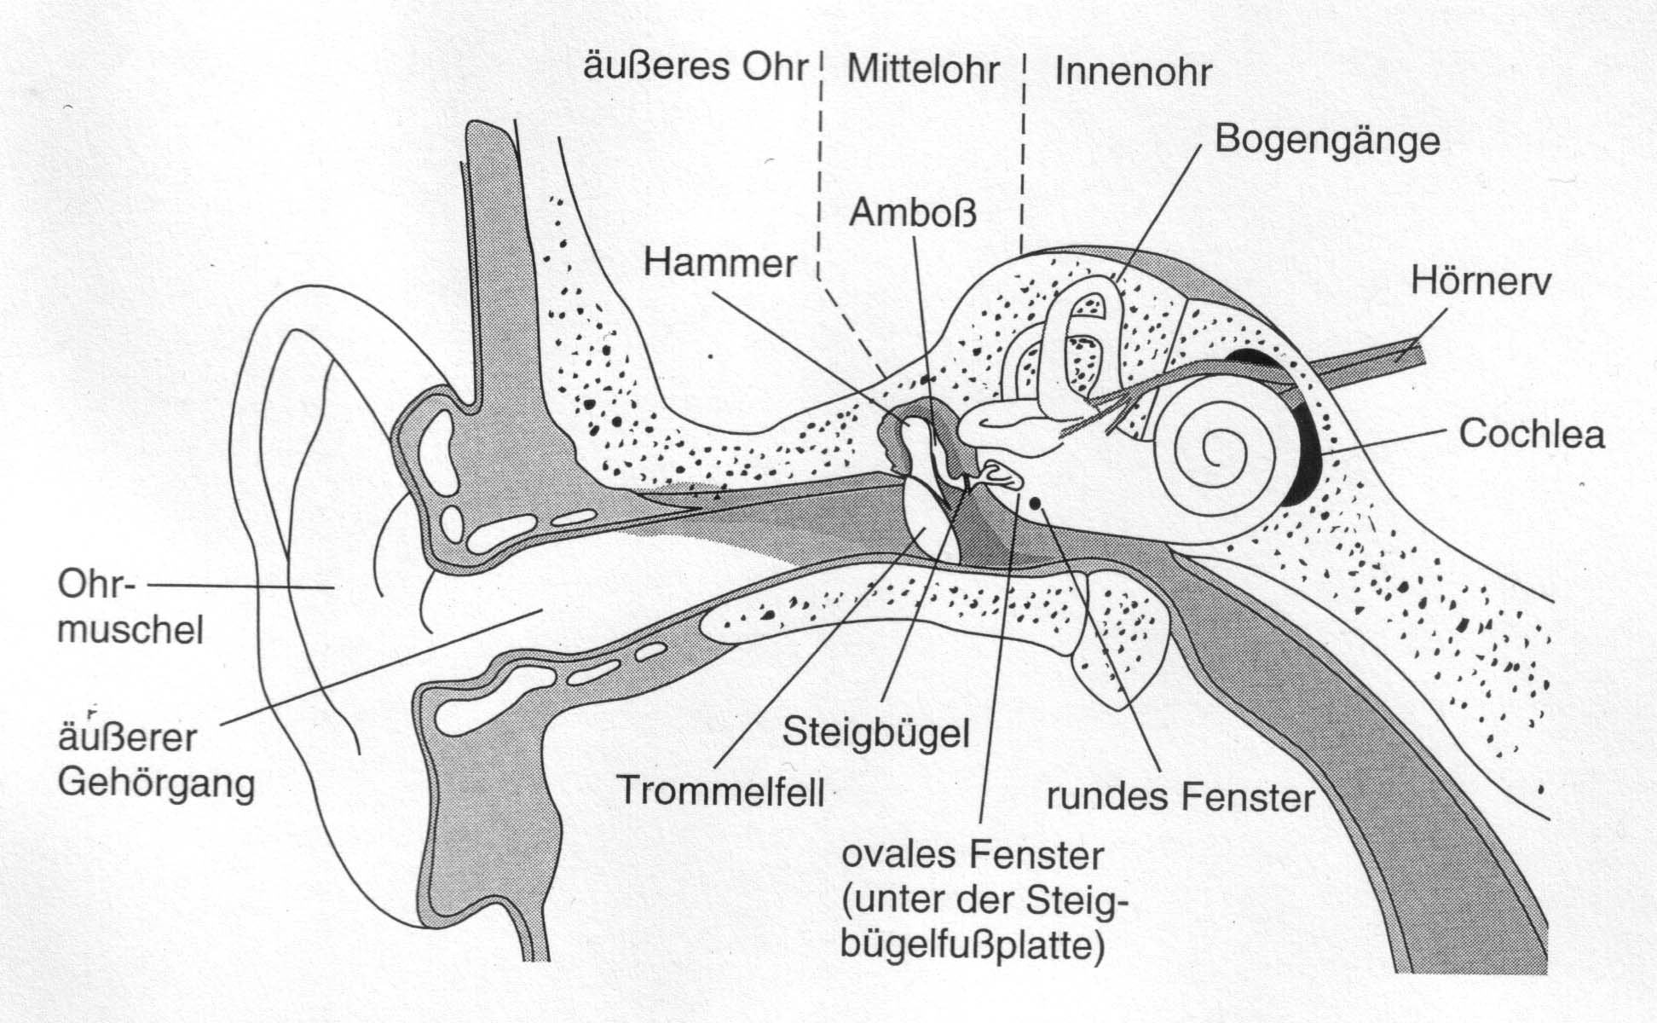
Outer ear, middle ear, inner ear
semicircular canals
incus
cochlear nerve
malleus
pinna/auricle
stapes
auditory canal
eardrum
[Goldstein, 1997, p.322]

Slide 18
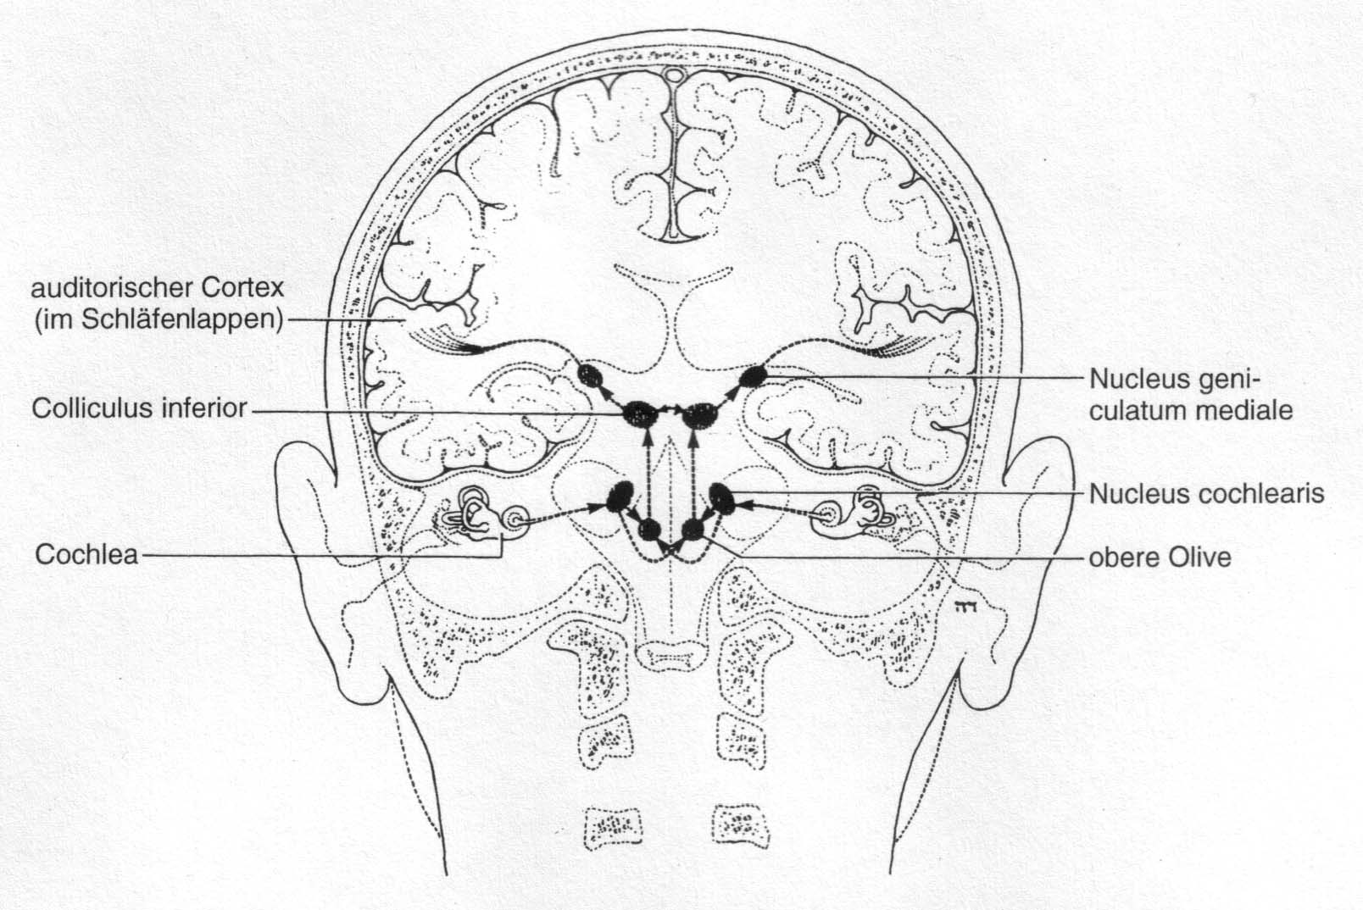
Connections in auditory system
auditory cortex (in temporal lobe)
superior olivary complex
[Goldstein, 1997, p.327]

Slide 19
Phoneticians
What do phoneticians do, anyway?
  observe how people say things
  describe language on the level of pronunciation
  measure properties of spoken language, pronunciation events
  model pronunciation behavior and speech processing
  explain the communicative contribution of pronunciation patterns
  construct theories, hypotheses and models of phonetic events – and test them experimentally

Slide 20
Phoneticians and speech corpora
Perform technical recordings of spoken language.
  Choice: language/variety, speaker, type of signal.
  This choice determines the types of analysis.
    Language: speech sounds, precise or informal speech; monologue, discourse, dialogue
    Speaker: (e.g., dialectal, regional or "standard" speaker)
    Signal: acoustic=microphone, electromyographical, physiological, neurological (EGG, EPG, MEG, fMRI)
  The type of signal determines the experimental design: only the acoustic signal, and perhaps not even that, makes natural recordings possible.

Slide 21
Some application areas of phonetics
An understanding of the mechanisms of spoken language, i.e., of the processes of speech production and perception, is indispensable for
  learning and teaching foreign languages
  pronunciation dictionaries
  speech pathology and language and speech disorders, clinical phonetics
  forensic phonetics
  speech technology (automatic speech and speaker recognition, speech synthesis, speech-to-speech translation, dialog systems)

Slide 22
Phonetic transcription - IPA
Phonetic transcription (DE, standard text)
  "Einst stritten sich Nordwind und Sonne…"
  [ˈʔaɪns ʃtʁɪtn zɪç ˈnɔɐtvɪnt ʊnt ˈzɔnə]
IPA = International Phonetic Association
  established 1886 in Paris
  Aim: universal classification system for all speech sounds
  Aim: universal phonetic alphabet, to describe all speech sounds of all languages
  most recent major revision: Kiel 1989 (alphabet: 2005)
  IPA home page
  More on the IPA system in Omnia’s exercise session on Nov 6!

Slide 23
Suggested readings
John Clark, Colin Yallop, Janet Fletcher (³2007): An Introduction to Phonetics and Phonology. Blackwell.
Victoria Fromkin, Robert Rodman, Nina Hyams (⁹2011): An Introduction to Language. Wadsworth. Chapter 4. [covers basic articulatory phonetics only]
IPA (ed.) (1999): Handbook of the International Phonetic Association. Cambridge University Press. IPA Handbook

Slide 24

Thanks!

