Slide 1


M.Sc. LST Speech Science
Psychoacoustics
Jan 16, 2025
Bernd Möbius & Valentin Kany
Language Science and Technology
Saarland University

Slide 2
Overview
Anatomy and physiology of the auditory system
Speech perception
  auditory perception
  psychoacoustics
  auditory-perceptual phonetics

Slide 3
Perception of loudness
Loudness: perceptual correlate of acoustic sound intensity
  differences in loudness are perceived on a logarithmic scale (e.g., decibel/[dB]) by the auditory system
    0 dB is equivalent to sound pressure level of a reference signal (at perceptual threshold at 1 kHz)
    doubling of loudness is equivalent to increase by 10 dB
  perceptual threshold ("just noticeable difference", JND) for pure tones: approx. 1 dB

Slide 4
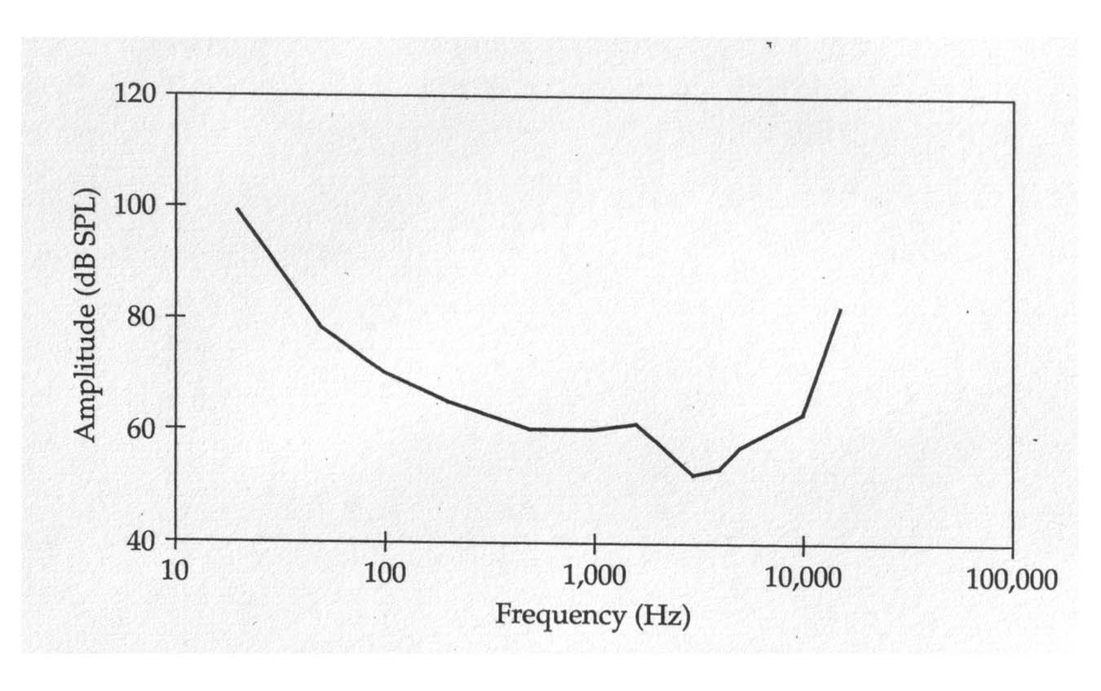
Equal-loudness contour
[Johnson, 1997, p.54]

Slide 5
Perception of pitch
Pitch: perceptual correlate of acoustic frequency
  auditory frequency range: approx. 20 – 20,000 Hz
  frequency selectivity: resolution of frequency components of a complex (e.g., speech) signal:
    optimal below 500 Hz
    logarithmically decreasing above 500 Hz
  JND for pure tones:
    below 1000 Hz: approx. 0.5%
    at higher frequencies: approx. 5%
  auditory frequency scale (e.g., Bark [Z]): auditory system is more sensitive to frequency differences in low frequencies than in high frequencies

Slide 6
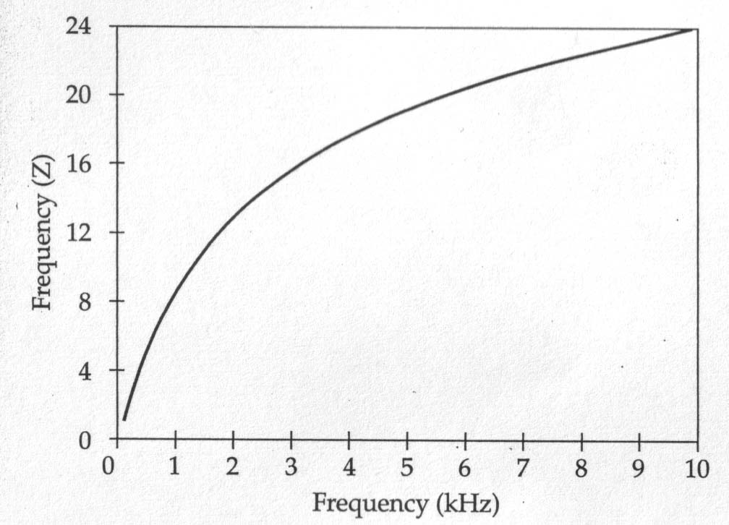
Auditory frequency scale
[Johnson, 1997, p.55]

Slide 7
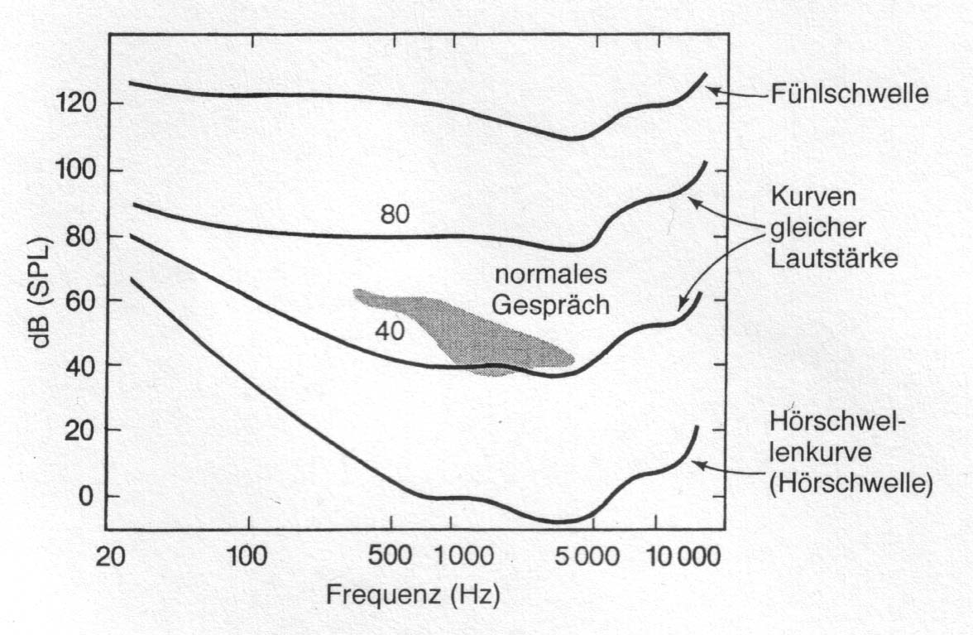
Auditory plane and auditory thresholds
threshold of feeling
conversation
equal-loudness contours
threshold of audibility
[Goldstein, 1997, p.354]

Slide 8
Loudness differences
Sound source | Sound pressure [μPa] | SPL [dB]
audibility threshold | 20 | 0
soft whisper | 200 | 20
quiet office | 2 000 | 40
normal conversation | 20 000 | 60
city bus | 200 000 | 80
subway train | 2 000 000 | 100
heavy thunder | 20 000 000 | 120
pain | 200 000 000 | 140
Sound pressure (Schalldruck), measured in micro-Pascal
  objective measurement of sound pressure differences
Sound pressure level (Schalldruckpegel), measured in dB
  subjective sensation of loudness differences

Slide 9
Perception of duration
Duration: perceptual correlate of physical property "time"
  temporal processing and resolution:
    over which temporal interval can the auditory system integrate information?
    detection of gaps in otherwise continuous signals
  JND:
    duration differences: >20 ms at 500 - 1500 Hz
    detection of gaps of 6 – 8 ms
    fast spectral changes within <30 ms are not analyzed, but perceptually integrated

Slide 10
Speech perception
Psychoacoustic properties of auditory system are compliant with requirements of speech perception; e.g.:
  very good frequency resolution in low-frequency range → fundamental frequency analysis (voicing, intonation)
  medium frequency resolution in mid-frequency range → formant analysis and tracking (vowels, sonorants)
  poor frequency resolution in high-frequency range → rough spectral patterns (fricatives)
  temporal integration supports capturing coarticulation, and good temporal resolution supports recognition of stop releases (but stop bursts are too short for spectral analysis)
Co-evolution, or adaptation of production system to auditory system?

Slide 11
Speech intelligibility
Intelligibility of speech depends on many factors, including:
  frequency band (e.g., telephone 350 – 3500 Hz)
  loudness
  duration of segments of speech and gaps
  semantic content (top-down processing) and semantic predictability
  robustness of speech signals
    gaps <200 ms hardly disturb intelligibility
    gaps >500 ms destroy intelligibility
  disturbing noise (signal-to-noise ratio, SNR)

Slide 12

Thanks!

