Slide 1
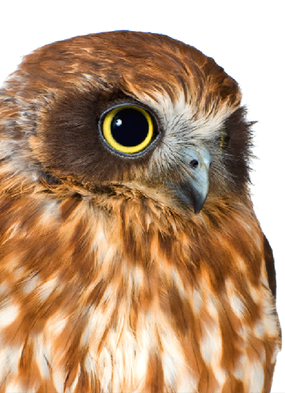
Speech Science
WiSe 2024
Respiration, Phonation, Voice Quality
Nov 7, 2024
Bernd Möbius & Valentin Kany
Language Science and Technology
Saarland University

Slide 2
Speech production
Functional model of speech production
Respiration, respiratory system (breathing)
Phonation, voicing produced by vocal fold vibration
Articulation, speech sound formation by means of active and passive articulators

Slide 3
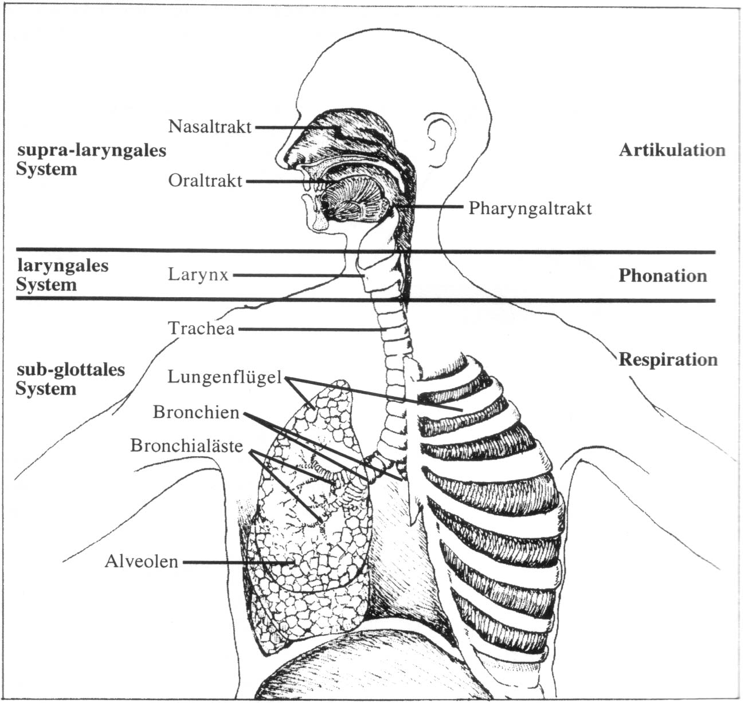
Speech production organs [Reetz 1999, p. 101]

Slide 4
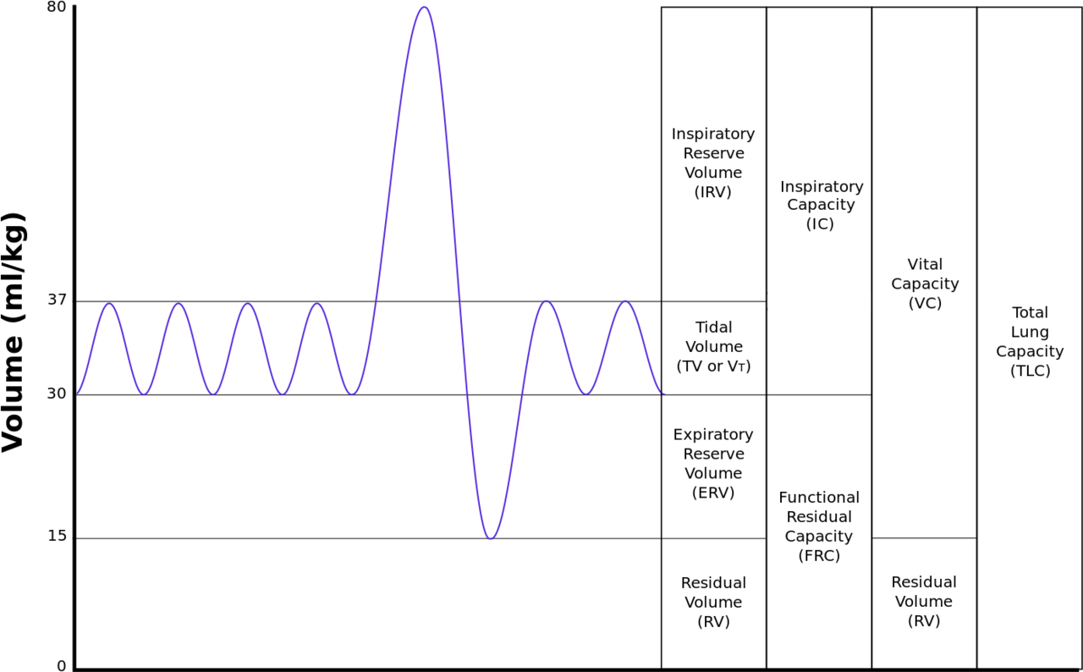
Respiration: no air, no fun(etics)
By Kapwatt at English Wikipedia, CC BY-SA 3.0, https://commons.wikimedia.org/w/index.php?curid=74891988

Slide 5
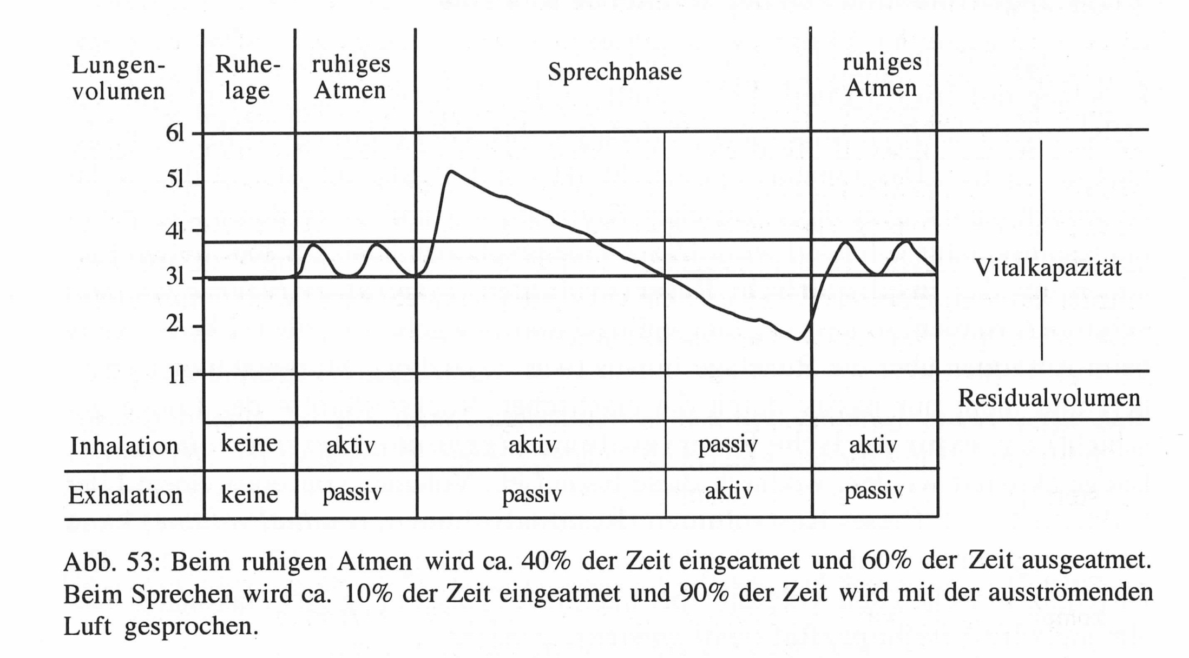
Respiration: no air, no fun(etics) [Reetz 1999, p. 108]
quiet breathing
speaking
quiet breathing
quiet breathing: 40% inhale, 60% exhale
speaking: 10% inhale, 90% exhale

Slide 6
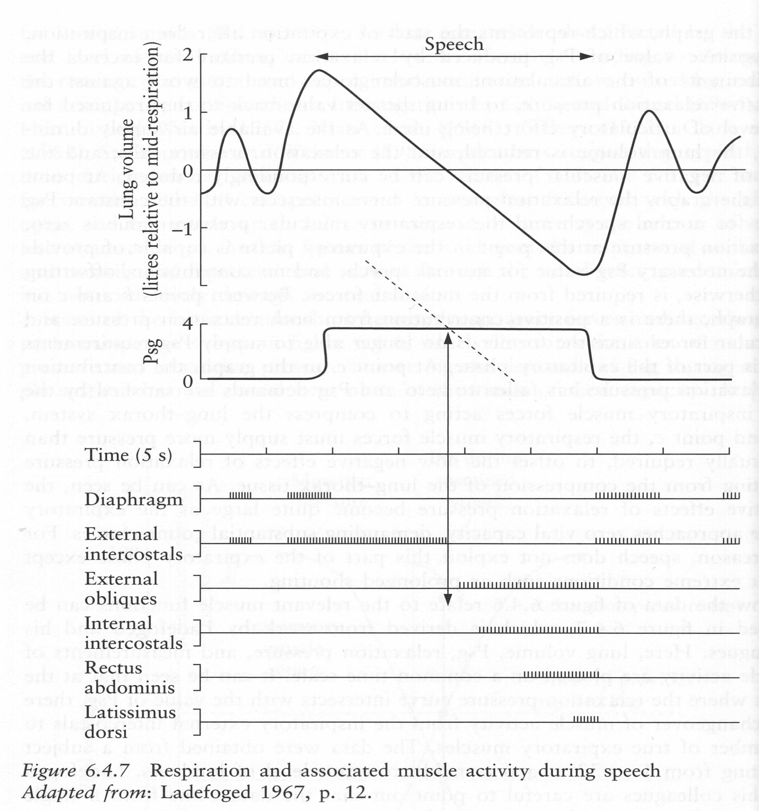
Respiration: no air, no fun(etics) [Clark et al. 2007, p. 176]

Slide 7
Airstream mechanisms
Airstream: origin and direction
pulmonic airstream, by means of lung activity
egressive: most speech sounds
ingressive: paralinguistic functions only
glottal airstream, by means of laryngeal activity
egressive: ejectives; closed glottis, raised larynx
ingressive: implosives; closed glottis, lowered larynx
velic airstream, by means of velic closure
egressive: pops; attested only with paralinguistic function
ingressive: clicks; linguistic and paralinguistic functions
(what is: egressive-esophageal?)

Slide 8
Phonation
Phonation
production of quasi-periodic excitation signal by means of (regular) vocal fold vibration
based on egressive pulmonic airstream
Voiced vs. voiceless speech sounds
speech sounds produced with vs. without vocal fold vibration
Fundamental frequency (F₀)
rate or frequency of vocal fold vibration
measured in Hz (number of vibrations per second)
perceived as pitch

Slide 9
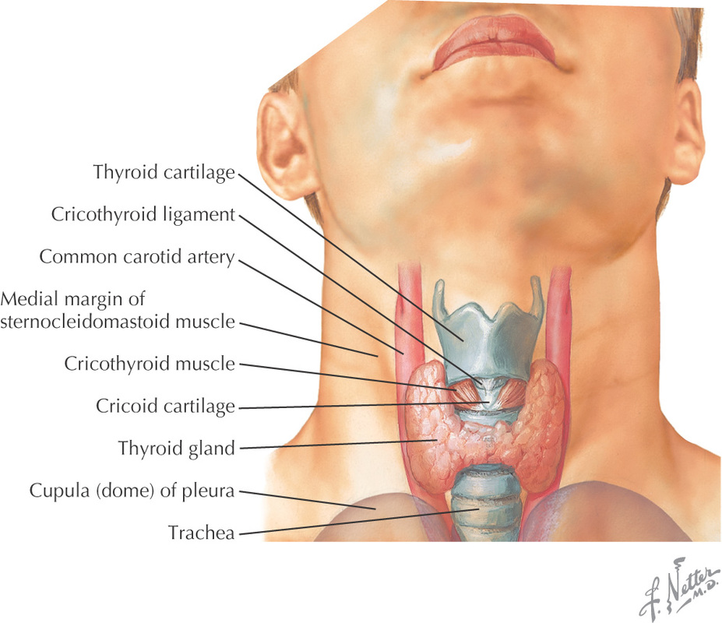
Larynx (1)

Slide 10
Larynx (2)

Slide 11
Larynx: structure
Larynx comprises 5 cartilages
flexible position w.r.t. each other
held together by membranous tissue
Cricoid (Ringknorpel)
lowest component of larynx
cartilaginous part of trachea (windpipe)
Thyroid (Schildknorpel), pair of cartilages
pair of cartilages connecting at the front ("Adam's apple")
protects vocal folds from external physical impact from front
controls vocal fold tension by tilting w.r.t. cricoid
Arytenoid (Stellknorpel), pair of cartilages
move w.r.t. cricoid by sliding and rotation
controls position (adducted vs. abducted) of vocal folds

Slide 12
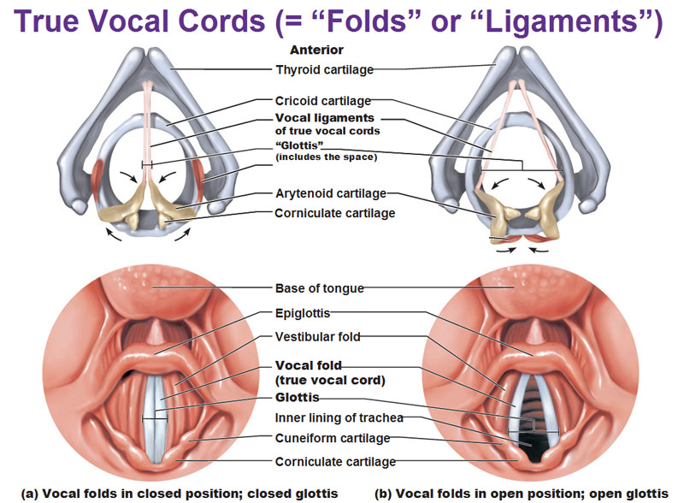
Variable glottis area

Slide 13
Vocal folds
Vocal folds
pair of ligaments, attached at inferior edge of thyroid angle and at anterior part of arytenoid cartilages
Glottis
opening between vocal folds
length of glottis edges: males 17-22 mm, females 11-16 mm
Intrinsic larynx muscles
between laryngeal cartilages
control abduction (opening), adduction (closing), and tension of vocal folds
Extrinsic larynx muscles
control overall (mainly vertical) movement of larynx

Slide 14
Video demos
Structure of the larynx
https://www.youtube.com/watch?v=b89RSYCaUBo
Phonation
https://www.youtube.com/watch?v=Aoa_N1vQS4M
Video stroboscopy of vocal fold vibration
https://www.youtube.com/watch?v=mJedwz_r2Pc

Slide 15
Aerodynamic-myoelastic theory
Aerodynamic-myoelastic theory of phonation [van den Berg 1958]
glottis closed, expiration airstream builds up subglottal pressure
vocal folds opening, speeded airflow through glottis
pressure drop (Bernoulli effect)
pressure reduction sucks vocal folds together
process assisted by elasticity of vocal folds
production of voicing by (quasi-)periodic train of air pulses

Slide 16
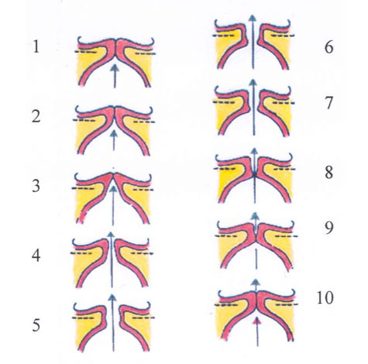
Glottal vibration cycle
closed phase: 1–3, 8–10
open phase: 4–7

Slide 17
Phonation – acoustics - perception
Phonation → acoustics
F0 = lowest frequency component of a complex periodic signal
speech signal results from shaping, or filtering, the excitation signal by varying the geometry of the vocal tract
Phonation → perception
rate of vocal fold vibration → perceived pitch
subglottal pressure → perceived loudness
phonation type → perceived voice quality

Slide 18
Phonation types and voice qualities
Modal voice (modal): normal speaking voice without noisy components, regular vocal fold vibrations along entire length of folds
Breathy voice (behaucht): voice with soft noise components, moderate vocal fold tension, glottis never completely closed
Creaky voice (knarrend): low voice without noise components, small front opening of vocal folds, irregular vocal fold vibration
Rough voice (rau): high vocal fold tension
Falsetto voice (falsetto): high adductive vocal fold tension, narrowing of vocal folds, reduced vibrating mass, high frequency
Whisper (flüsternd): strong frication without phonation, moderate vocal fold tension, open "whisper triangle" between arytenoids
Voicelessness (stimmlos): no glottal voice source, glottis wide open along entire length of vocal folds

Slide 19
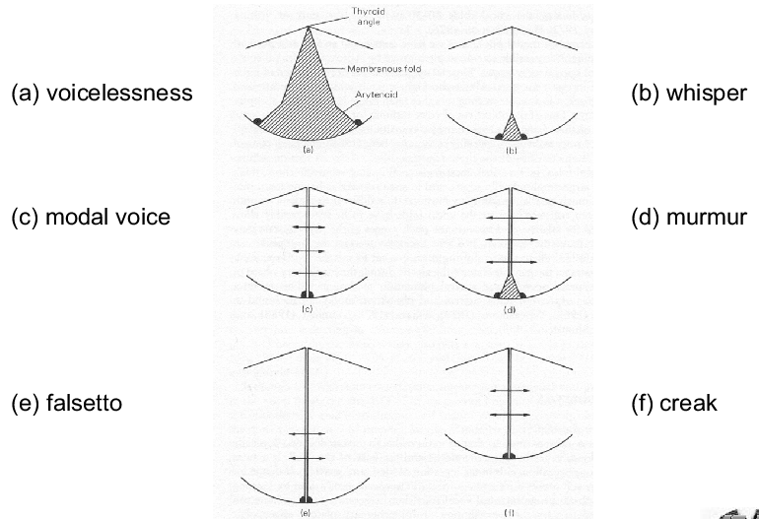
Phonation types and voice qualities

Slide 20
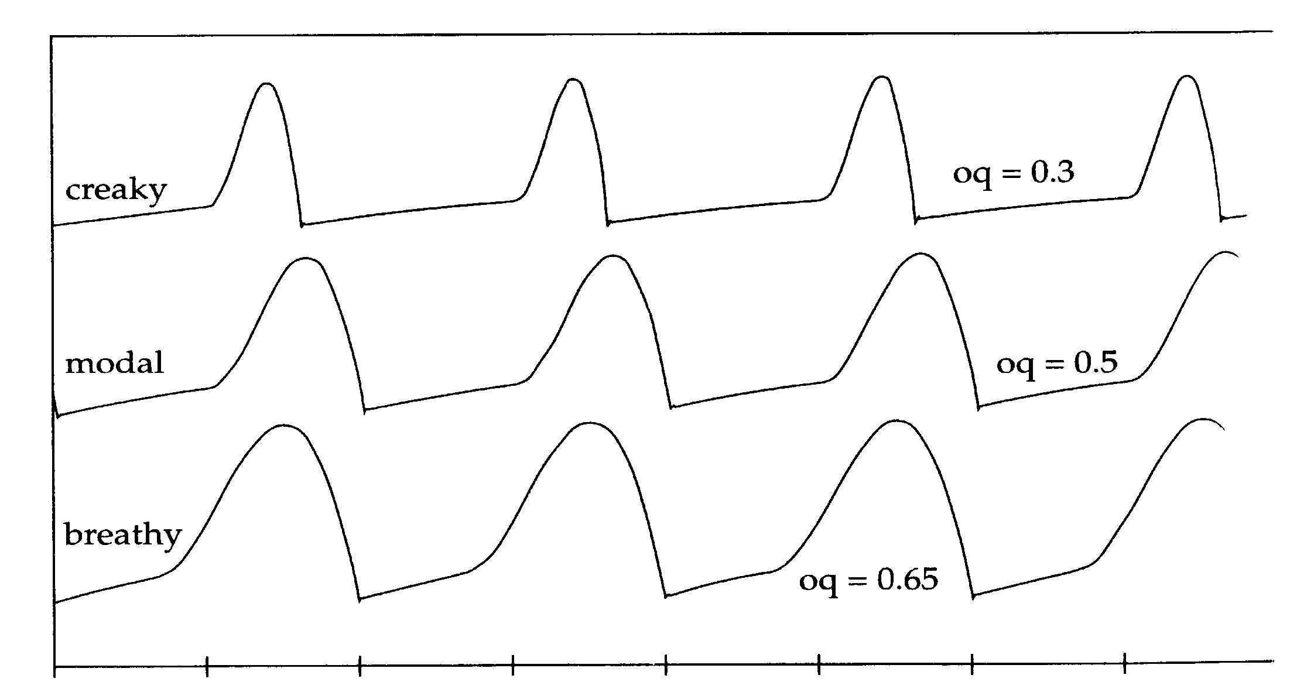
Glottal excitation signal
Lx signal, recorded by electroglottography (EGG, laryngograph)

Slide 21
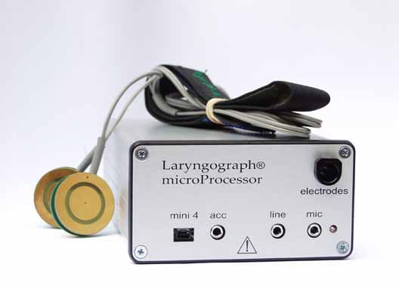
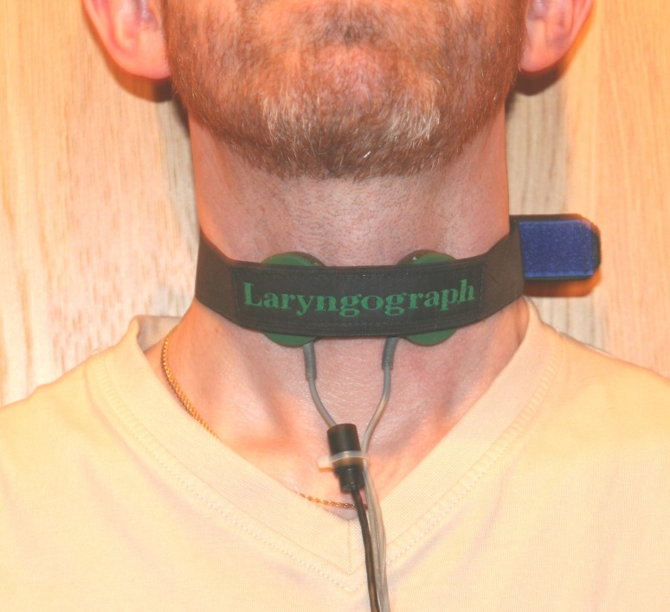
Laryngograph (Electroglottograph)

Slide 22
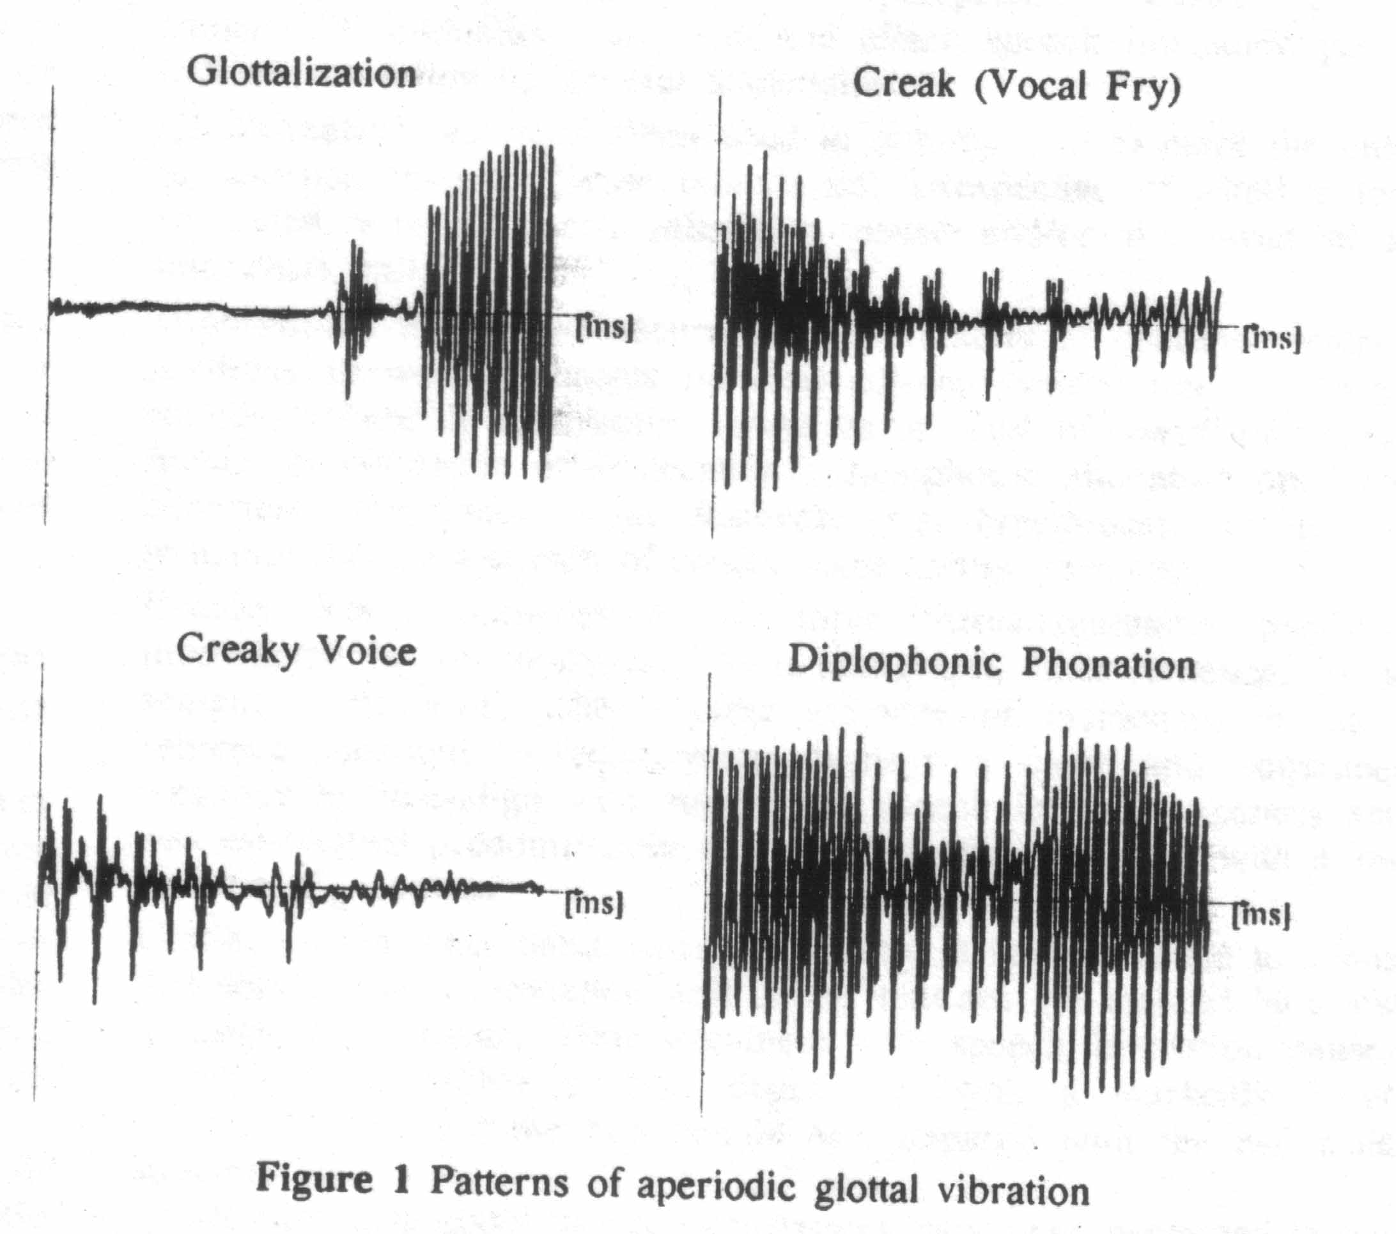
Laryngealization

Slide 23
References
John Clark, Colin Yallop, Janet Fletcher (2007): An Introduction to Phonetics and Phonology. Blackwell.
Peter Ladefoged (1967): Three Areas of Experimental Phonetics. Oxford University Press.
Henning Reetz (1999): Artikulatorische und akustische Phonetik. Wissenschaftlicher Verlag, Trier.
Janwillem van den Berg (1958): "Myoelastic-aerodynamic theory of voice production". Journal of Speech and Hearing Research 1, 227-244.
Hartwig Eckert, John Laver (1994): Menschen und ihre Stimmen. Beltz PVU. [demos on accompanying Audio CD]
John Laver (2009): The Phonetic Description of Voice Qualities. Cambridge University Press.

Slide 24
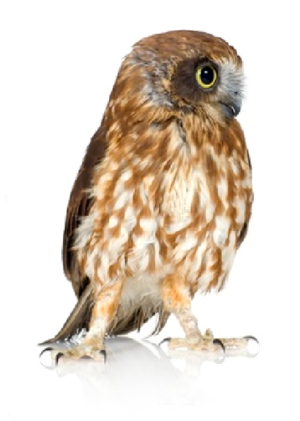
Thanks!

