Slide 1
M.Sc. LST Speech Science
Theories and Models of Speech Perception
Jan 30, 2025
Bernd Möbius & Valentin Kany
Language Science and Technology
Saarland University

Slide 2
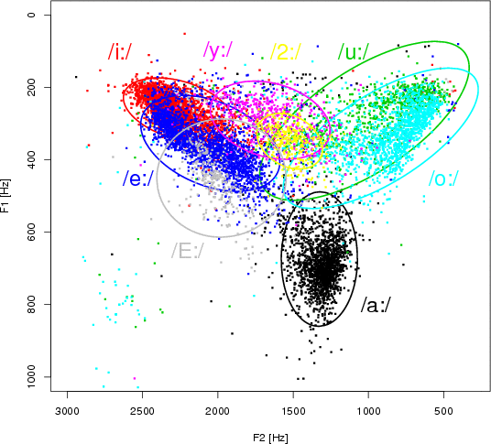
Variability

Slide 3
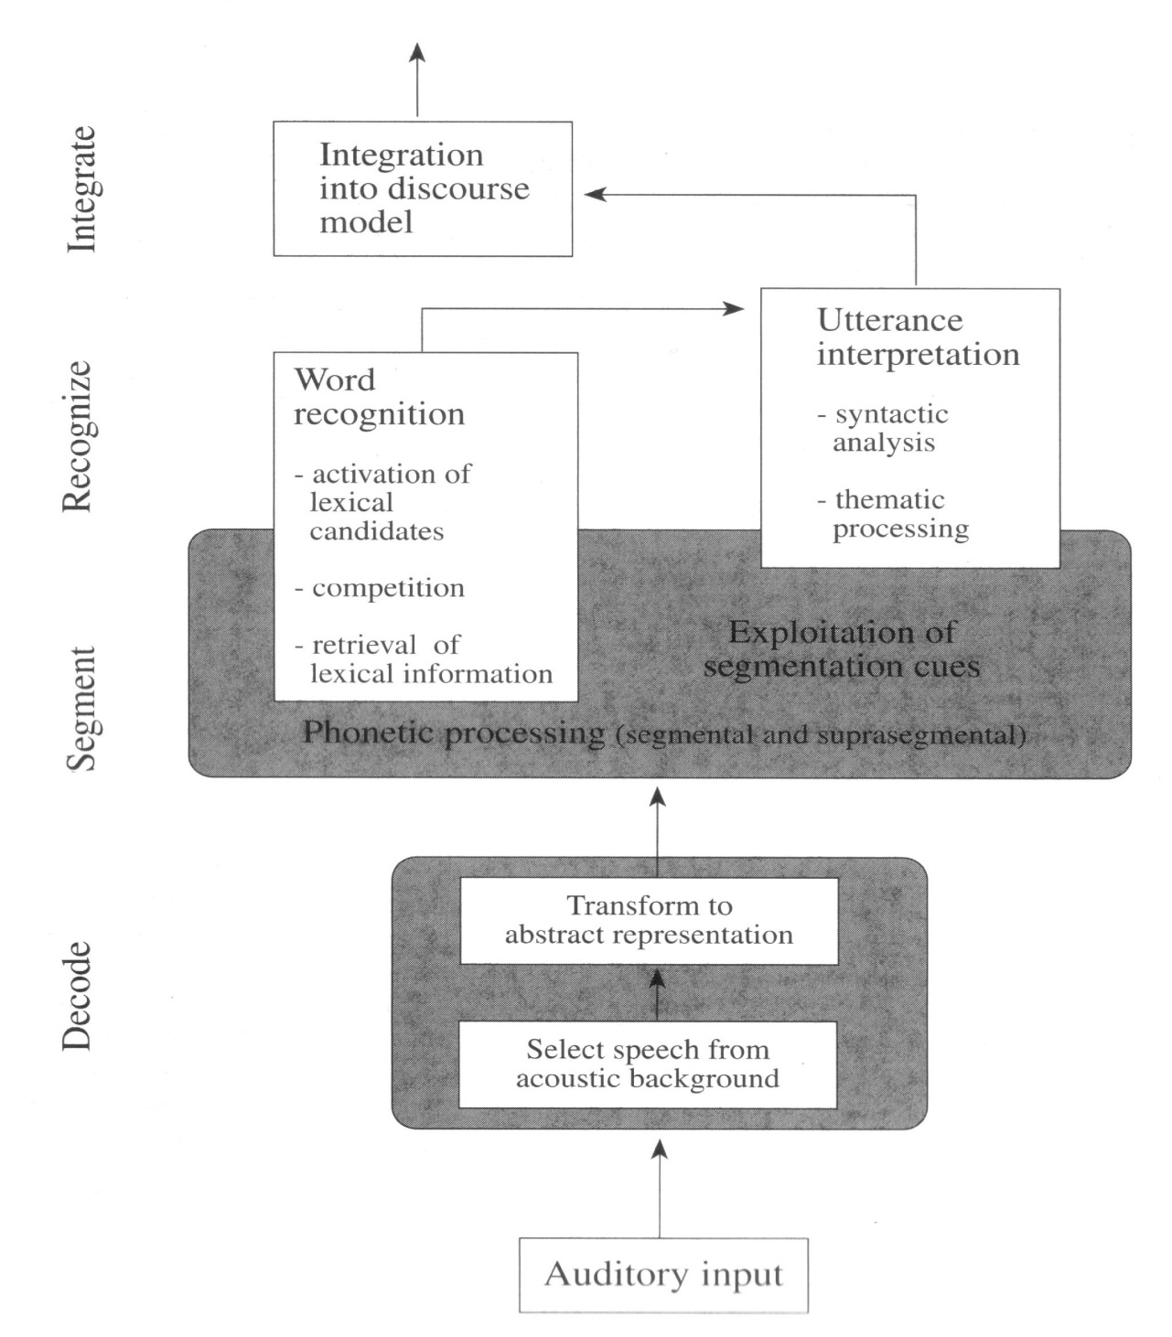
A blueprint of the listener
[Cutler & Clifton 1999, p124]

Slide 4
Components of the blueprint
Speech decoding: distinguish speech from other auditory input
Segmentation of continuous signal in constituent parts
incremental, partially parallel processing
higher-level (e.g. word) processing starts before segmentation is complete
Lexical activation: recognition of spoken words
activation of multiple word candidates → competition
relevant information: segm., suprasegm.; full/partial match?
Morphology and word semantics from lexicon
Syntactic relations and thematic roles
restriction of search space by prosody?
Architecture of "listener"
degree of interactions?

Slide 5
Speech perception
What are the objects of speech perception?
discrete segments; phone-based, syllable-based?
motor commands?
articulatory gestures?
vocal tract constrictions or geometries?
acoustic sound targets?
perceptually defined speech sound targets?

Slide 6
Speech perception
Major theories
Motor Theory
Direct Realist Theory
Auditory Enhancement Theory
H&H Theory
Quantal Theory
(Connectionist models)
(Exemplar Theory)
Phonetic "consensus model" of speech perception

Slide 7
Motor Theory
first proposed in 1950s; last modified 1985 [Liberman et al. 1967, Liberman & Mattingly 1985]
objects of perception: invariant motor gestures intended by speaker
perceptual invariance despite vast acoustic variability
perception relies on production, not on acoustics
consonants are produced and perceived categorically
vowels are produced and perceived continuously
speech is special: phonetic module responsible for both production and perception of speech

Slide 8
Direct Realist Theory
first proposed in 1980s, based on general perception theories [Fowler 1986]
strongly related to Motor Theory
objects of perception: discrete articulatory gestures executed by speaker
variability arises from gestural overlap → variable coarticulation
perceptual invariance relies on auditory separation and recoverage of gestures
no special phonetic module
speech perception follows general perceptual principles

Slide 9
Auditory enhancement
proposed in late 1980s [Diehl & Kluender 1989]
listeners are particularly sensitive to auditory qualities of phonetic segments (not to articulatory gestures)
universal tendencies in sound systems of languages originate from general auditory capabilities of human listeners
articulatory gestures are not determined predominantly by physics and physiology
articulatory co-variation is not random but serves common goal
gestures co-vary to jointly support certain auditory effects
speaker and listener oriented principles
phonetic categorization follows general auditory mechanisms
phonetic categories are natural auditory classes, but language-specific and must be learned

Slide 10
H&H Theory
proposed in late 1980s [Lindblom 1990]
no invariance in articulation and acoustics
adaptive balance between hypo- and hyperarticluation
hypo-articulation: economy principle, principle of least effort → target undershoot, reduction
hyper-articulation: help listeners extract contrasts in adverse conditions or insufficient context
encode maximum information in signal with minimal articulatory effort
structure of speech sound inventories relies on adaptive dispersion: less vowel variability in languages with large vowel inventories

Slide 11
Quantal Theory
first proposed in 1970s [Stevens 1972, 1989]
non-linear relations between
articulatory space and acoustic space
acoustic space and auditory-perceptual space (e.g., CP)
invariance based on non-linear relations
invariance may be found in perception, acoustics, not in articulation
structure of sound inventories relies on regions of invariance, phoneme boundaries in areas of quantal changes
further developed into Lexical Access From Features model
objects of perception: distinctive features, extracted from quantal space
feature-based specification of mental lexicon

Slide 12
Phonetic "consensus" model
context
phon.
pros.
periph.
auditory
process.
acoustic
phonetic-
prosodic
module
speechsignal
features
(w/ confid)
lexicon/
syllabary
cues
category hypotheses
landmarks/pivots
=?
contexts
internal
percept.
models
internal
synthesis
analysis-by-synthesis

Slide 13
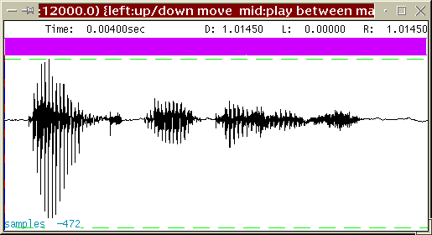
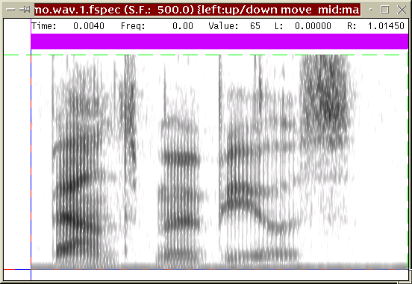
Phonetic "consensus" model
syl [-stress]
P lab | V hi-fr-or | C alv-nas
context
90 [-cons]
95 [+cont]
80 [-nas]
75 [-low]
75 [-back]
80 [-tense]
95 [+voice]
V hi-fr-or
/b-i:-n-.../
/bIn/ σ
/p-I-n-.../
/b-e-n-.../
phon.
pros.
periph.
auditory
process.
B9 discont. | high-freq. peaks | high-freq. peaks
multiband discont. | 2500 Hz peak | 2000 Hz peak
B1 discont. | 2000 Hz peak | 1100 Hz zero
low total energy | 300 Hz peak | 400 Hz zero
low-freq. intensity | low-freq. intensity | low-freq. intensity
flat spectrum | struct. spectrum | struct. spectrum
Pvoiced | Vnucl | Cnasal
acoustic
phonetic-
prosodic
module
speechsignal
features
(w/ confid)
lexicon/
syllabary
/bIn/ σ
/b-e-n-.../
cues
Pv | Vn | Cn
category hypotheses
landmarks/pivots
=?
contexts
internal
percept.
models
internal
synthesis
analysis-by-synthesis

Slide 14
Model: Components
acoustic feature extraction at key locations in speech signal [Stevens 1989, Dogil 1987]
feature-based lexicon access [Stevens 2005]
articulatory verification by means of analysis-by-synthesis [Gaskell et al. 1995, Stevens 2005]
underspecified abstract lexicon and episodic exemplar lexicon [Dogil 2006, Möbius & Schütze 2006 (SFB)]

Slide 15
Model: Analysis
incremental process of underspecification
extraction of acoustic parameters and robust features
considering contextual information (segmental, prosodic, syllable structure)
abstraction from speaker properties
lexicon access (words, morphemes, syllables, segments(?))

Slide 16
Model: Synthesis
incremental process of specification
applied to each hypothesized category
internal synthesis
exploiting all available contextual information (segmental, prosodic, syllable structure; syntax, pragmatics)
transformation into perceptual space
fully specified representation (exemplars)
comparison of perceived exemplars with synthesized/stored exemplars

Slide 17
Computational model
Why do we need a computational model?
requires explicit (mathematical, algorithmical) formulation
model-based predictions can be tested experimentally
interactions between assumptions can be investigated formally
observed behavior → model specification

Slide 18
Exemplar Theory: Key assumptions
Exemplar space: multidimensional cognitive map
similarity of exemplars ~ stance in this space
Exemplars comprise detailed phonetic information (ling./paraling./extraling. dimensions) [Goldinger 1997, Pierrehumbert 2001, 2003]

Slide 19
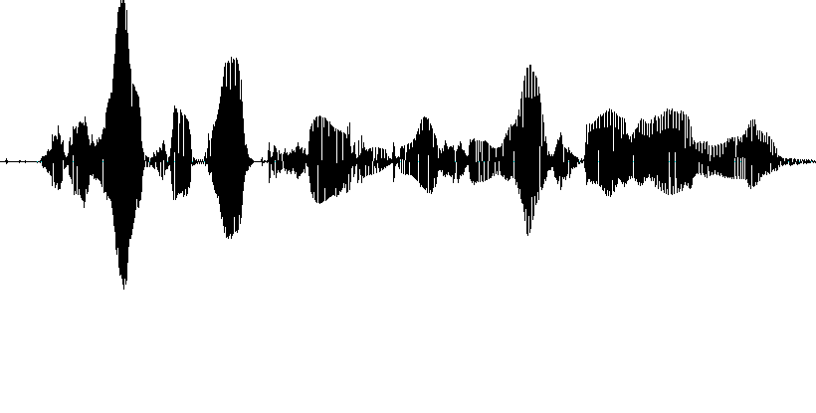
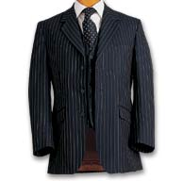
Exemplar Theory: Key assumptions
[+voice]
suit
“she had your dark suit in greasy wash water all year”

Slide 20
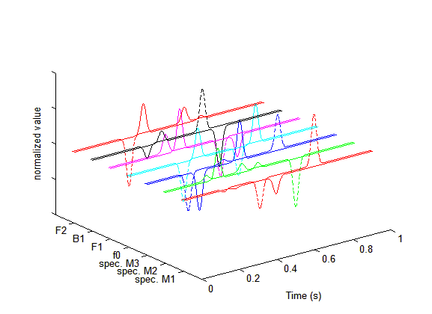
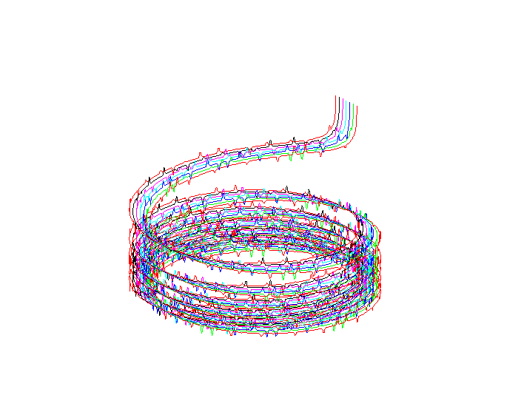
Exemplar Theory: Key assumptions
[+voice]
suit
“she had your dark suit in greasy wash water all year”

Slide 21
Exemplar Theory: Key assumptions
Exemplar space: multidimensional cognitive map
similarity of exemplars ~ stance in this space
Exemplars comprise detailed phonetic information (ling./paraling./extraling. dimensions) [Goldinger 1997, Pierrehumbert 2001, 2003]
Effects of frequency and recency:
exemplar space is updated continuously
memory traces decay over time

Slide 22
Exemplar Theory: Key assumptions
Common levels of representation for perception and production
exemplars: concrete, experienced tokens
phonetic encoding: properties of exemplars
phonological encoding: category label
quantitative knowledge: frequency distributions

Slide 23
References
Cutler A., Clifton C. (1999): Comprehending spoken language: a blueprint of the listener. In C.M. Brown, P. Hagoort (eds.), The Neurocognition of Language. Oxford Univ. Press, 123-166.
Diehl R.L., Kluender K.R. (1989): On the objects of speech perception. Ecol. Psychology 1:121-144.
Dogil G. (1987): Prototypical speech events and speech perception. Proc. ICPhS (Tallinn), 3:360-366.
Dogil G. (2006): Incremental specification in context: Phonetics. SFB 732, Univ. Stuttgart. [www.uni-stuttgart.de/linguistik/sfb732/]
Fowler C.A. (1986): An event approach to the study of speech perception from a direct-realist perspective. J.Phon., 14:3-28.
Gaskell M.G., Hare M., Marslen-Wilson W.D. (1995): A connectionist model of phonological representation in speech perception. Cognitive Science, 19(4):407-439.
Liberman A.M., Cooper F.S., Shankweiler D.P., Studdert-Kennedy M. (1967): Perception of the speech code. Psych. Rev., 74, 431-461.

Slide 24
References
Liberman A.M., Mattingly I.G. (1985): The motor theory of speech perception revised. Cognition 21:1-36.
Lindblom B. (1990): Explaining phonetic variation: a sketch of the H&H theory. In W.J. Hardcastle, A. Marchal (eds.), Speech Production and Speech Modelling. Kluwer, 403-439.
Möbius B., Schütze H. (2006): Exemplar-based speech representation. SFB 732, Univ. Stuttgart. [www.uni-stuttgart.de/linguistik/sfb732/]
Stevens K.N. (1972): The quantal nature of speech: evidence from articulatory-acoustic data. In E.E. Davis, P.B. Denes (eds.), Human Communication: A Unifed View. 51-66.
Stevens K.N. (1989): On the quantal nature of speech. J.Phon., 17:3-45.
Stevens K. (2005): Features in speech perception and lexical access. In: Pisoni D.B., Remez R.E. (eds.), The Handbook of Speech Perception. Blackwell, 125-155.

Slide 25
Thanks!

