Slide 1
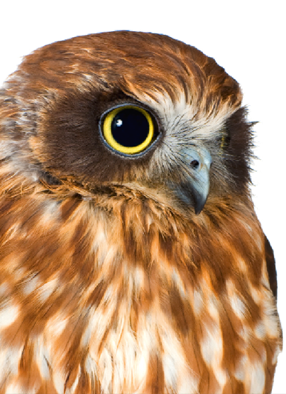

Speech Science
WiSe 2023
Speech Sounds (and more)
Nov 9, 2023
Bernd Möbius & Omnia Ibrahim
Language Science and Technology
Saarland University

Slide 2
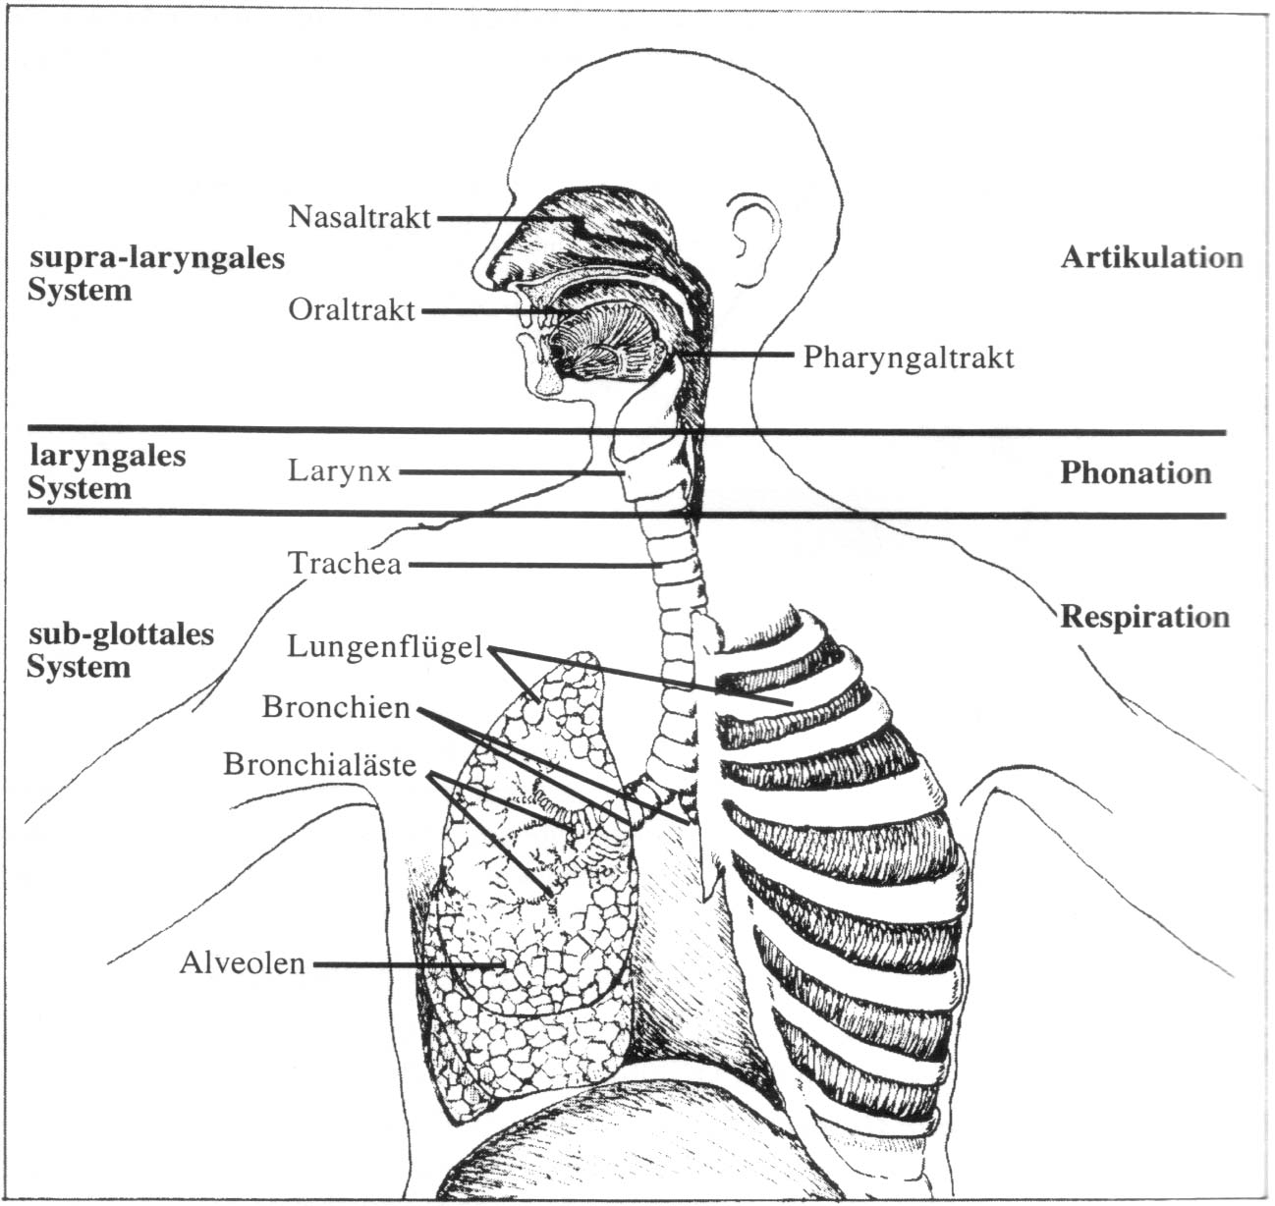
Speech production organs
[Reetz,1999]

Slide 3
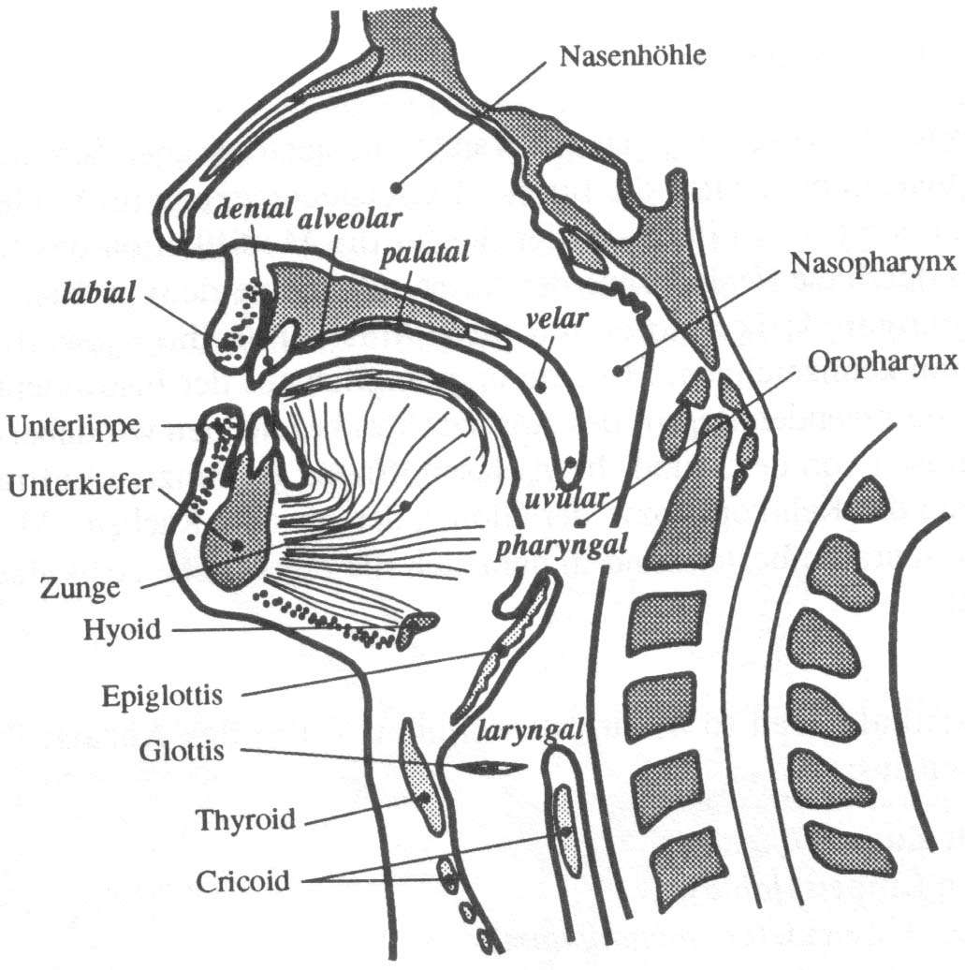
Speech production organs
[Reetz,1999]

Slide 4
Phonetic transcription - IPA
Phonetic transcription (standard text)
  "The north wind and the sun…"
IPA = International Phonetic Association
  aim: universal phonetic alphabet, suitable to transcribe all speech sounds of the world's languages
  aim: universal classification system for all speech sounds
  founded 1886 in Paris
  most recent major revision: Kiel 1989 (alphabet: 2015)
Online resources
  UCLA index of languages / speech sounds
  UPSID database
  UdS Audio demo of sounds and languages

Slide 5
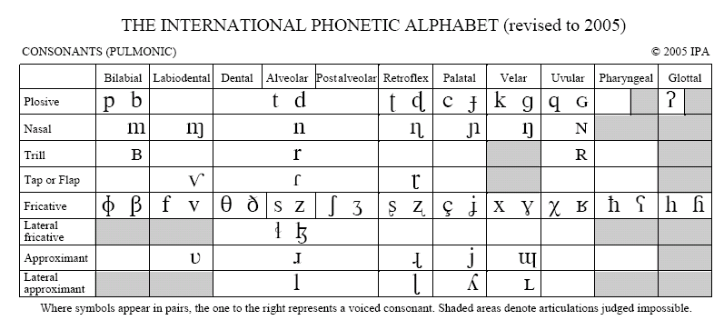
IPA: Consonants

Slide 6
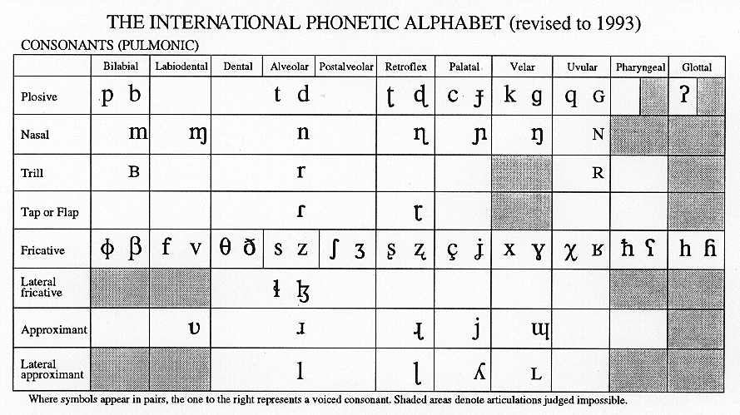
Consonants of German

Slide 7
Consonants of German
ʔ

Slide 8
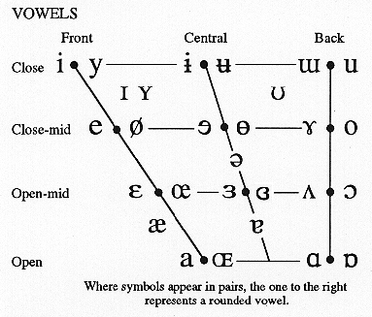
IPA: Vowels

Slide 9
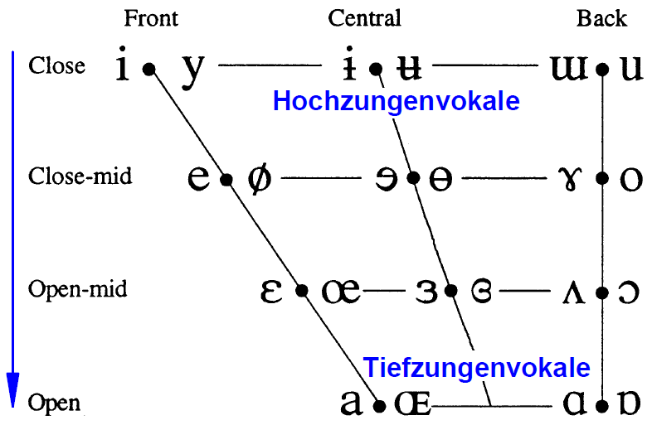
Vowels: high vs. low, open vs. closed
high-tongue vowels
low-tongue vowels
degree of jaw opening

Slide 10
Vowels: front vs. back
front-tongue vowels
back-tongue vowels
Vorderzungenvokale
Hinterzungenvokale

Slide 11
Vowels: unrounded vs. rounded
-round +round
lip rounding

Slide 12
Vowels of German

Slide 13
Vowels of German
A

Slide 14
Vowels of German

Slide 15
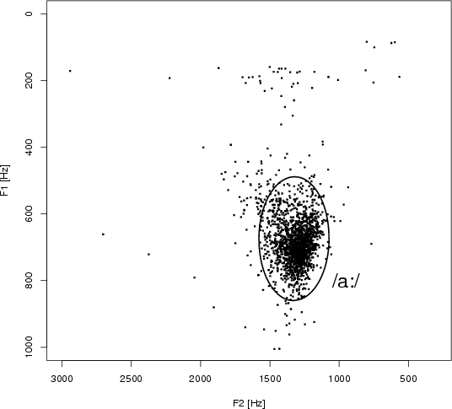
Vowel exemplars

Slide 16
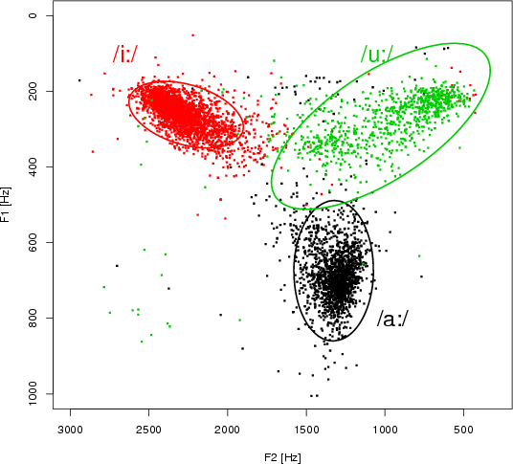
Vowel exemplars

Slide 17
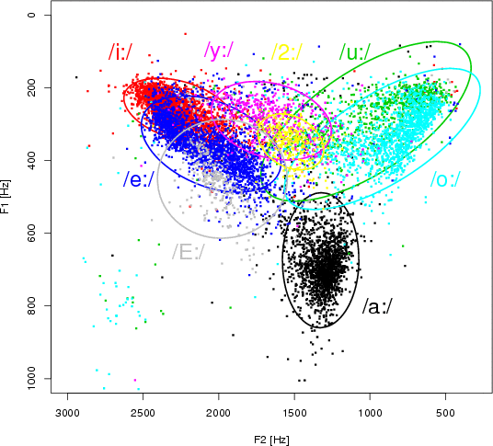
Vowel exemplars

Slide 18
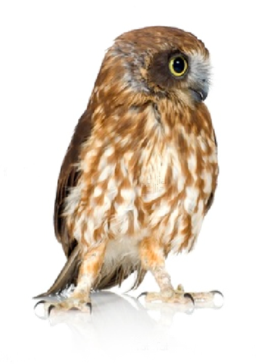
Thanks!

