Slide 1


M.Sc. LST Speech Science
Speech Perception
Jan 25, 2024
Bernd Möbius & Omnia Ibrahim
Language Science and Technology
Saarland University

Slide 2
Overview
Categorical Perception
Perceptual Magnet Effect
Multimodal perception

Slide 3

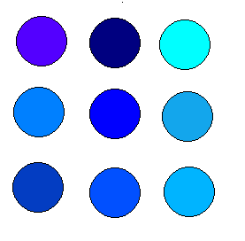
Categorical Perception
phenomenon:
  speech stimuli are not perceived continuously in auditory-perceptual space
  stimuli are classified as belonging to categories

Slide 4
Categorical Perception
test:
  presentation of a continuum of speech stimuli between 2 categories (e.g. phonemes: /pa/ - /ba/)
  stimulus construction by editing natural speech or by speech synthesis
  combination of 2 tasks
    identification: 1 stimulus
    discrimination: pair of stimuli

Slide 5
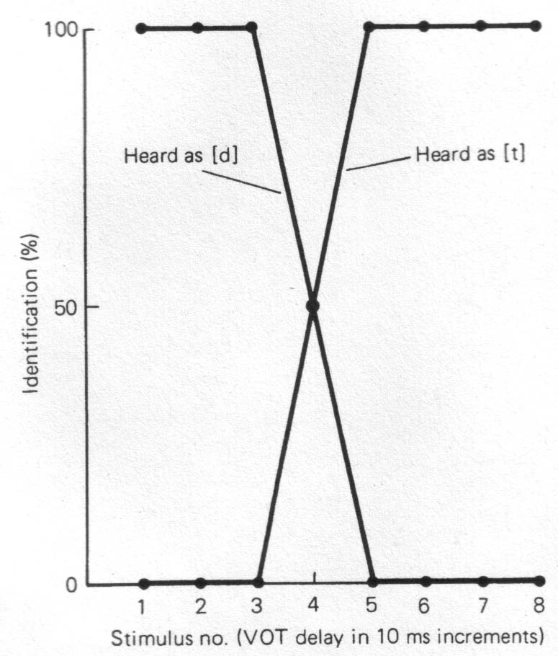
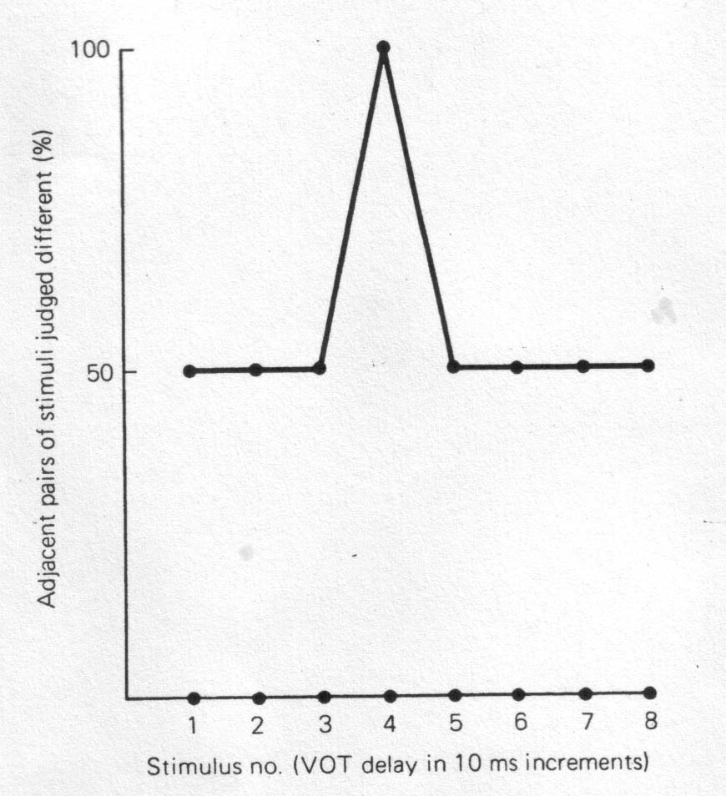
Categorical Perception
Identification
Discrimination
[Clark and Yallop, 1995, p.314]

Slide 6
Categorical Perception
CP is demonstrated if
  listeners assign each stimulus to one of the offered categories and recognize categories of speech but not intermediary steps
  identification is optimal within category boundaries but at chance level at category cross-over
  discrimination is weaker within category boundaries
  the maximum of the identification function coincides with the maximum of the discrimination function (category switch at same location in acoustic/auditory space)
Categories and category boundaries are language-specific

Slide 7
Categorical Perception
Examples of speech sound contrasts explored in the CP paradigm:
  voice onset time (VOT) of stop consonants (/pa/ - /ba/)
  place of articulation of stop consonants (/ba/ - /da/ - /ga/)
  fricatives vs. affricates (/sa/ - /tsa/)
  manner of articulation (/ba/ - /wa/, /la/ - /ra/)
  vowel quality: less clear categoriality, hints of continuous perception
  prosodic features: categoriality doubtful, mainly continuous perception
  most experiments done for English
Review paper: Repp (1984)

Slide 8
Categorical Perception
CP has also been observed in
  infants → preceding language and speech acquisition
  apes, monkeys, rabbits, chinchillas, some birds → without phoneme-based, linguistic communication
  experiments involving non-speech signals → subjects not in linguistic perception mode
CP appears to be a generic auditory or even generic perceptual phenomenon, rather than a specifically language-based one
Online experiment:
  [http://www.ling.gu.se/~anders/KatPer/Applet/test.eng.html]
  (does not always work reliably – we will use our own tool)

Slide 9
Perceptual Magnet Effect
Infants can discriminate speech sounds of all languages, but with advancing L1 acquisition some of the contrasts lose their discriminability
Sound categories become established around the most typical, i.e. prototypical, exemplar
Prototype functions like a magnet
  perceptual space is warped by shrinking the auditory distance between exemplars in the vicinity of the prototype – a magnet effect
  reduced discrimination sensitivity between prototypes and similar exemplars
  effective within categories

Slide 10

PME
[Kuhl 1991]

Slide 11
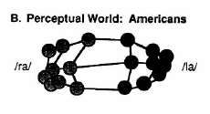
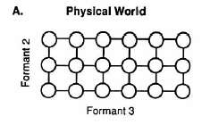
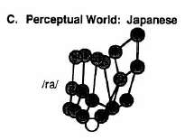
PME
[Kuhl 1991]

Slide 12
PME
available evidence
  /i/ - /e/ contrast
  /r/ - /l/ contrast
  English, Japanese
  adults, infants, monkeys
  German boundary tones [Schneider et al., 2005, 2006, 2009]

Slide 13
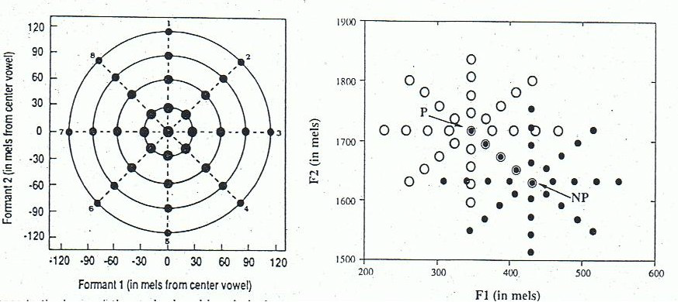
PME
test – 3 tasks
  identification - cf. CP – stimulus construction:

Slide 14
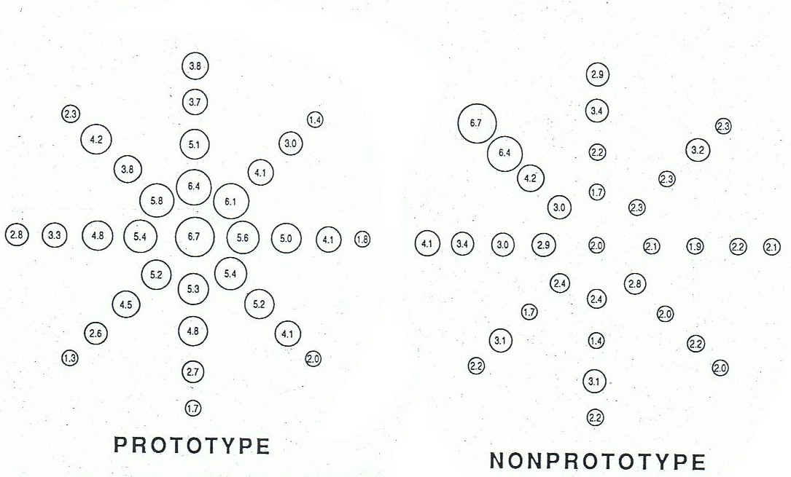
PME
test – 3 tasks
  identification - cf. CP
  goodness rating – for P and NP exemplars of target category:

Slide 15
PME
test – 3 tasks
  identification - cf. CP
  goodness rating
  discrimination - cf. CP, except that stimulus pairs are
    P + neighbor(s)
    NP + neighbor(s)
  expected result (see above)
    discrimination sensitivity reduced around P but not NP

Slide 16
Multimodal Perception
Perceptual fusion of multimodal stimuli
  McGurk effect [McGurk and MacDonald, 1978]:
    visual stimulus: [ga]
    acoustic stimulus: [ba]
    → multimodal perception: [da] !!
  Online demos:
    [http://www.youtube.com/watch?feature=endscreen&NR=1&v=jtsfidRq2tw]
    [http://www.youtube.com/watch?v=aFPtc8BVdJk&NR=1]

Slide 17
References
John Clark, Colin Yallop, and Janet Fletcher (2007): An Introduction to Phonetics and Phonology. 3rd edition (2nd ed. Clark&Yallop 1995). Blackwell, Oxford.
E. Bruce Goldstein (1997): Wahrnehmungspsychologie. Spektrum Akademischer Verlag, Heidelberg.
Keith Johnson (1997): Acoustic and Auditory Phonetics. Blackwell, Oxford.
J. MacDonald and H. McGurk (1978): Visual influences on speech perception process. Perception and Psychophysics 24, 253-257.
Bernd Pompino-Marschall (1995): Einführung in die Phonetik. De Gruyter, Berlin.
Henning Reetz (1999): Artikulatorische und akustische Phonetik. Wissenschaftlicher Verlag, Trier.
Patricia Kuhl (1991): "Human adults and human infants show a 'perceptual magnet effect' for the prototypes of speech categories, monkeys do not". Perception and Psychophysics 50, 93—107.

Slide 18
References
Iverson, P. and Kuhl, P.K. (1995): "Mapping the perceptual magnet effect for speech using signal detection theory and multidimensional scaling". JASA 97(1), 553-562.
Kuhl, P.K. and Iverson, P. (1995): "Linguistic experience and the 'Perceptual Magnet Effect'". In W. Strange (ed.), Speech perception and linguistic experience: Issues in crosslanguage research. York Press, 1995, 121-154.
Schneider, K. and Möbius, B. (2005): "Perceptual Magnet Effect in German boundary tones". Proc. Interspeech (Lisbon), 1177-1189.
Katrin Schneider, Britta Lintfert, Grzegorz Dogil, Bernd Möbius (2006): "Phonetic grounding of prosodic categories". In Stefan Sudhoff et al. (eds.), Methods in Empirical Prosody Research (De Gruyter, Berlin), 335-361.
Katrin Schneider, Grzegorz Dogil, Bernd Möbius (2009): "German boundary tones show categorical perception and a perceptual magnet effect when presented in different contexts". Proc. Interspeech (Brighton), 2519-2522.

Slide 19

Thanks!

