Slide 1


M.Sc. LST Speech Science
Prosody
Jan 4/11, 2024
Bernd Möbius & Omnia Ibrahim
Language Science and Technology
Saarland University

Slide 2
Prosody
Prosody comprises properties of spoken language beyond single sounds
  features extending over longer units/stretches of speech (pitch, sentence melody, loudness, tempo, rhythm, ...)
"prosodic", "suprasegmental", "nonsegmental" (often synonymous)
  realized simultaneous with segments
  longer than segments
  manifestation of units higher in phonological hierarchy: syllables, words, phrases, sentences, discourses

Slide 3
Prosody: terminology
Prosody: a subdiscipline of linguistics and phonetics
Terminology debate at IPA conference at Kiel (1989): diversity of opinions on topic "Prosody", its symbolic representation, notation, transcription
3 terms: prosody, suprasegmentals, intonation
  often used synonymously
  unified definitions helpful (even if only in class)
Literature:
Clark et al. (2007), ch. 9
Botinis et al. (2001)
Lehiste (1970), ch. 1
Möbius (1993), ch. 2

Slide 4
Remark on orthography
Most writing systems:
  only rudimentary markers of prosodic features: punctuation, typographic emphasis (underline, bold face, italic, spaced out)

Slide 5
Proposed systematicity
Prosody:
  linguistic subdiscipline, generic term
  comprising linguistic and paralinguistic function
Feature systems with linguistic function
  intonation (tonal): linguistically relevant functions of fundamental frequency on levels of syllables, words, utterances, discourses
  duration (temporal): linguistically relevant functions of absolute and relative duration of units
  intensity (stress): linguistically relevant functions of energy-related features
("suprasegmentals"?)

Slide 6
More terminology
Prominence: acoustic-phonetic and perceptual emphasis of parts of utterances; relative feature, binary, or gradual?
Stress (syllabic stress, word stress): acoustic realization of (lexical) stress
Accent: tonally marked (by F0) stressed syllable
  special cases: contrast accent, emphasis
Further prosodic features (somewhat under-researched): speaking rate (tempo), rhythm, pauses, hesitations, voice quality, phonation type, . . .
  subject to conventions of linguistic community, may convey linguistic functions (e.g. laryngealization as boundary signal)
  cue for speaking style, situative context, attitude, emotional state of speaker

Slide 7
Acoustic parameters
Classical acoustic parameters
  fundamental frequency (F0)
  segmental duration
  intensity
Problems: each of these parameters
  is also part of specification of speech sounds
  supports several linguistic functions
  also supports paralinguistic functions

Slide 8
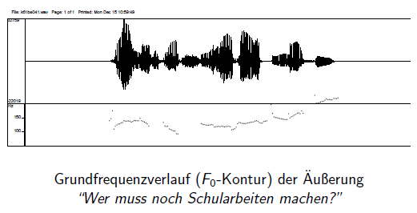

Fundamental frequency contour

Slide 9
Perception of fundamental frequency
Auditory-perceptual correlate of F0 variation is pitch variation - but this is not a bi-unique relationship!
  pitch can be perceived even when fundamental is not present in signal
  e.g. speech signal transmission: telephone bandwidth 300-3300 Hz
  fundamental frequency is reconstructed from spectral harmonics, via integration of virtual and spectral pitch into combined sensory entity (Terhardt, 1974) or inferred from signal periodicity
Fundamental frequency is only one of several acoustic correlates of perceived pitch!

Slide 10
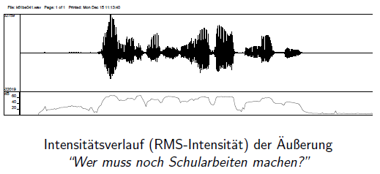
Intensity contour

Slide 11
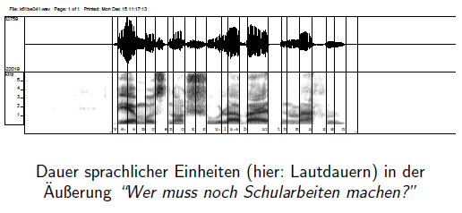
Segmental durations

Slide 12
Word prosody
Fixed word accent (predictable): WA always on specific syllable position in word, e.g. on first syllable in all words (Finn., Hung., Czech) or penultimate (Pol.) or last (French)
Flexible word accent (not predictable): WA lexically associated with specific syllable, per word (Ger., Engl., Russ.); segmentally identical words may form prosodic minimal pairs:
  DE umfahren – umfahren, übersetzen – übersetzen, Tenor, August, Konstanz
  EN import – import, abstract – abstract
  RU мука ['mukə] "pain" – мука [mʊ'ka] "flour", замок ['zamək] "castle" – замок [zɐ'mok] "lock"
  ES término – termino – terminó

Slide 13
Accent groups
Accent group, sometimes called stress group
  unit comprising an accented syllable and all subsequent unaccented syllables (if any)
  independent of word boundaries
  sensitive to phrase boundaries
  e.g. | unit com | prising an | accented ...
Stress-timed vs. syllable-timed languages? Isochrony?

Slide 14
Sentence/phrase prosody
Phrasing
  segmentation of utterances in sections characterized by their own intonation
  intonation phrases do not have to be co-extensive with syntactic phrases
  boundary signals: final fall, final rise, continuation rise, declination reset(ting), phrase-final lengthening, utterance-final lengthening
  phrasing as cue for syntactic disambiguation?
    "Ja zur Not geht's auch am Samstag"
    "Flying planes can be dangerous."

Slide 15
Sentence/phrase prosody
Phrasing and accenting affect meaning!
    Ja zur Not geht’s auch am Samstag
    Ja! Zur Not geht’s auch am Samstag.
    Ja? Zur Not geht’s, auch am Samstag.
    Ja, zur Not. Geht’s auch am Samstag?
    Ja, zur Not geht’s. Auch am Samstag!
    Ja, zur Not geht’s. Auch am Samstag?
    ...
  But it does not always disambiguate meaning!
    Flying planes can be dangerous.
    (To fly planes vs planes that are flying)

Slide 16
Sentence/phrase prosody
Sentence mode
  semantic/syntactic/functional definitions: relation between formal-grammatical sentence types and pragmatic function types, e.g.: declarative, interrogative, imperative, exclamative sentences
  prosodic/intonational definitions: interrogative, progredient; terminal vs. non-terminal

Slide 17
Discourse and information structure
Discourse and information structure
  Carter called Nixon a Republican, and then he offended him.
  Carter_{i} called Nixon_{j} a Republican, and then he_{i} offended him_{j}.
  Carter_{i} called Nixon_{j} a Republican, and then he_{j} offended him_{i}.
Given/new information
Topic/Focus structure

Slide 18
Intonation
Intonation: linguistically relevant functions of fundamental frequency on syllable, word, utterance, discourse levels
  primarily lexical: on mora, syllable (tone, tone languages, pitch accent languages)
  primarily intonational: on words (tone, pitch accent, accenting/accentuation)
  primarily syntactic: on phrases and sentences (phrase boundaries, phrasing)
  primarily semantic: on phrases and sentences (information structure, sentence mode)

Slide 19
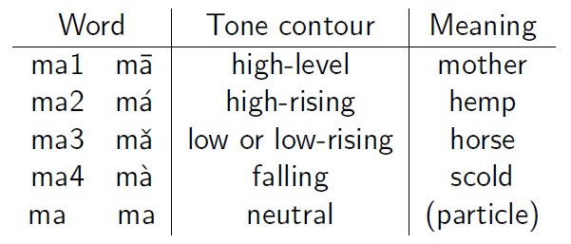
Tone languages
Tone languages: e.g. Yoruba, Igbo, Thai, Vietnamese, Mandarin-Chinese (example below)
Chinese tones (UCLA Sounds of the World's Languages)
In tone languages, the tone contour is part of the lexical specification of all syllables.

Slide 20
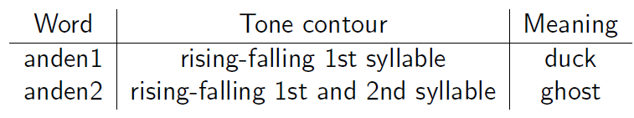
Pitch accent languages
Pitch accent languages: Japanese, Serbian, Croatian, Lithuanian, Latvian, Norwegian, Swedish (example below)
Swedish pitch accents (Wikipedia)
In pitch accent languages, the tone contour is part of the specification of syllables and words only in parts of the lexicon.

Slide 21
Intonational phonology
Intonation languages: English, German, French, Spanish, ...
The domain of distinctive tone contours is the prosodic word, the phonological phrase, the intermediate phrase, and the intonation phrase.
Autosegmental-metrical theory of intonation (Pierrehumbert 1980)
  intonation is represented by sequence of high (H) and low (L) tones
  H and L are members of a primary phonological contrast
  hierarchy of intonational domains
    IP – Intonation Phrase; boundary tones: H%, L%
    ip – intermediary phrase; phrase tones: H-, L-
    pw – prosodic word; pitch accents: H*, H*L, L*H, …

Slide 22
Intonational phonology
Finite-state grammar of well-formed tone sequences
pw ip IP
Example [adapted from Pierrehumbert 1980, p. 276]
  That's a remarkably clever suggestion.
  | |
  %H H* H*L L- L%

Slide 23
Intonation phonology
Finite-state graph
pw
ip
IP

Slide 24
ToBI: Tones and Break Indices
Formalization of intonation model as transcription system [Silverman et al. 1992]
  phonemic (=broad phonetic) transcription
  originally designed for American English
  limited applicability to other varieties/languages
    language-specific inventory of phonological units
    language-specific details of F0 contours
  adapted to many languages (e.g. GToBI, JToBI, KToBI)
  implemented in many TTS systems

Slide 25
Fujisaki’s model
[Fujisaki 1983, 1988; Möbius 1993]

Slide 26
Fujisaki’s model
Properties
  superpositional
  physiological basis and interpretation of components and control parameters
  linguistic interpretation of components
  applied to many (typologically diverse) languages
Origins
  Öhman and Lindqvist (1966), Öhman (1967)
  Fujisaki et al. (1979), Fujisaki (1983, 1988)

Slide 27
Fujisaki’s model
[Möbius 1993]

Slide 28
Fujisaki’s model
Approximation of natural F₀ by optimal parameter values within linguistic constraints (accents, phrase structure)
[Möbius 1993]

Slide 29
Many functions of F₀
F₀ serves as a cue for many linguistic, paralinguistic, and extralinguistic factors, including:
  lexical tones
  word accent, syllabic stress
  stress or accent groups
  prosodic phrasing
  sentence mode
  information structure
  discourse structure
  pitch range, register
  phonation type, voice quality
  microprosody: intrinsic and coarticulatory F₀

Slide 30
References
IPA (ed.) (1999): Handbook of the International Phonetic Association. Cambridge University Press. https://www.internationalphoneticassociation.org/content/handbook-ipa
Hadumod Bußmann (²1990): Lexikon der Sprachwissenschaft. Kröner.
Antonis Botinis, Björn Granström, Bernd Möbius (2001): "Developments and paradigms in intonation research". Speech Communication 33 (4), 263-296.
John Clark, Colin Yallop, and Janet Fletcher (2007): An Introduction to Phonetics and Phonology. Blackwell.
Ilse Lehiste (1970): Suprasegmentals. MIT Press.
Ernst Terhardt (1974): "Pitch, consonance, and harmony". Journal of the Acoustical Society of America 55, 1061-1069.

Slide 31
References
IPA (ed.) (1999): Handbook of the International Phonetic Association. Cambridge University Press. https://www.internationalphoneticassociation.org/content/handbook-ipa
Hadumod Bußmann (²1990): Lexikon der Sprachwissenschaft. Kröner.
Antonis Botinis, Björn Granström, Bernd Möbius (2001): "Developments and paradigms in intonation research". Speech Communication 33 (4), 263-296.
John Clark, Colin Yallop, and Janet Fletcher (2007): An Introduction to Phonetics and Phonology. Blackwell.
Ilse Lehiste (1970): Suprasegmentals. MIT Press.
Bernd Möbius (1993): Ein quantitatives Modell der deutschen Intonation - Analyse und Synthese von Grundfrequenzverläufen. Niemeyer.
Ernst Terhardt (1974): "Pitch, consonance, and harmony". Journal of the Acoustical Society of America 55, 1061-1069.

Slide 32

Thanks!

