Slide 1


M.Sc. LST Speech Science
Auditory system
Jan 18, 2024
Bernd Möbius & Omnia Ibrahim
Language Science and Technology
Saarland University

Slide 2
Overview
Anatomy and physiology of the auditory system
Speech perception
  auditory perception
  psychoacoustics
  auditory-perceptual phonetics

Slide 3
Audition and speech perception
Audition / listening: auditory system converts sound (i.e. air pressure changes) to neural impulses
  perception within frequency range relevant to speech
  filtering out irrelevant background noise
  adaptation to idiosyncratic properties of speaker
Speech perception / understanding: interpretation of neural signals as speech events
  decoding and segmentation into meaningful elements
  association of identified elements with mental representations
  association of recognized representations with semantic concepts

Slide 4
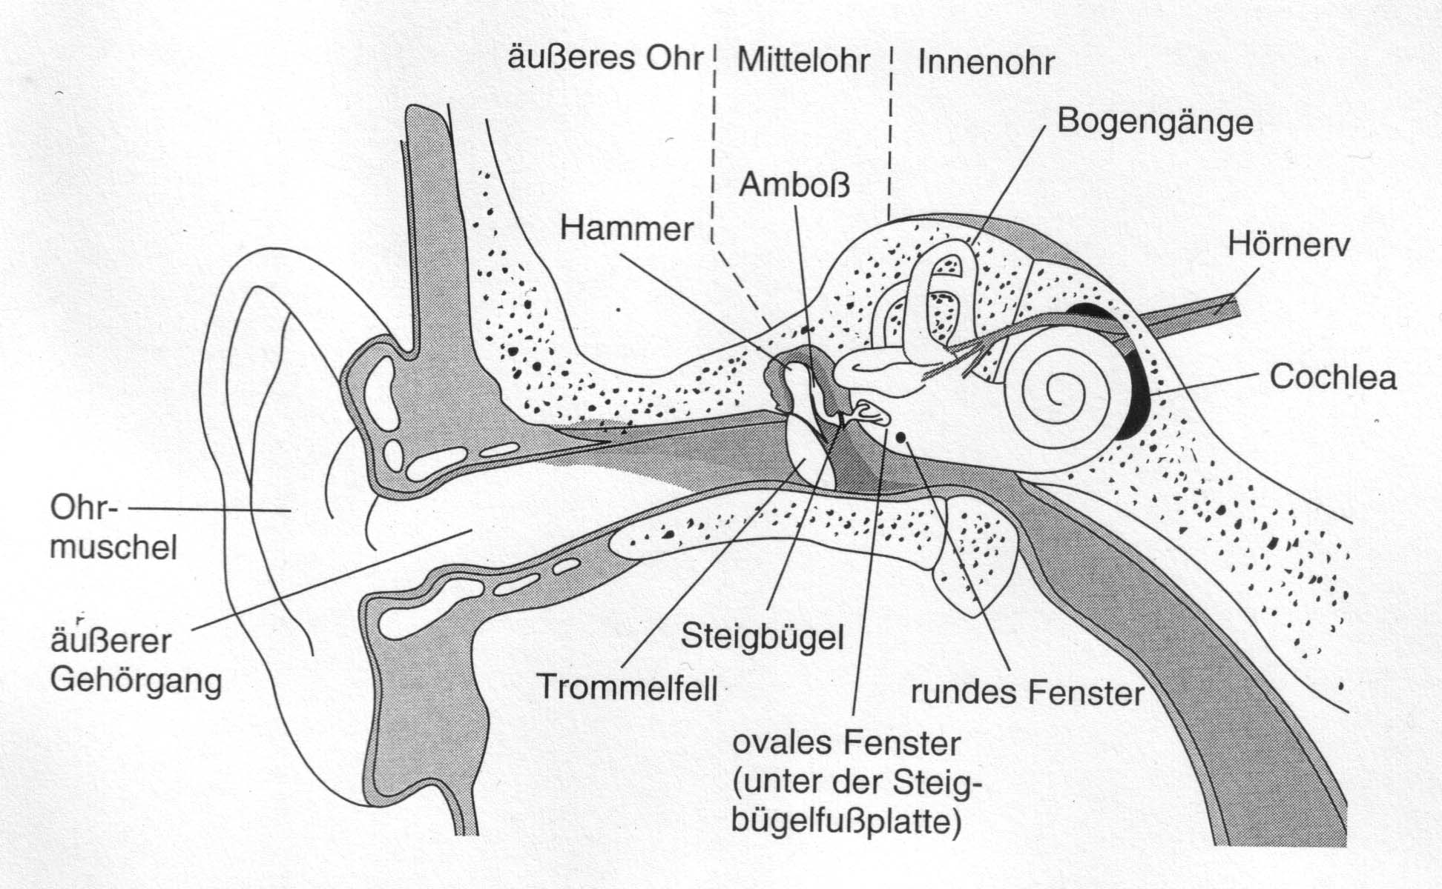
Outer ear, middle ear, inner ear
vestibular system
incus
cochlear nerve
malleus
pinna/auricle
stapes
auditory canal
eardrum
[Goldstein, 1997, p.322]

Slide 5
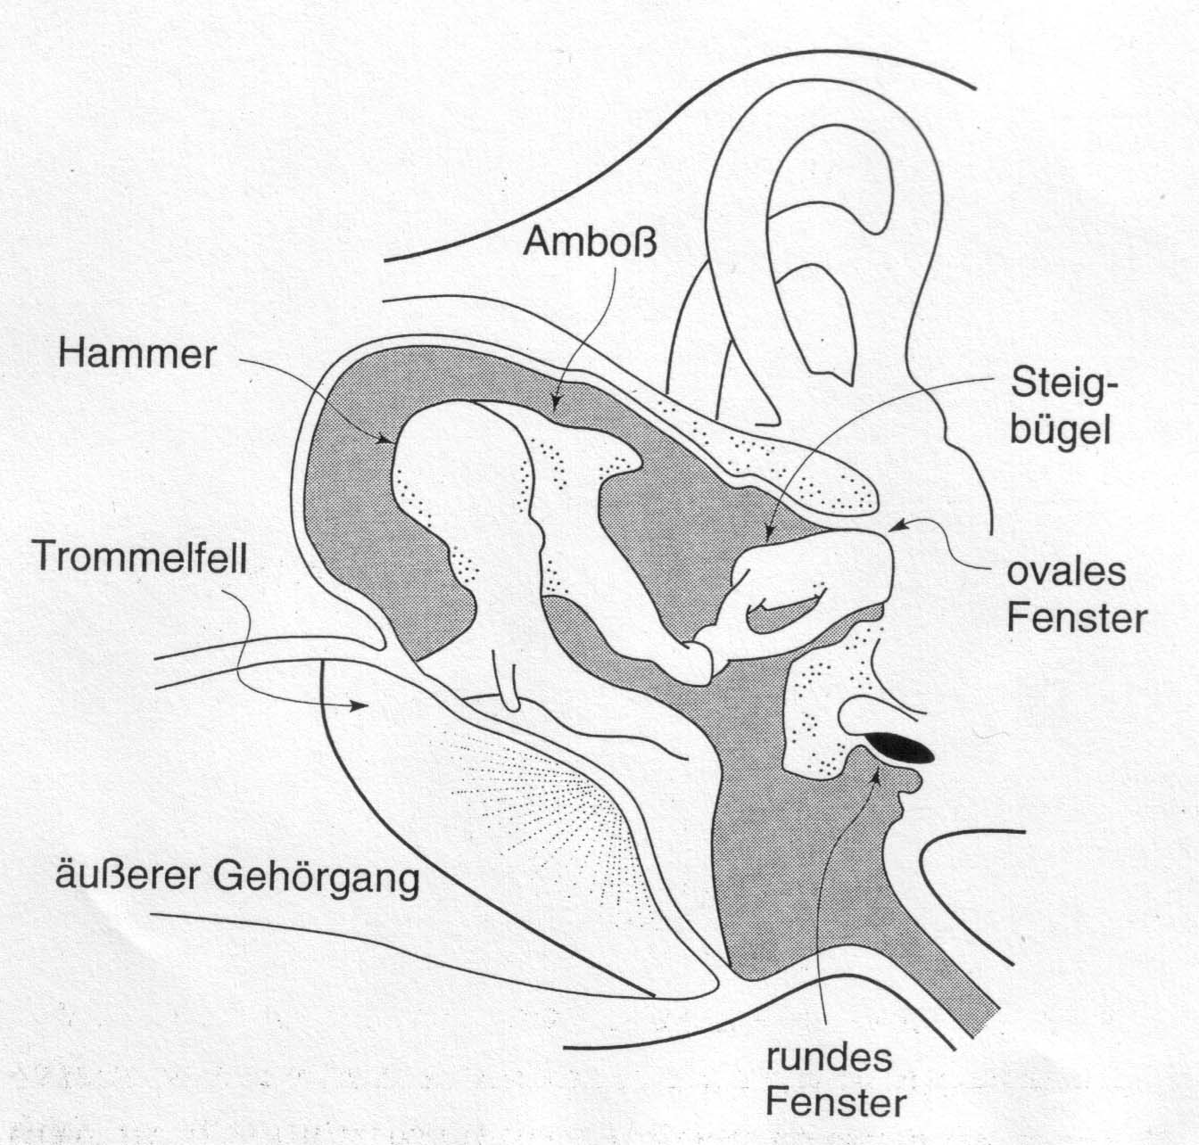
Middle ear
incus
stapes
malleus
oval window
eardrum
round window
auditory canal
[Goldstein, 1997, p.322]

Slide 6
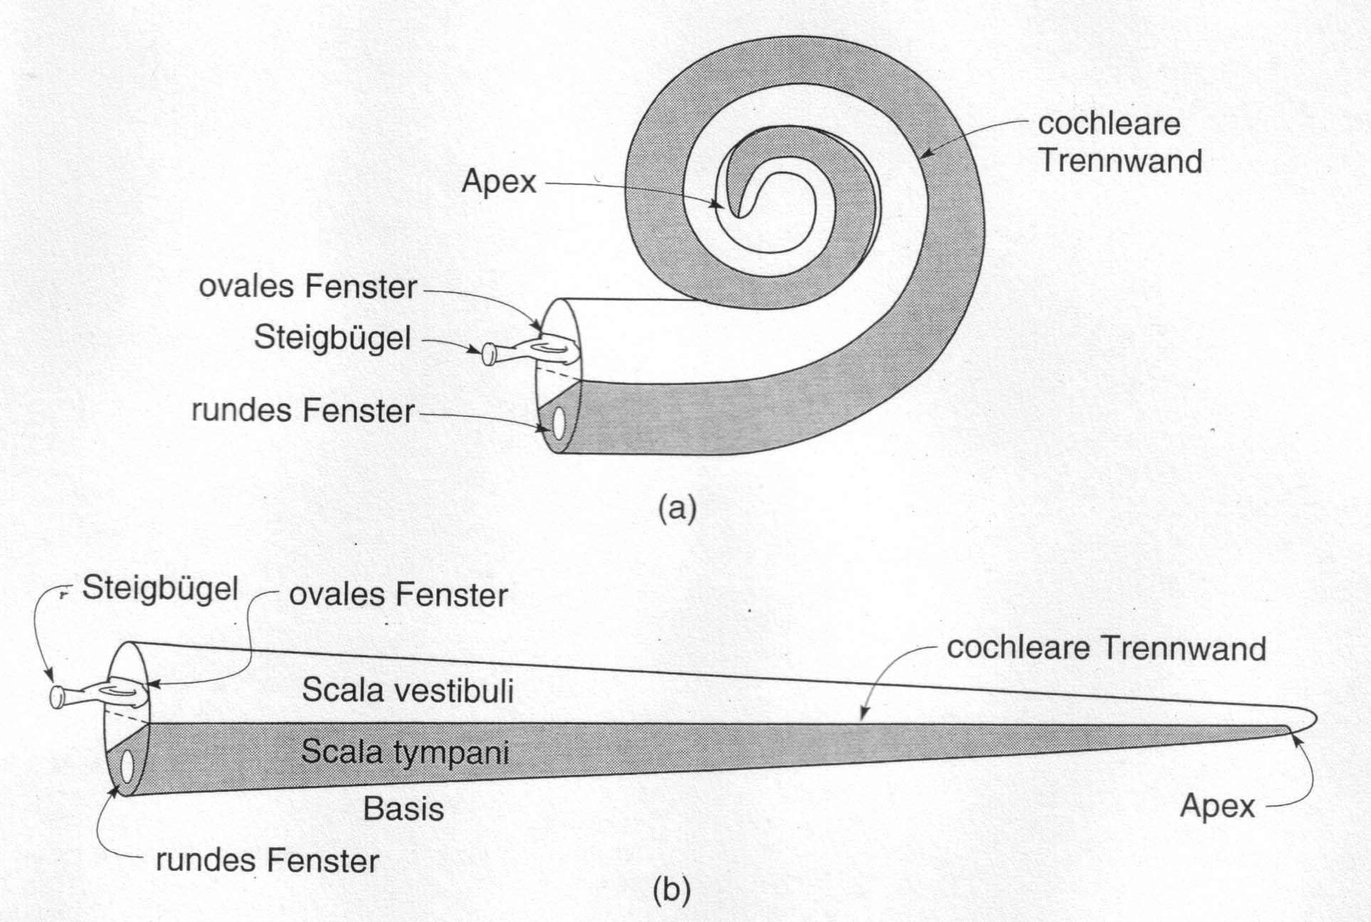
Cochlea
oval window
cochlear membrane
stapes
[Goldstein, 1997, p.324]
round window
oval window
cochlear membrane
stapes
round window

Slide 7
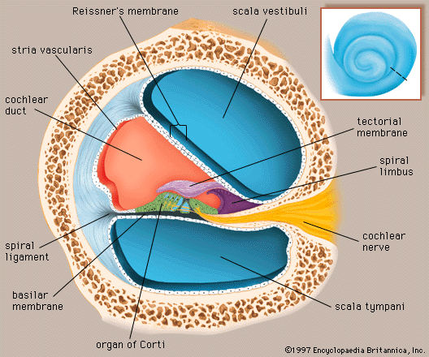
Cochlea
[http://www.britannica.com/EBchecked/media/534/A-cross-section-through-one-of-the-turns-of-the]

Slide 8
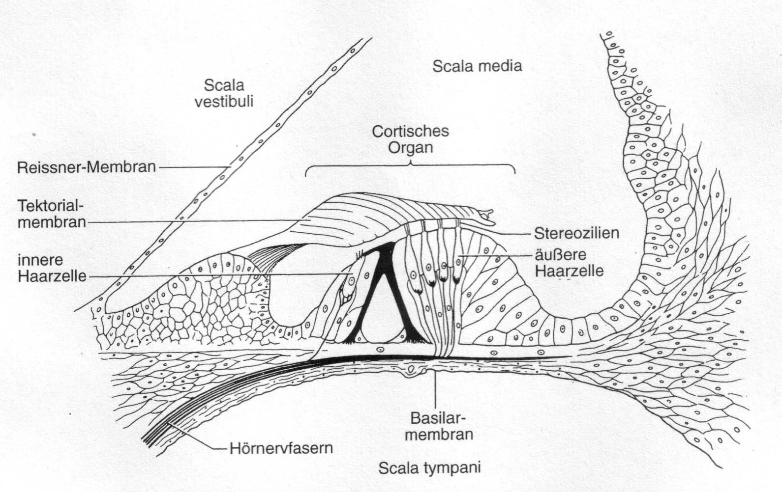
Organ of Corti
tectorial membrane
inner hair cells
outer hair cells
cochlear nerve fibres
[Goldstein, 1997, p.325]

Slide 9
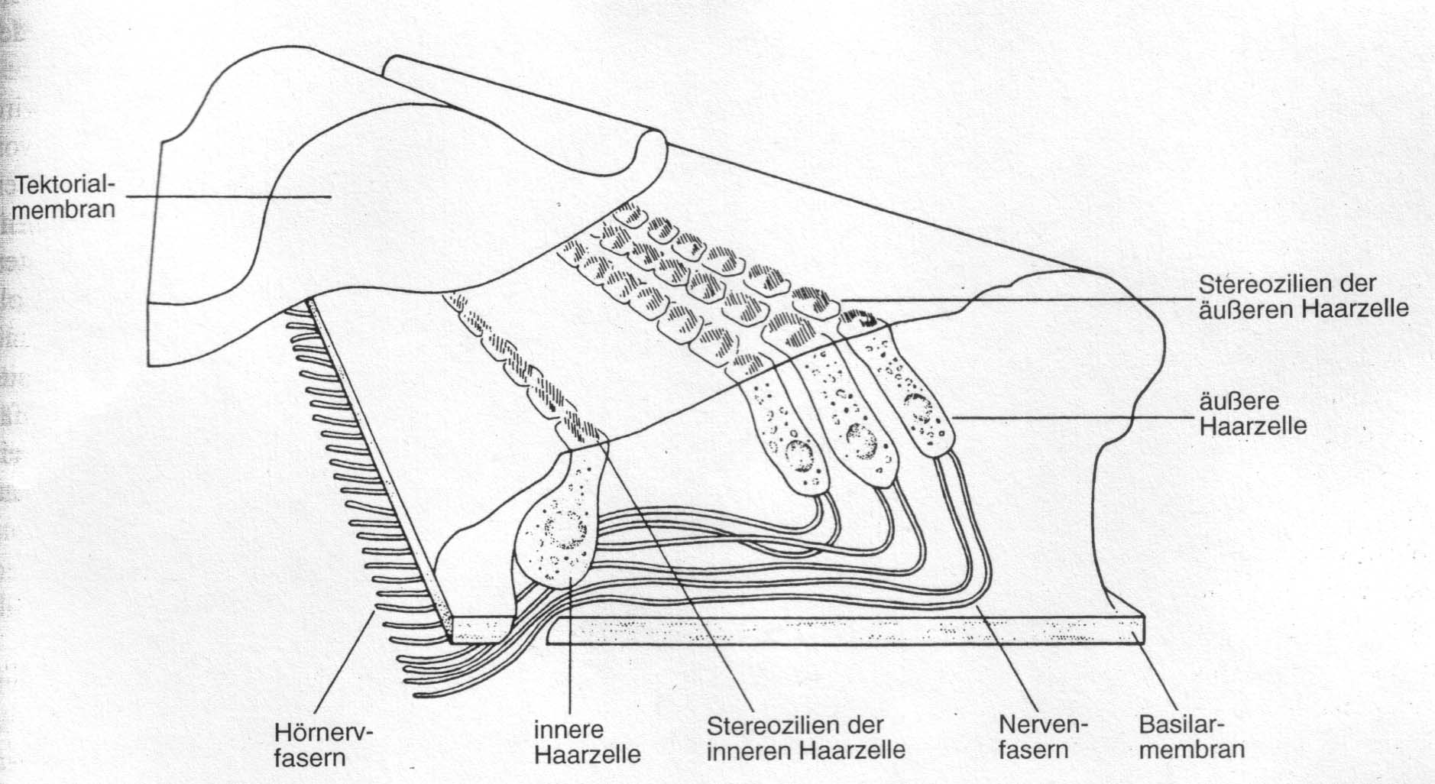
Organ of Corti
tectorial membrane
outer hair cell
cochlear nerve fibres
inner hair cell
nerve fibres
[Goldstein, 1997, p.325]

Slide 10
Auditory system: overview
 | Component | Function
Outer ear | Pinna | Localization of sound source
 | Auditory canal | Protection; enhance 2 – 4 kHz
 | Eardrum (tympanic membrane) | Register sound pressure changes
Middle ear | Ossicles (malleus, incus, stapes) | Reinforce eardrum vibrations
 | Oval window | Interface air → fluid
Inner ear | Scala vestibuli, tympani, media | Container of perilymph (sc.v./t.), endolymph (sc.m.)
 | Organ of Corti, with bas./tect. membranes, inner/outer hair cells | Register fluid pressure changes, spectral analysis, transformation to neural signals

Slide 11
From sound to neural signals
air pressure changes → vibrations → oval window
vibrations → fluid movements
perilymph movements → standing waves in cochlea → spatial encoding of frequency components
elicitation of hair cells of organ of Corti
hair cells comprises approx. 100 cilia (stereocilia)
movement of cilia causes emission of chemical neurotransmitter (glutamate) to primary auditory neurons
auditory nerve fibres transmit resulting electrophysiological signal to primary auditory cortex

Slide 12
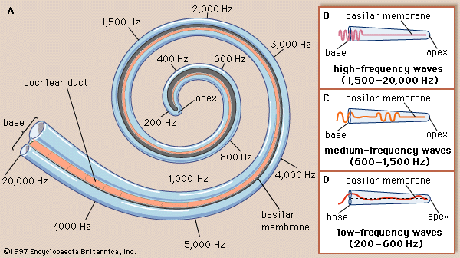
Spatial encoding of frequency components
oval window
round window
[http://teddysratlab.blogspot.com/2011/03/and-ears-to-hear.html]

Slide 13
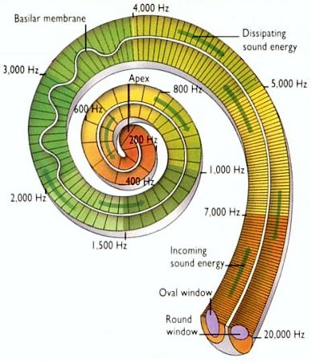
Spatial encoding of frequency components
[http://universe-review.ca/ I10-85-cochlea2.jpg]

Slide 14
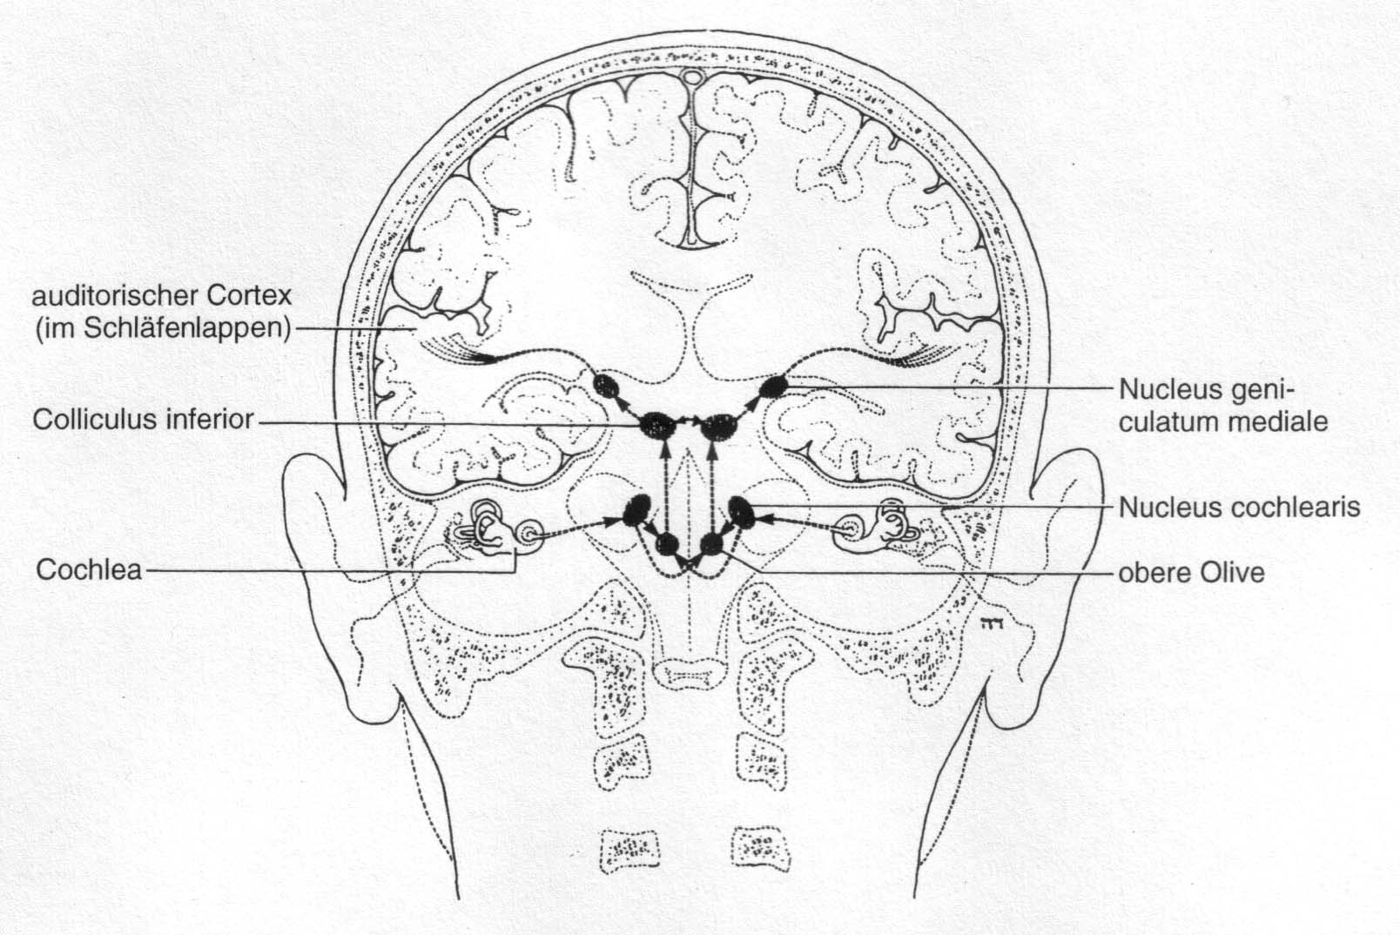
Connections in auditory system
auditory cortex (in temporal lobe)
superior olivary complex
[Goldstein, 1997, p.327]

Slide 15
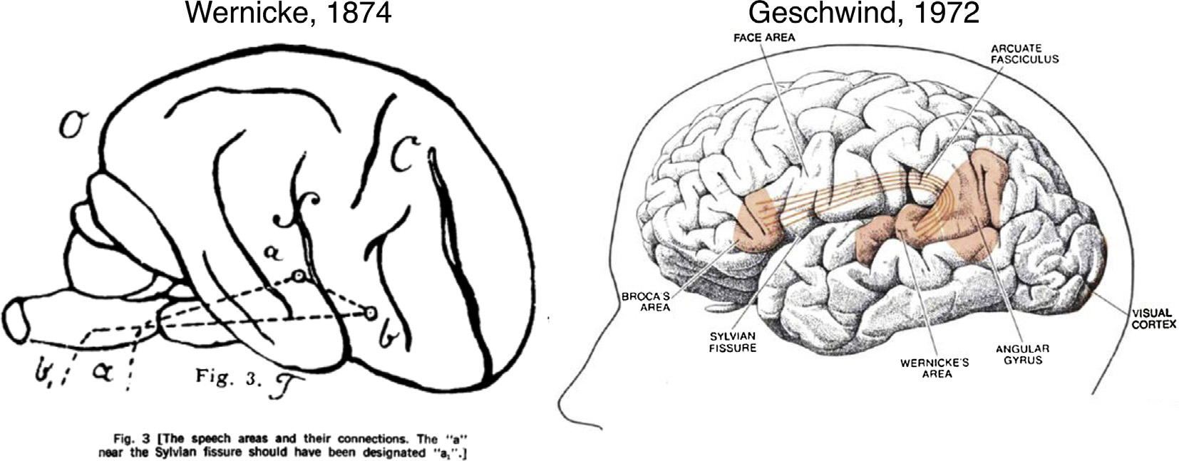
Language areas in the brain

Slide 16

Thanks!

