Slide 1


Speech Science
WiSe 2023
Acoustic Phonetics
Nov 23, Nov 30, Dec 7, Dec 14, 2023
Bernd Möbius & Omnia Ibrahim
Language Science and Technology
Saarland University

Slide 2
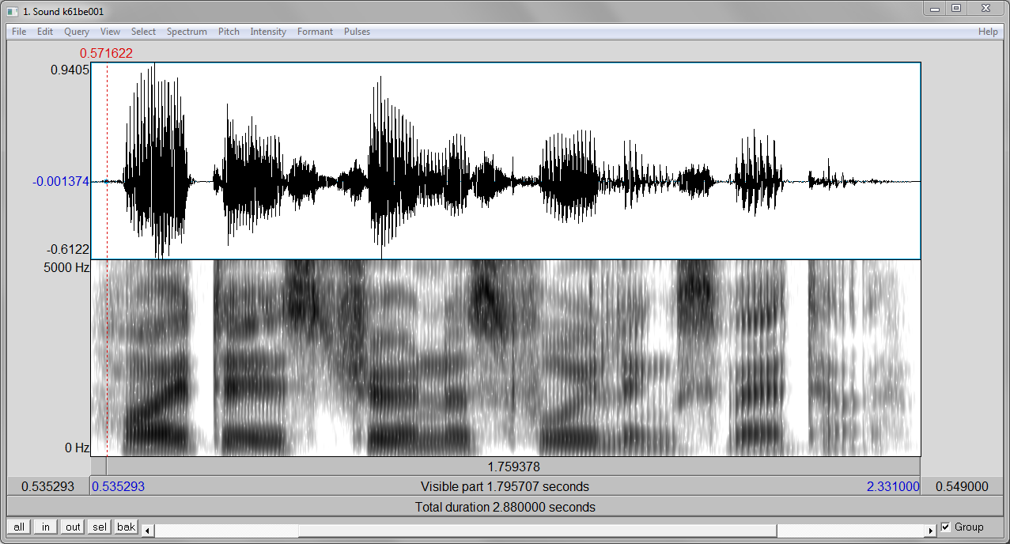
Speech waveforms and spectrograms
A
f
t
"Heute ist schönes Frühlingswetter."

Slide 3
Speech sounds and speech signals
Basic types of speech signals
  quasi-periodic signals: sonority
    vowels
    sonorants (approximants, glides, nasals, liquids)
    stochastic signals: frication noise
    fricatives
    plosive aspirations
  transient signals – impulse
    plosive releases
    mixed excitation – voiced frication noise
      voiced fricatives

Slide 4
Speech sounds and speech signals: vowels
"Heute ist schönes Frühlingswetter."

Slide 5
Speech sounds and speech signals: sonorants
"Heute ist schönes Frühlingswetter."

Slide 6
Speech sounds and speech signals: fricatives
"Heute is schönes Frühlingswetter."

Slide 7
Speech sounds and speech signals: plosives
t?
"Heute is(t) schönes Frühlingswetter."

Slide 8
Speech sounds...: voiced fricatives
voiced?
"Heute ist schönes Frühlingswetter."

Slide 9
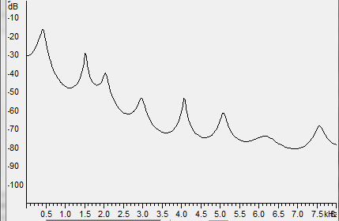
Speech waveforms and spectrograms
A
F1
F2
F3
A
f
f
t

Slide 10
Formants
Spectral peaks (energy maxima) of the sound spectrum: formants (F1, F2, ..., Fn)
Formants emerge as a consequence of selective reinforcement of certain frequency ranges, corresponding to resonance characteristics of the vocal tract.
Distinguishing between voice source (excitation) and sound formation in the vocal tract (acoustic filter) motivates the source-and-filter model of speech production.
References:
  Gunnar Fant (1960): Acoustic theory of speech production
  Gerold Ungeheuer (1962): Elemente einer akustischen Theorie der Vokalartikulation

Slide 11
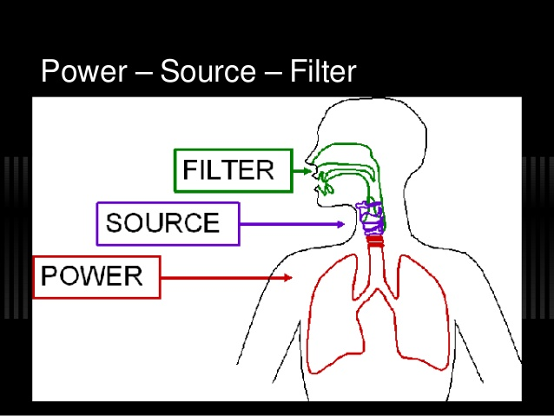
Source-filter model of speech production
[https://www.vocalsonstage.com]

Slide 12
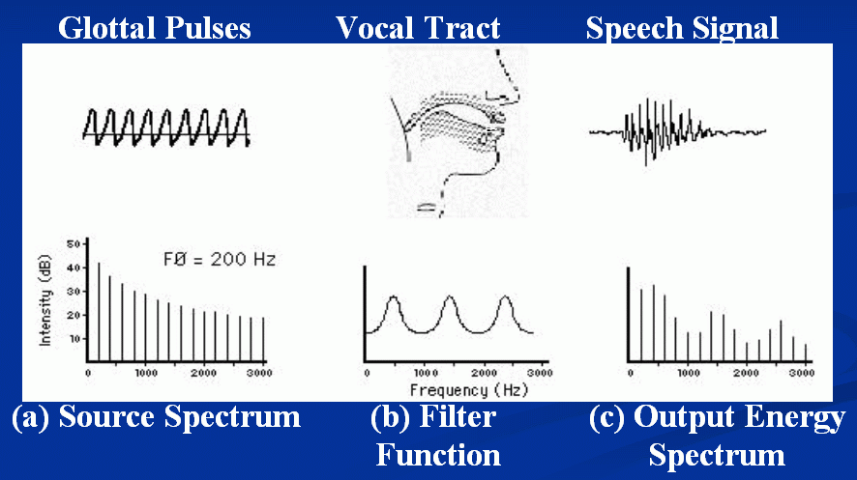
Source-filter model of speech production

Slide 13
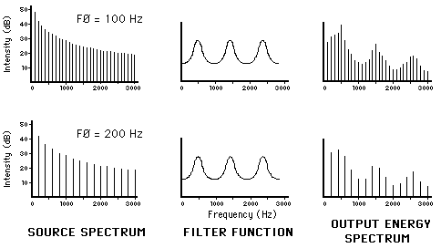
Source-filter model of speech production
Glottal excitation
Vocal tract frequency response
Sound spectrum

Slide 14
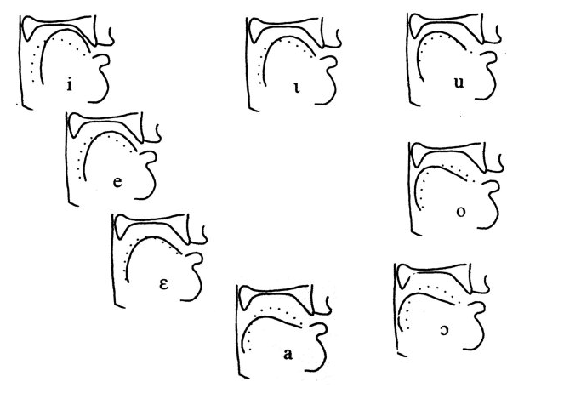
Vocal tract as acoustic filter
Vocal tract geometry, determined by tongue position (and jaw opening and lip protrusion, not shown)

Slide 15
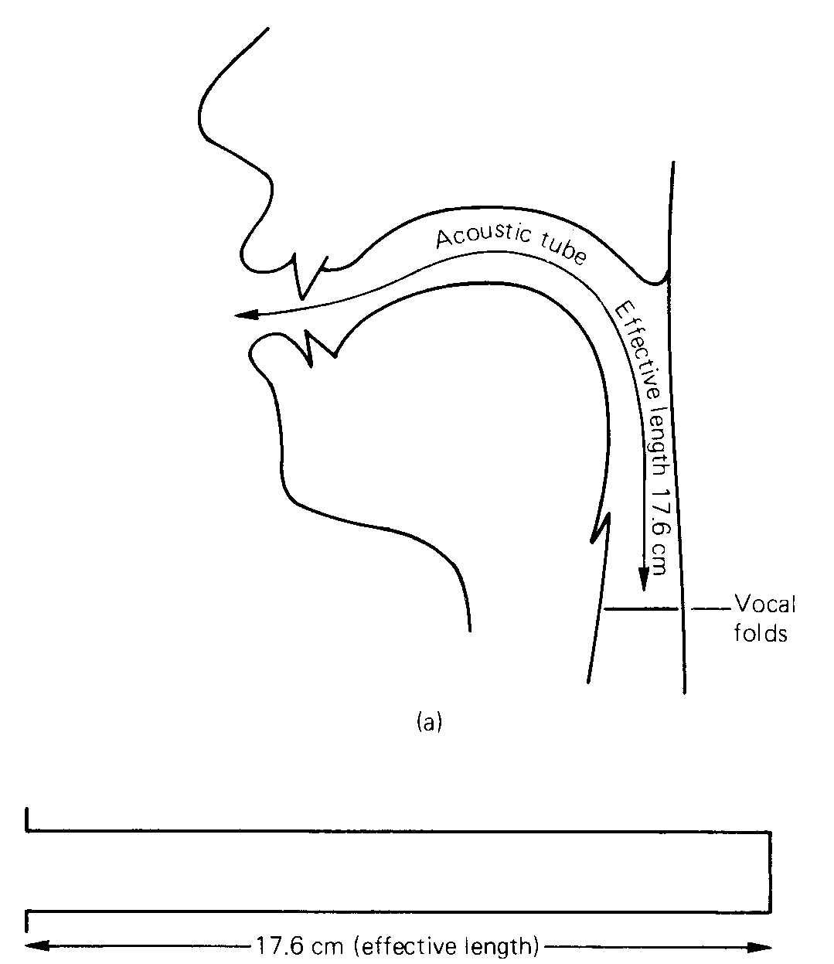
Vocal tract: acoustic tube model
[Clark et al., 2007a, p.241]

Slide 16
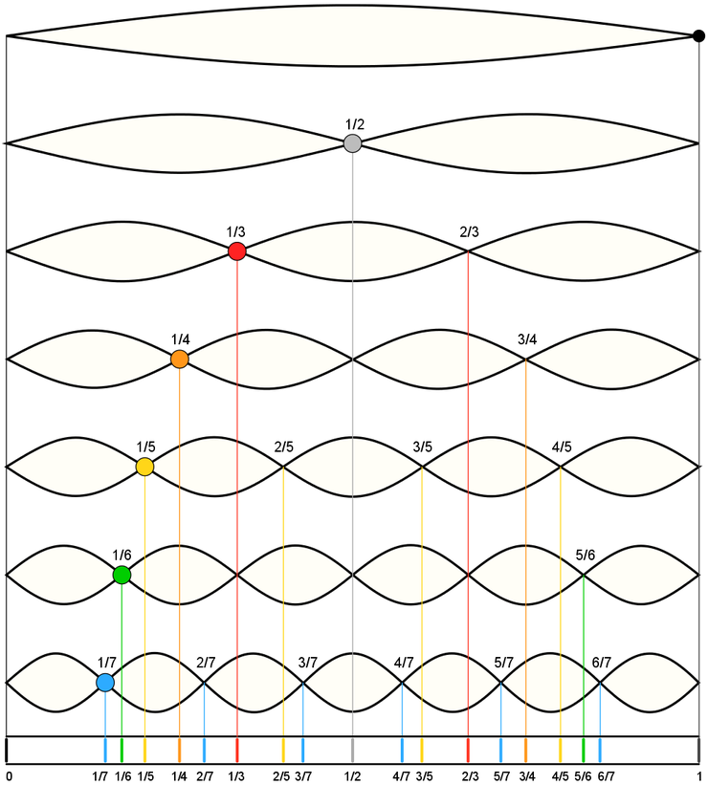
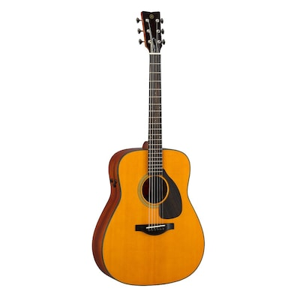
Vibration modes: string

Slide 17
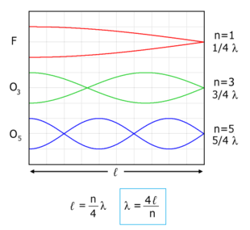
Vibration modes: vocal tract
glottis
lips

Slide 18
Longitudinal waves
Acoustic signals evolve as longitudinal waves in vocal tract
Physical parameters of acoustic waves
  sound pressure p : change of air pressure caused by sound event, local deviation from average ambient pressure
  sound/particle velocity v : particle velocity caused by sound event, oscillation of particle around resting position
  speed of sound c : speed of sound waves in air (or other material), particle-to-particle interaction, distance of travel per unit of time (e.g. 340 m/s in air)

Slide 19
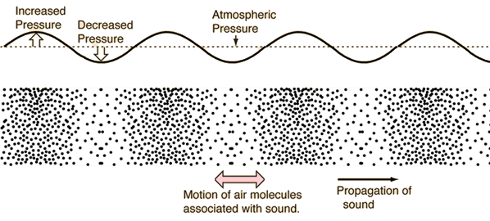
Sound propagation

Slide 20
Sound pressure waves in vocal tract
p=0
v=0
[Hess, ms.]

Slide 21
Vocal tract: acoustic tube model
Perfect reflexion at sound-hard (lossless) walls of tube
  v = 0 at place of reflexion
(Lossy) reflexion at sound-soft transition from vocal tract to free acoustic field (i.e. from lips to air)
  p = 0 at place of radiation

Slide 22
Computing formant frequencies
Resonance frequencies of neutral vocal tract computed as speed of sound divided by wave length: f _{i} = c / λ _{i}
Frequencies of resonances/formants:
  F1 = 340 / (4 * 0.17) = 340 / 0.68 = 500 Hz
  F2 = 340 / (4/3 * 0.17) = 3 * 340 / (4 * 0.17) = 1500 Hz
  F3 = 340 / (4/5 * 0.17) = 5 * 340 / (4 * 0.17) = 2500 Hz
Distribution of formant frequencies in neutral vocal tract corresponds to formants of central vowel [ǝ]
Simple tube model, with constant area, is inadequate for computing formants of other vowels (cf. acoustic theory of vowel articulation [Ungeheuer 1962])

Slide 23
Vibration modes: vocal tract (repeated)
glottis
lips

Slide 24
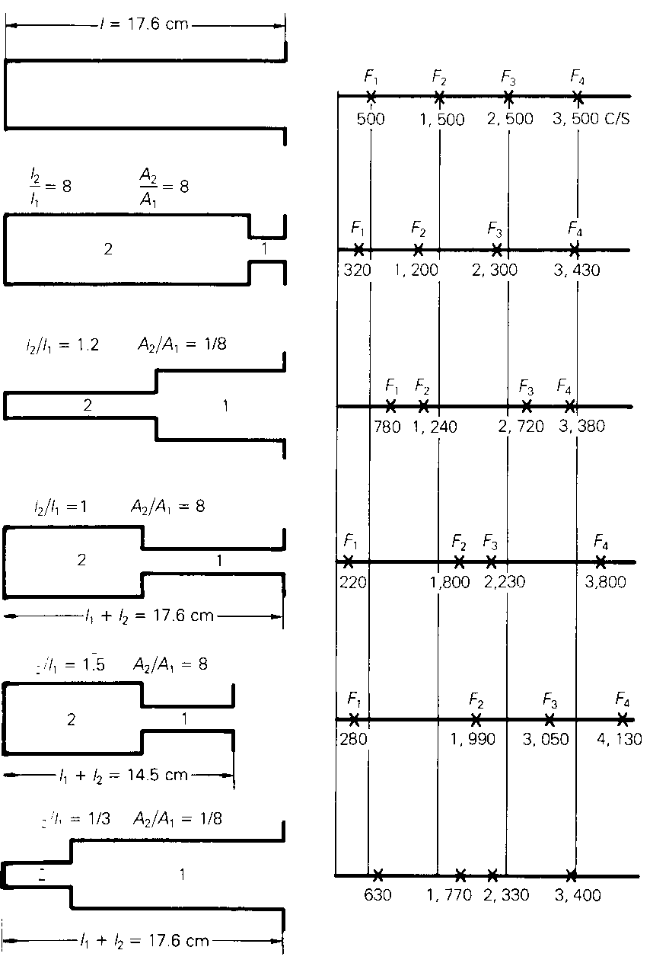
Tube model with variable area
[Clark et al., 2007a, p.246]

Slide 25
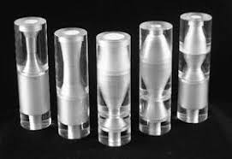
T. Arai’s cylinder-type models
[http://www.splab.net/Vocal_Tract_Model/index-e.htm]

Slide 26
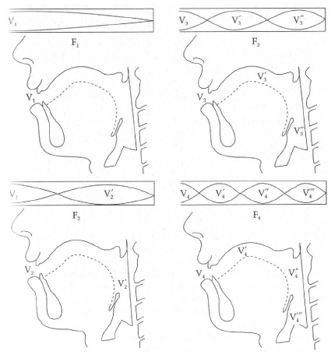
Resonances: standing waves
parameter: v [Johnson, 1997, p.99]

Slide 27
Standing waves: interpretation
interpretation of the graphical representation of standing waves in idealized vocal tract (neutral configuration, see previous figure):
first 4 formants displayed (F1 – F4)
in tube model and in vocal tract
places of maximum sound velocity (sound velocity nodes, V_{i})
places of maximum sound pressure (wave maxima, "antinodes")
localization of V_{i} in vocal tract

Slide 28
Dynamic area changes
resonances of vocal tract with variable area cannot be straightforwardly visualized as in the neutral tube model
  local area changes affect frequencies of resonances, depending on energy distribution of standing wave in tube along longitudinal axis ("z-axis")
  e.g., constriction at lip end of tube has same effect as constriction at glottis end: lower resonance frequency
  acoustic vowel system can be interpreted as representing geometrical changes with respect to neutral tube geometry and resulting changes of resonance frequencies away from neutral values
  → acoustic theory of vowel articulation [Ungeheuer (1962)]

Slide 29
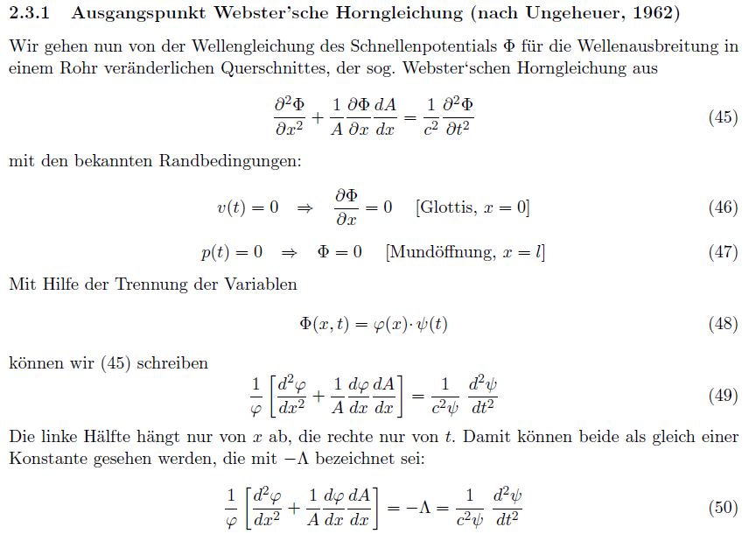
Acoustic theory of vowel articulation
NOT REQUIRED

Slide 30
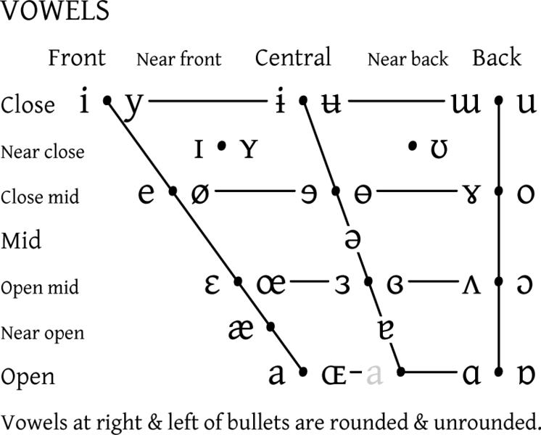
Vowels (IPA)
F2
F1

Slide 31
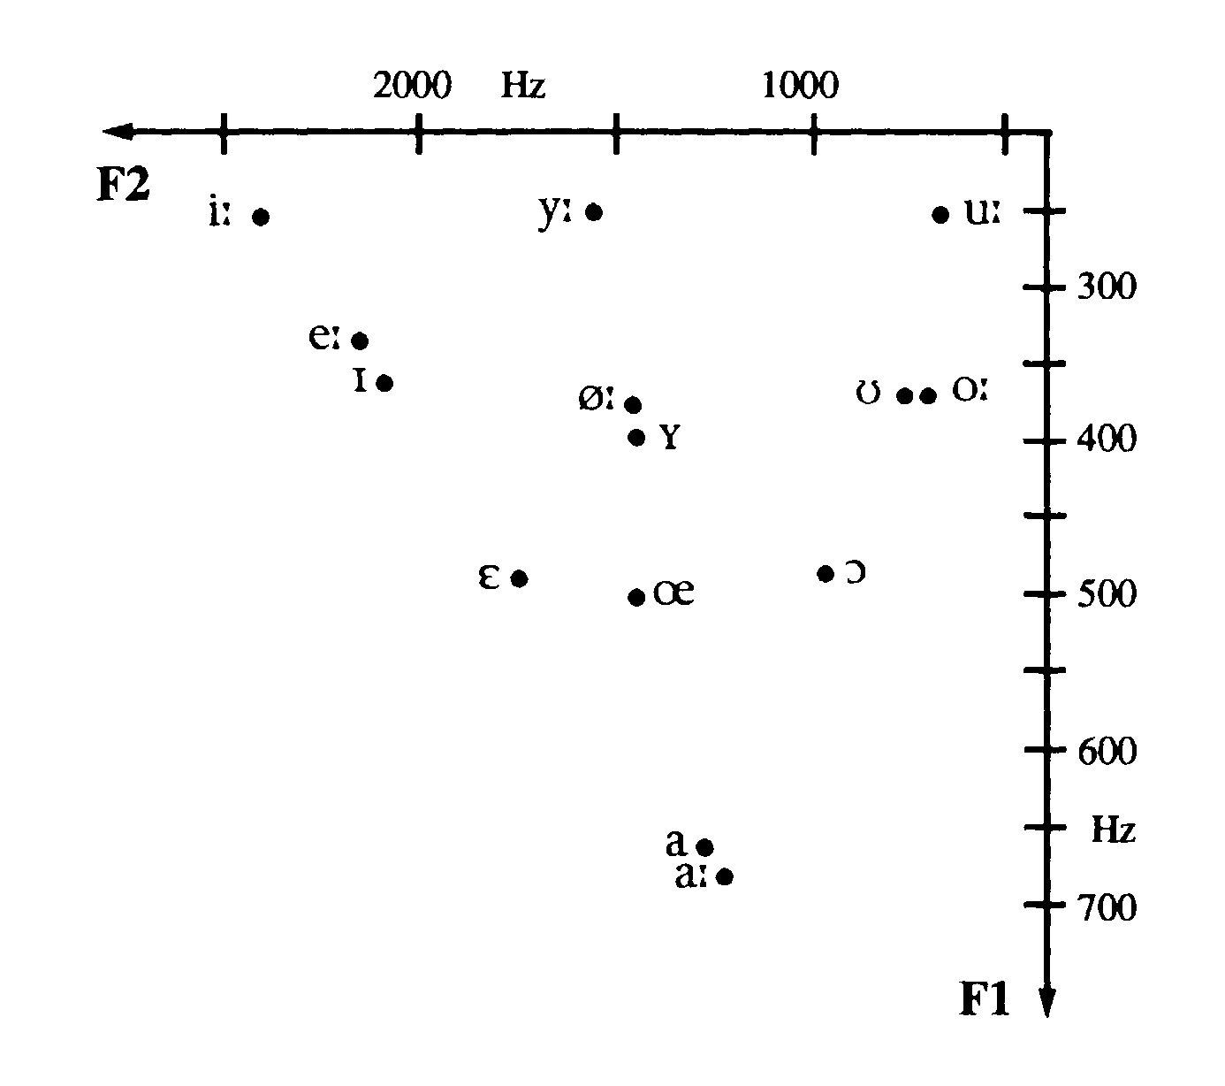
Vowels (German [Pompino-Marschall, 1995])

Slide 32
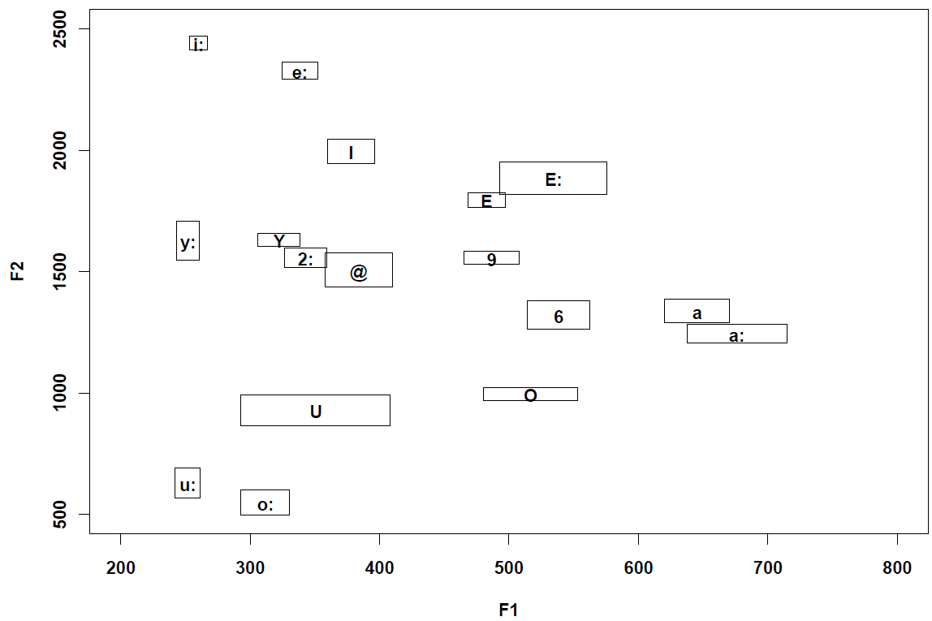
Vowels (German [Möbius, 2001])

Slide 33
Vowels (German, F1/F2/F3 [Möbius, 2001])

Slide 34
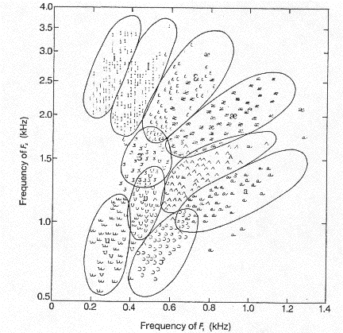
Vowels (Am. English [Peterson and Barney, 1952])

Slide 35
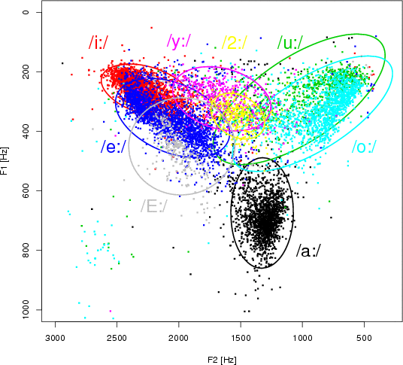
Vowels (German [Möbius])

Slide 36
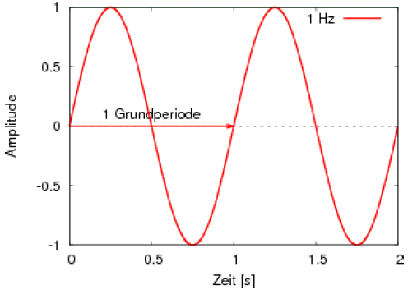
Simple waveforms

Slide 37
Simple waveforms
Simple periodic oscillation: pure sine wave
  cyclically recurring, simple oscillation pattern, determined by
    fundamental period T₀
    amplitude A
    phase Φ
  Fundamental frequency [Hz]: 1 / fundamental period [s]
    F₀ = 1 / T₀

Slide 38
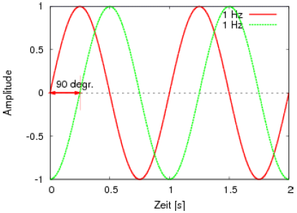
Simple waveforms
Phase relation
  two sine waves of same frequency and amplitude, but temporally displaced maxima, minima, and zero crossings
  → phase shift (here: angle 90º)

Slide 39
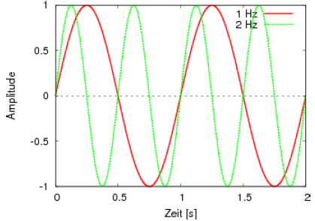
Simple waveforms
Frequency differences
  two sine waves of same amplitude and phase, but different frequency (here: 1 vs. 2 Hz)

Slide 40
Complex waveforms
Complex periodic signals
  cyclically recurring oscillation patterns
  composed of at least two sine waves
  fundamental frequency = 1 / complex fundamental period
  Form of resulting complex wave depends on frequency, amplitude and phase relations between component waves

Slide 41
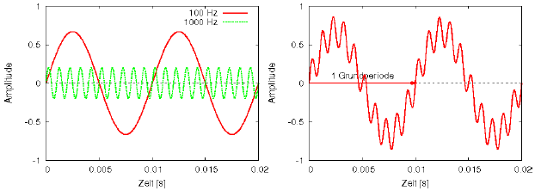
Complex waveforms
Complex waveform: 2 components
  two sine waves (100 Hz, 1000 Hz) with same phase and different amplitude (left)
  complex wave (right) resulting from addition of the two components
  F₀ = 100 Hz

Slide 42
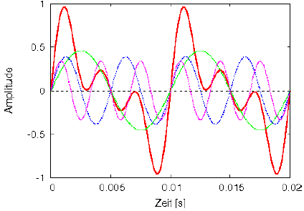
Complex waveforms
Complex waveform (red): 5 components
  five sine waves (100, 200, 300, 400, 500 Hz) with same phase
  only 3 lowest frequency components displayed

Slide 43
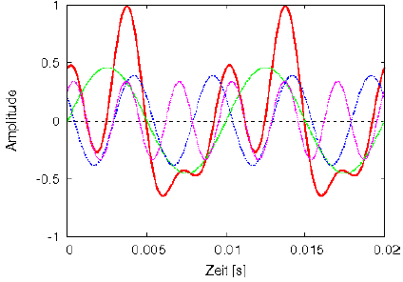
Complex waveforms
Complex waveform (red): 5 components
  five sine waves (100, 200, 300, 400, 500 Hz) with phase shifts
  only 3 lowest frequency components displayed

Slide 44
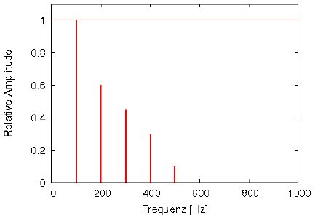
Power/line spectrum
Line spectrum (amplitude over frequencies) of the complex waveform composed of five components (see above)

Slide 45
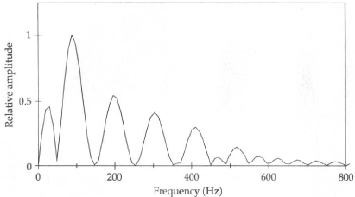
Fourier analysis
Fourier's theorem: every complex wave can be analytically decomposed into a set of sine waves, each with specific values of frequency, amplitude and phase.
  Fourier analysis: power spectrum of 5 component wave

Slide 46
Fourier analysis and power spectrum
Differences between result of Fourier analysis (Fast Fourier Transform, FFT) and idealized line spectrum:
  broader peaks rather than lines
  additional peaks (number of components is a parameter!)
  Reasons for these differences:
    Fourier analysis assumes infinitely long signal, whereas analysis is performed over a few fundamental periods
    Fourier analysis assumes periodicity, whereas speech signals are quasi-periodic, changing slowly from one fundamental period to the next, or even stochastic
    digital (discrete) rather than analog (continuous) signal

Slide 47
Discrete Fourier Transform
Discrete Fourier analysis (Discrete Fourier Transform, DFT)
  digital Fourier analysis of complex signals, yielding a spectrum of sine wave components
  transformation of data from time domain into frequency data
  resolution parameters
    sampling rate, e.g. 16000 Hz
    window size (or frame length), e.g. 512 samples ~ 32 ms (512/16000)

Slide 48
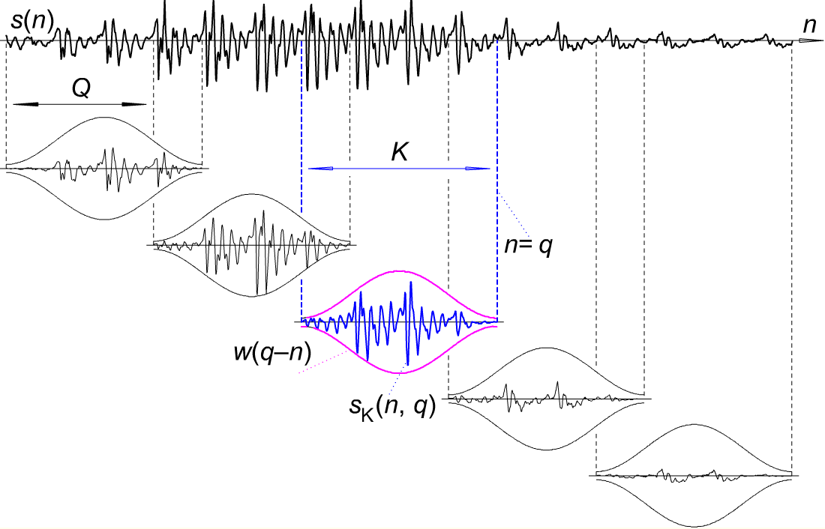
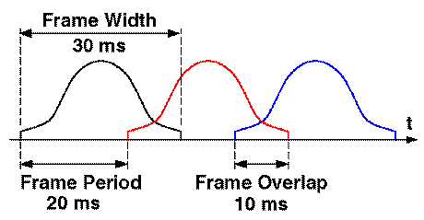
Analysis window
Windowing: splitting the input signal into temporal segments
  window functions, e.g. Hamming window, cosine window, ...

Slide 49
Speech signal processing
Typical parameter values in speech signal processing applications:
  window length: 25 or 40 ms, 512 or 1024 samples (FFT)
  window step size: 10 ms
    resulting in a series of n-dimensional feature vectors, one vector every 10 ms
  Granularity of computed spectrum ca. 31 Hz (16000/512=31.25)
  Trading relation (uncertainty principle)
    good frequency resolution ↔ poor time resolution
    good time resolution ↔ poor frequency resolution

Slide 50
From spectrum to spectrogram
Power spectrum:
  snapshot taken at a specific instant of time in the speech signal
  Spectrogram:
    narrow band spectrogram (e.g. 31 Hz): good frequency resolution
    wide band spectrogram (e.g. 300 Hz): good temporal resolution
    analysis window size/length:
    short temporal window: good time resolution
    long temporal window: good frequency resolution

Slide 51
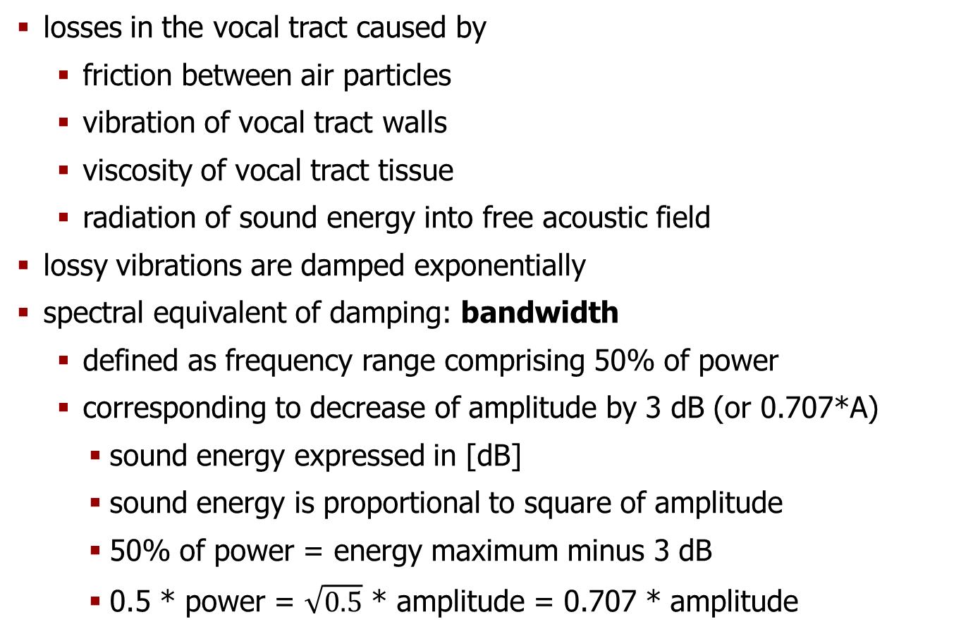
Vocal tract vs. lossless tube
losses in the vocal tract caused by
  friction between air particles
  vibration of vocal tract walls
  viscosity of vocal tract tissue
  radiation of sound energy into free acoustic field
lossy vibrations are damped exponentially
spectral equivalent of damping: bandwidth
  defined as frequency range comprising 50% of power
  corresponding to decrease of amplitude by 3 dB (or 0.707*A)
    sound energy expressed in [dB]
    sound energy is proportional to square of amplitude
    50% of power = energy maximum minus 3 dB
    0.5 * power = $\sqrt{0.5}$ * amplitude = 0.707 * amplitude

Slide 52
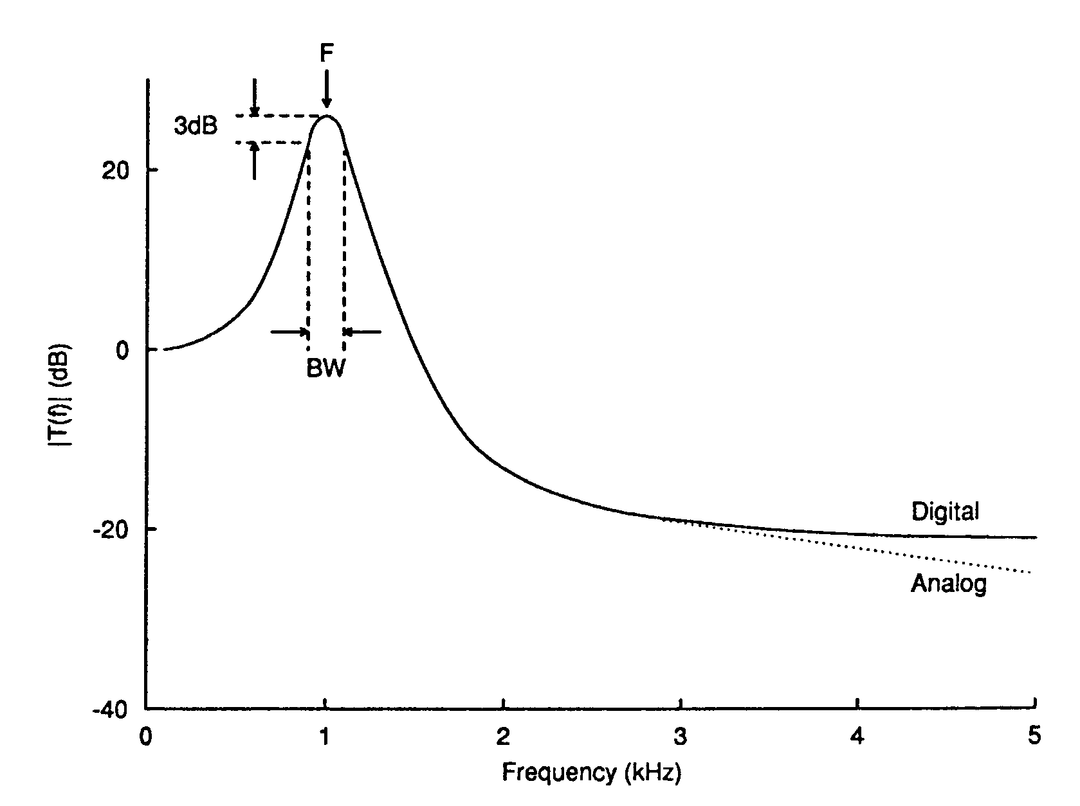
Resonance response
Formant parameters:
(center) frequency,
(peak) amplitude,
bandwidth

Slide 53
Speech waveforms and spectrograms
B3=bandwidth(F3)
B2=bandwidth(F2)
B1=bandwidth(F1)

Slide 54
Continuous and discrete signals
continuous (analog) signal
  represented graphically as a continuous curve
  amplitude values at all points in time
  theoretically infinite number of time and amplitude values (arbitrary number of decimal places, e.g. "amplitude of 3.211178... volt at 1.034678 sec.")
discrete (digital) signal:
  represented graphically by individual, discrete bars
  sequence of separate amplitude values
  limited number of different time and amplitude values

Slide 55
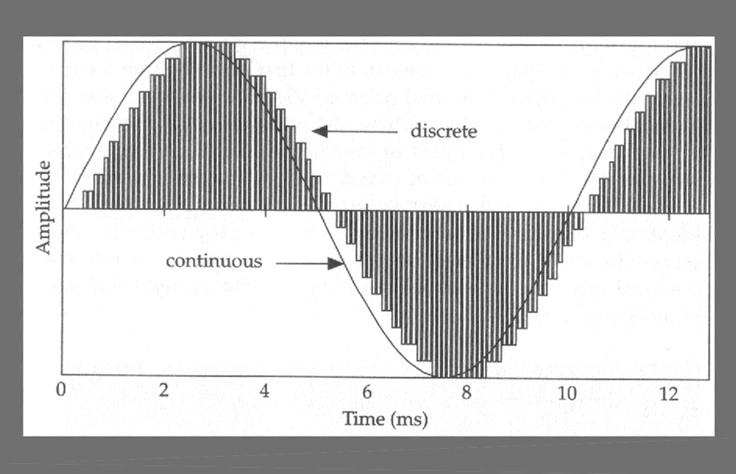
Continuous and discrete signals
continuous vs. discrete sine wave [Johnson, 1997, p.23]

Slide 56
Analog-to-digital conversion
A/D conversion – step 1: sampling
  limitation of decimal places along time axis (x-axis)
  slice-by-slice decomposition of continuous time signal
    discrete points in time: samples
    density of samples per time unit (sec.): sampling rate or sampling frequency [Hz]
A/D conversion – step 2: quantization
  limitation of decimal places along amplitude axis (y-axis)
  slice-by-slice decomposition of continuous amplitudes
    discrete amplitude values: amplitude steps
    density of amplitude values: quantization accuracy [bit]

Slide 57
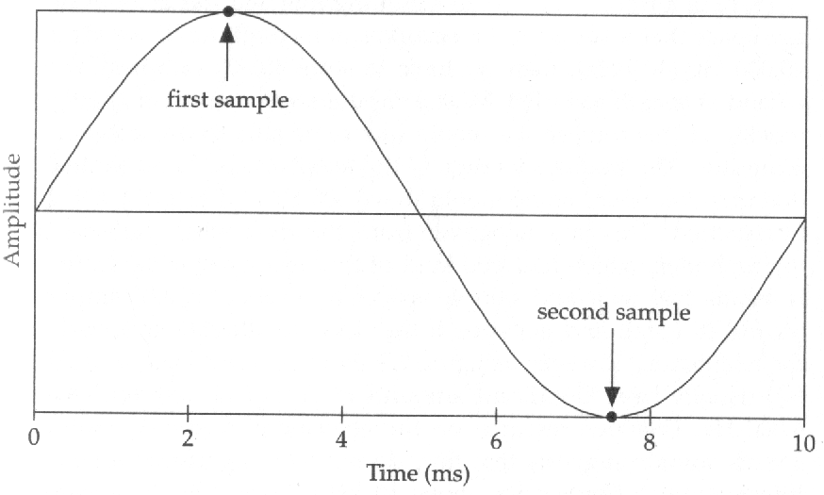
Sampling
periodicity of sine wave can be represented by (minimally) 2 samples
[Johnson, 1997, p.25]

Slide 58
Sampling theorem
Which sampling rate is required for periodic (sine) waves?
  2 samples per fundamental period
    sampling frequency ≥ 2 * fundamental frequency
    e.g.: 100 Hz sine wave → 200 Hz sampling rate
    known as sampling theorem
What does this mean for complex (e.g. speech) signals?
  useful information in speech signal of up to approx. 8 kHz
    requires 16 kHz sampling rate
    (cf. audio CDROM: 44.1 kHz)
  Nyquist frequency: 0.5 * sampling frequency
    highest frequency component of sampled signal

Slide 59
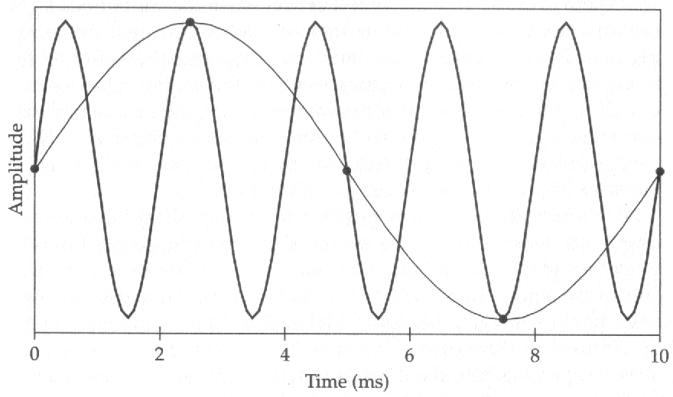

Aliasing effect by undersampling
Undersampling of a sine wave [Johnson, 1997, p.27]
digital signal has a low-frequency component and fails to represent correctly the high-frequency analog signal; audio demo:
  in practice: use low-pass filter to remove all frequencies above Nyquist frequency (frequency band limitation)

Slide 60
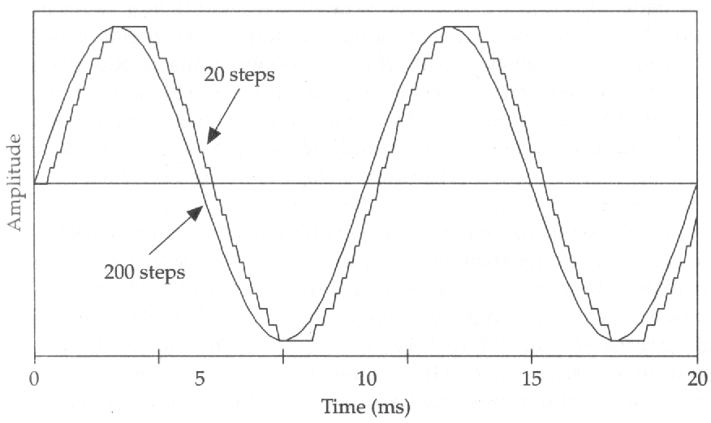
Quantization
2 different quantizations (20 vs. 200 steps) of sine wave amplitude [Johnson, 1997, p.29]

Slide 61
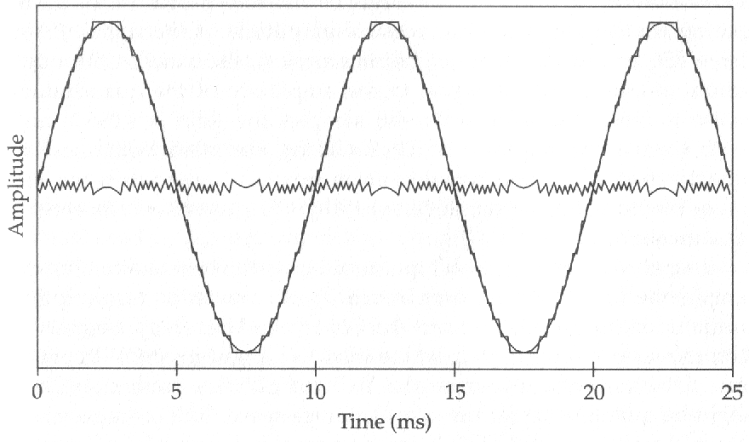
Quantization noise
difference between continuous and quantized signal [Johnson, 1997, p.31]
audio demo

Slide 62
Quantization steps and accuracy
How accurately should waveform amplitudes be quantized? Or: How many quantization steps should be used?
  digital representation by binary digits (bits): 0/1
    2 bit = 2² = 4 steps, or 3 bit = 2³ = 8 steps, etc.
    in practice: 16 bit = 2¹⁶ = 65536 steps, values: -32768 - 32768
  quantization noise is negligible when using 16 bit
How to report digitization:
  "The speech signal was quantized with 16 bit accuracy (or bit depth) and a sampling rate (or sampling frequency) of 16 kHz."

Slide 63

Thanks!

