Slide 1
FLST: Prosodic Models for Speech Technology
Bernd Möbius
moebius@coli.uni-saarland.de
http://www.coli.uni-saarland.de/courses/FLST/2014/

Slide 2
Prosody: Duration and intonation
Temporal and tonal structure in speech synthesis
  all synthesis methods
    use models to predict duration and F0
    models are trained on observed duration and F0 data
  Unit Selection:
    phone duration and phone-level F0 used in target specification
    F0 smoothness considered
  HMM synthesis: duration modeled by probability of remaining in the same state

Slide 3
Duration prediction
Task of duration model in TTS:
  predict duration of speech sound as precisely as possible, based on factors affecting duration
  factors must be computable/inferrable from text

Slide 4
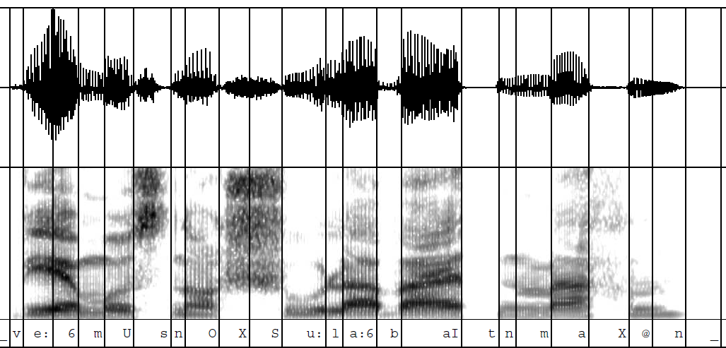
Duration prediction

Slide 5
Duration prediction
Task of duration model in TTS:
  predict duration of speech sound as precisely as possible, based on factors affecting duration
  factors must be computable/inferrable from text
Why is this task difficult?
  extremely context-dependent durations, e.g. [ɛ] = 35 ms in jetzt, 252 ms in Herren
  factors: accent status of word, syllabic stress, position in utterance, segmental context, …
  factors define a huge feature space

Slide 6
Duration models
Automatic construction of duration models
  general-purpose statistical prediction systems
    Classification and Regression Trees [Breiman et al. 1984; e.g. Riley 1992]
    Multiple regression [e.g. Iwahashi and Sagisaka 1993]
    Neural Nets [e.g. Campbell 1992]
  statistically accurate for training data
  but often insufficient performance on new data

Slide 7
Data sparsity
Why is this a problem?
  data sparsity: feature space (>10k vectors) cannot be covered exhaustively by training data
  LNRE distribution: large number of rare events - rare vectors must not be ignored, because there are so many rare vectors that the probability of encountering at least one of them in any sentence is very high

Slide 8
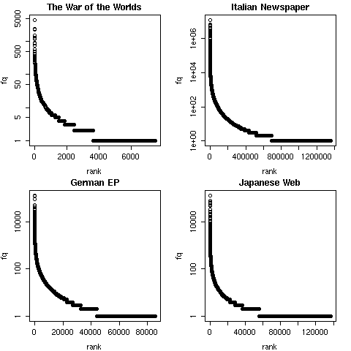
Data sparsity: word frequencies

Slide 9
Data sparsity
Why is this a problem?
  data sparsity: feature space (>10k vectors) cannot be covered exhaustively by training data
  LNRE distribution: large number of rare events - rare vectors must not be ignored, because there are so many rare vectors that the probability of encountering at least one of them in any sentence is very high
  vectors unseen in training data must be predicted by extrapolation and generalization
  general-purpose prediction systems have poor extrapolation and are not robust w.r.t. missing data

Slide 10
Sum-of-products model
Current best practice: Sum-of-products model [van Santen 1993, 1998; Möbius and van Santen 1996]
  exploits expert knowledge and well-behaved properties of speech (e.g. directional invariance, monotonicity)
  uses well-behaved mathematical operations (add./mult.)
  estimates parameters even for unbalanced frequency distributions of features in training data

Slide 11

Sum-of-products model
Sum-of-products model: general form [van Santen 1993, 1998]
K : set of indices of product terms
I_{i} : set of indices of factors occurring in i-th product term
S_{i,j} : set of parameters, each corresponding to a level on j-th factor
f_{j} : feature on j-th factor (e.g., f₁ = Vowel_ID, f₂ = ±stress, ...)

Slide 12
Sum-of-products model
Sum-of-products model: specific form [van Santen 1993, 1998]
V : vowel identity (15 levels)
C : consonant after V (2 levels: ±voiced)
P : position in phrase (2 levels: medial/final)
here: 21 parameters to estimate (2+2 + 2 + 15)

Slide 13
Sum-of-products model
SoP model requires:
  definition of factors affecting duration (literature, pilot)
  segmented and annotated speech corpus
  greedy algorithm to optimize coverage: select from large text corpus a smallest subset with same coverage
SoP model yields:
  complete picture of temporal characteristics of speaker
  homogeneous, consistent results for set of factors
  best performance: r = 0.9 for observed vs. predicted phone durations (Engl., Ger., Fr., Dutch, Chin., Jap., …)

Slide 14
SoP model: phonetic tree

Slide 15
Intonation prediction
Task of intonation model in TTS
  compute a continuous acoustic parameter (F0) from a symbolic representation of intonation inferred from text

Slide 16
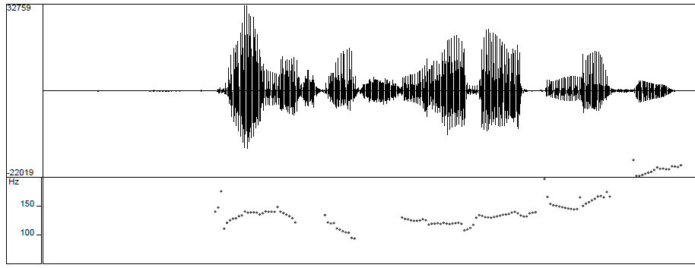
Intonation (F₀)

Slide 17

Intonation prediction
Task of intonation model in TTS
  compute a continuous acoustic parameter (F0) from a symbolic representation of intonation inferred from text
Intonation models commonly applied in TTS systems:
  phonological tone-sequence models (Pierrehumbert)
  acoustic-phonetic superposition models (Fujisaki)
  acoustic stylization models (Tilt, PaIntE, IntSint)
  perception-based models (IPO)
  function-oriented models (KIM)

Slide 18
Tone sequence model
Autosegmental-metrical theory of intonation [Pierrehumbert 1980]
  intonation is represented by sequence of high (H) and low (L) tones
  H and L are members of a primary phonological contrast
  hierarchy of intonational domains
    IP – Intonation Phrase; boundary tones: H%, L%
    ip – intermediary phrase; phrase tones: H-, L-
    pw – prosodic word; pitch accents: H*, H*L, L*H, …

Slide 19
Pierrehumbert's model
Finite-state grammar of well-formed tone sequences
pw ip IP
Example [adapted from Pierrehumbert 1980, p. 276]
That's a remarkably clever suggestion.
| |
%H H* H*L L- L%

Slide 20
Pierrehumbert's model
Finite-state graph
pw
ip
IP

Slide 21
ToBI: Tones and Break Indices
Formalization of intonation model as transcription system [Pitrelli et al. 1992]
  phonemic (=broad phonetic) transcription
  originally designed for American English
  limited applicability to other varieties/languages
    language-specific inventory of phonological units
    language-specific details of F0 contours
  adapted to many languages (e.g. GToBI, JToBI, KToBI)
  implemented in many TTS systems
    abstract tonal representation converted to F0 contours by means of phonetic realization rules

Slide 22
Fujisaki's model
[Fujisaki 1983, 1988; Möbius 1993]

Slide 23
Fujisaki's model
Properties:
  superpositional
  physiological basis and interpretation of components and control parameters
  linguistic interpretation of components
  applied to many (typologically diverse) languages
Origins:
  Öhman and Lindqvist (1966), Öhman (1967)
  Fujisaki et al. (1979), Fujisaki (1983, 1988), …

Slide 24
Fujisaki's model: Components
[Möbius 1993]

Slide 25
Fujisaki's model: Example
[Möbius 1993]
Approximation of natural F₀ by optimal parameter values within linguistic constraints (accents, phrase structure)

Slide 26
Comparison of models
Tone sequence or superposition?
  intonation
    TS: consists of linear sequence of tonal elements
    SP: overlay of components of longer/shorter domain
  F0 contour
    TS: generated from sequences of phonological tones
    SP: complex patterns from superimposed components
  interaction
    TS: tones locally determined, non-interactive
    SP: simultaneous, highly interactive components

Slide 27
F₀ as a complex phenomenon
Main problem for intonation models: linguistic, paralinguistic, extralinguistic factors – all conveyed by F0
  lexical tones
  syllabic stress, word accent
  stress groups, accent groups
  prosodic phrasing
  sentence mode
  discourse intonation
  pitch range, register
  phonation type, voice quality
  microprosody: intrinsic and coarticulatory F0

Slide 28
Thanks!
More on prosody in speech technology: ASR (Wed Jan 28)

